Slide 1




7ebb8e7a-42b6-479d-811b-d3e698eee7d5
Security Insights
Prepared for Contoso
Report generated with 'Scope' filter set to: Complete Scope

Slide 2


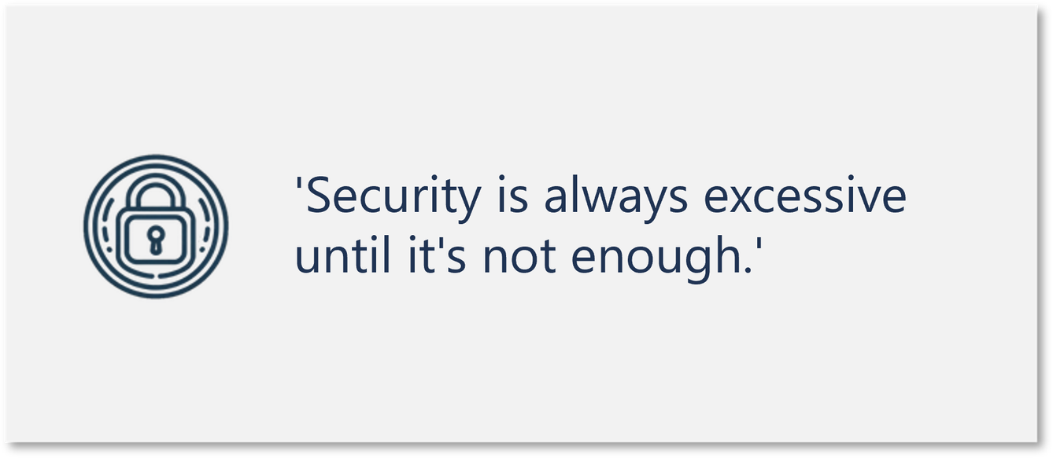
C1F8A2B7-5E93-42B4-80A6-2F9D3E7B5C14
Agenda
Executive Overview
Defender for Cloud
Azure Update
Extended Security Updates
Azure Arc

Slide 3

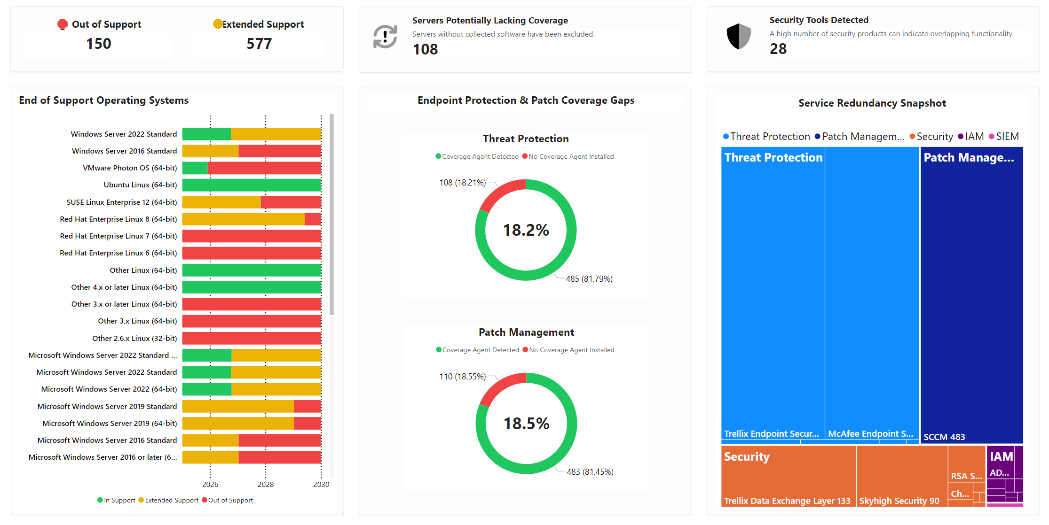
4E29C7D3-8B16-46A0-9D51-1C7A3B5F2E84
Security Snapshot
Provides an overview of the current operating system support status, endpoint protection, and security tool coverage. The data highlights key coverage gaps, end-of-support risks, and redundancy in current security services. Use Azure Arc to rapidly improve security posture.

Slide 4
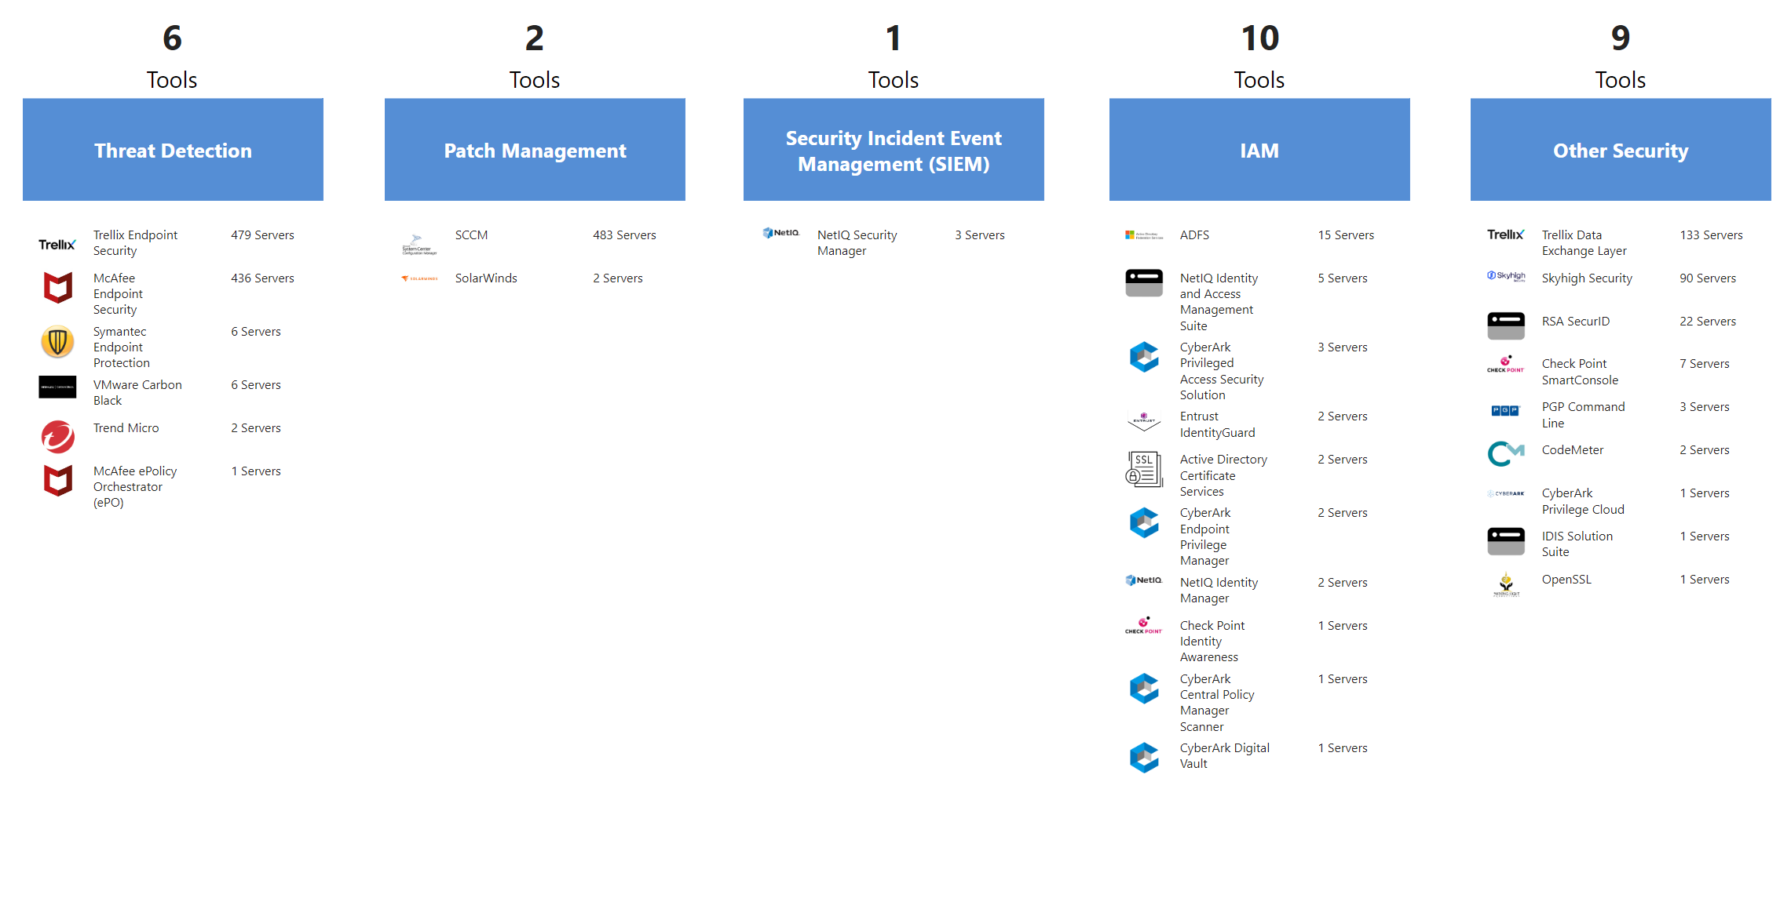
A5B3C8F7-29E1-40D9-8E4C-6B2F3A91D75C
Security Tool Sprawl
Multiple endpoint, identity, and security monitoring tools found across the server estate. Consider rationalizing where possible to reduce complexity and overhead.

Slide 5
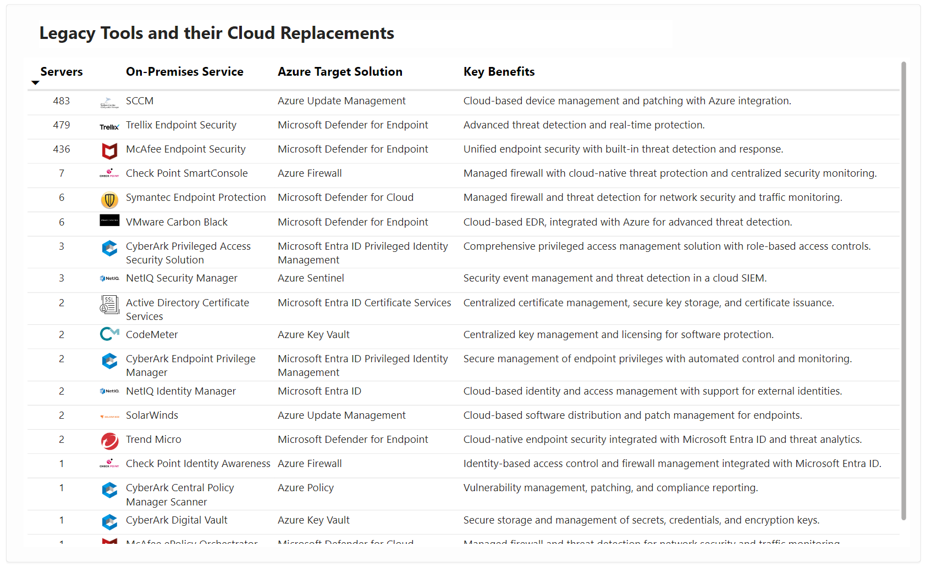
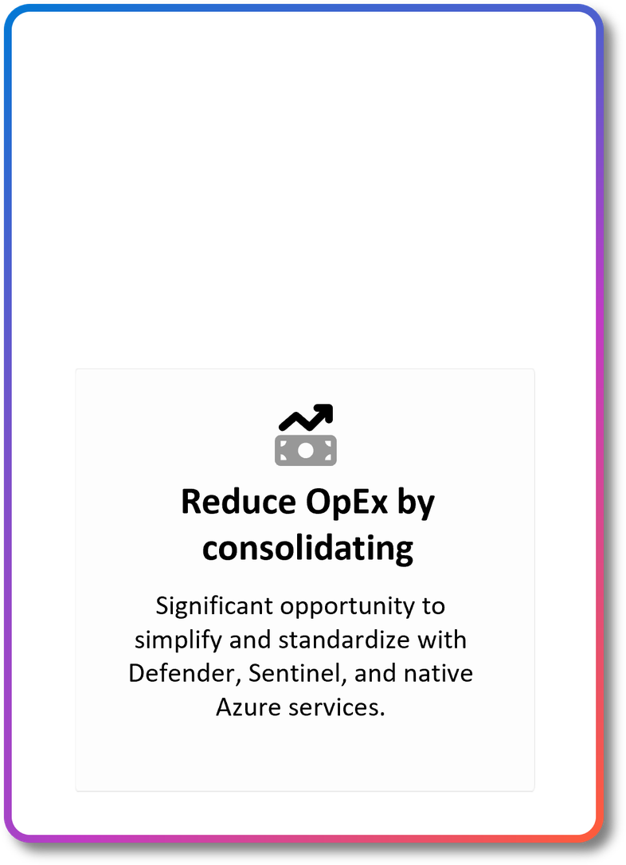
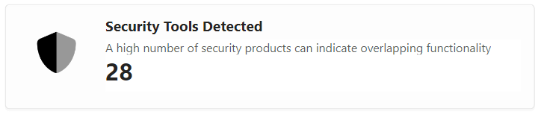
9C41E2A7-6B3D-44F5-8D92-0F7A1E3C5B28
Reducing Security Tool Overlap
This is an opportunity to simplify operations, cut costs, and improve coverage by consolidating around Microsoft's integrated security stack.

Slide 6


8A71D2E6-39C5-4BFA-9D27-1C0B3E4F85A2
Microsoft Defender for Cloud
Multi-Cloud Security

Slide 7
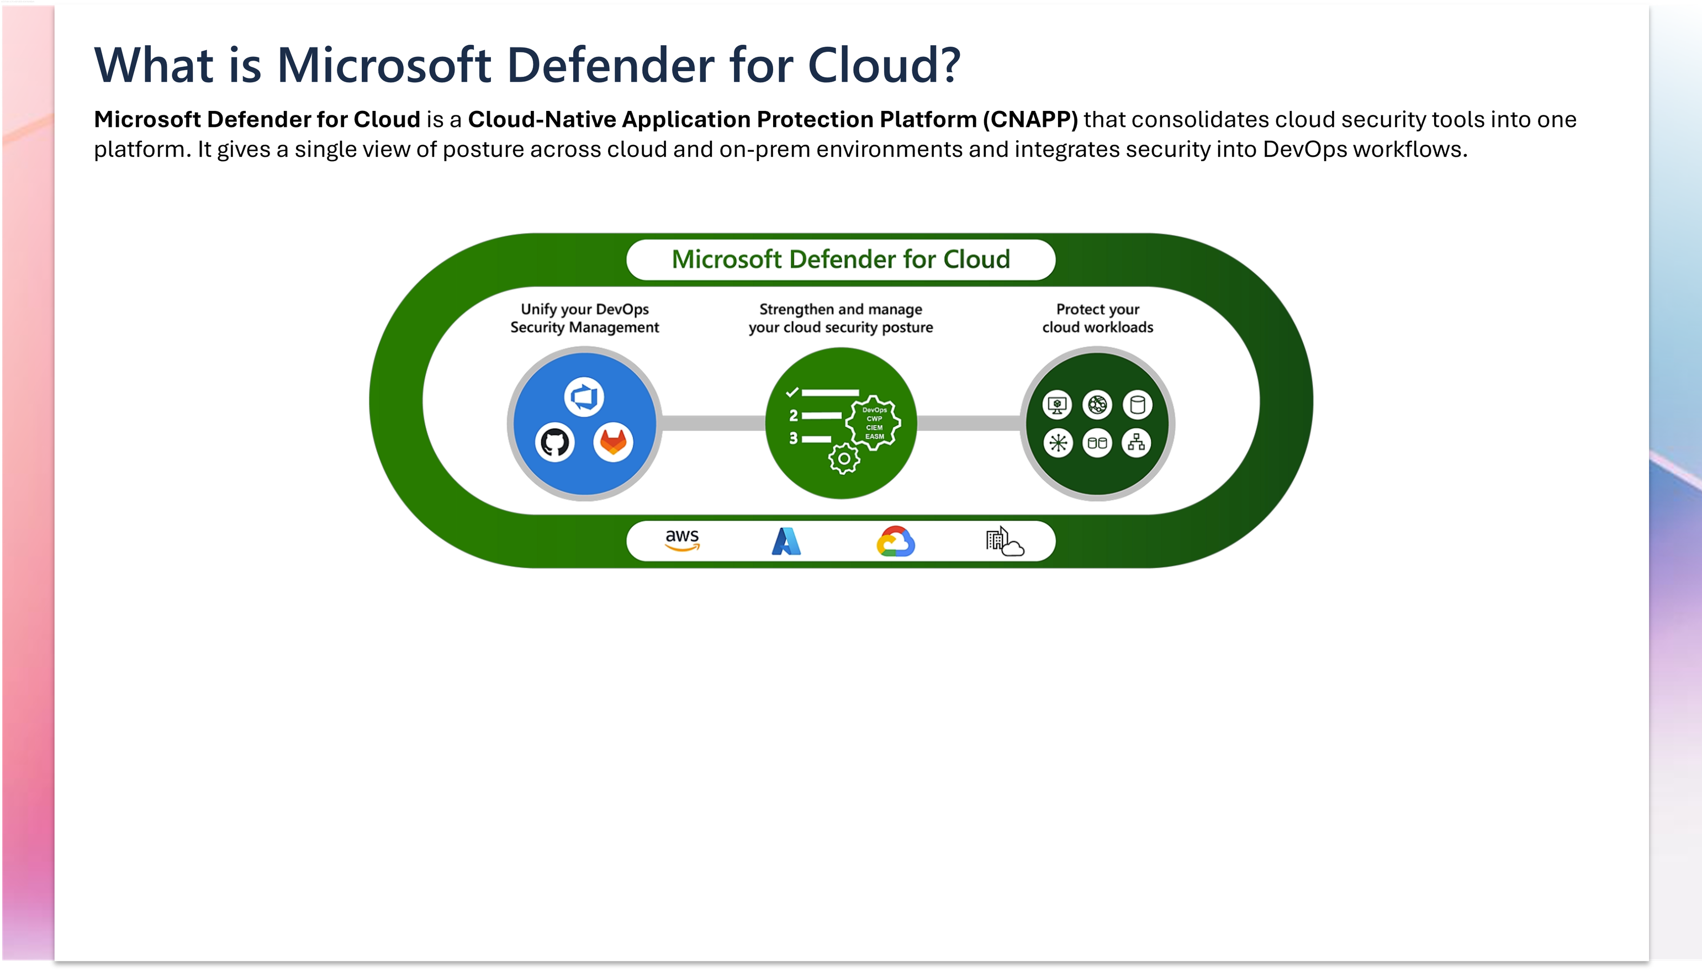
3B8F7C12-54A0-4E9D-9C63-2F1B7A5E8D40
There are three core components: - Development Security Operations (DevSecOps) manages code-level security across multicloud and multi-pipeline environments. - Cloud Security Posture Management (CSPM) checks and improves the security posture of cloud resources. - Cloud Workload Protection Platform (CWPP) checks and improves the security posture of cloud resources.

Slide 8

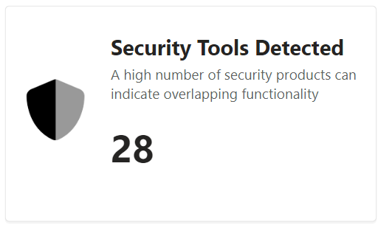
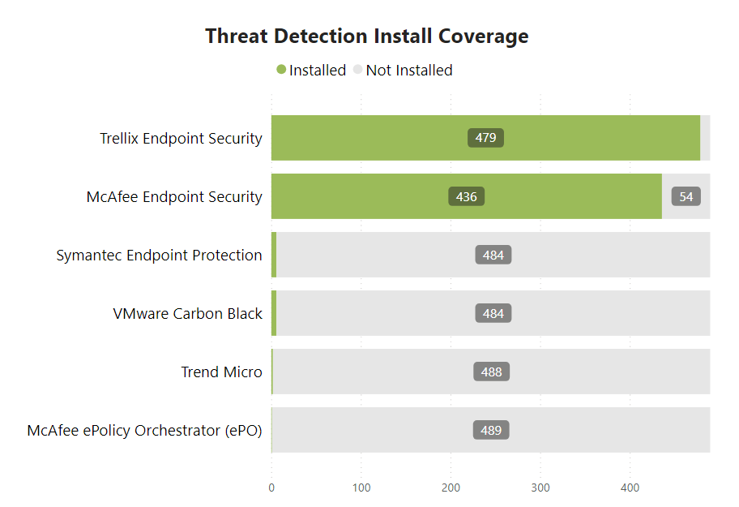
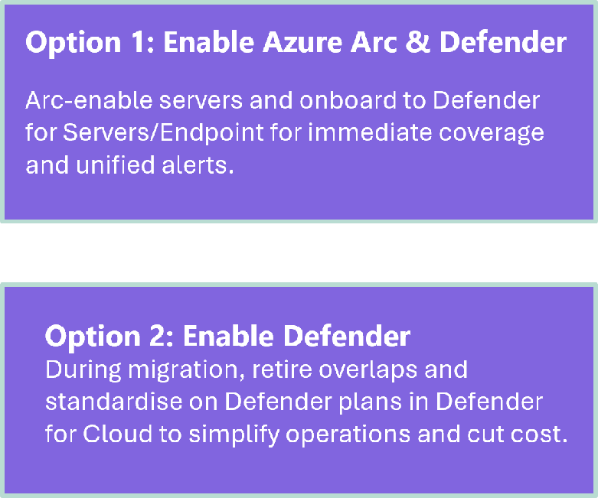
E2D4B7A9-17C6-49B3-92E0-6C4A3F5D81B7
Threat Detection Coverage
Scans results highlight detected endpoint threat-detection tools deployed whilst highlighting coverage gaps and product overlap. Unprotected servers expand the attack surface, while duplicated agents add cost and alert noise. Close the gaps immediately across on-prem and multicloud, then simplify as workloads move to Azure by standardizing on Defender plans managed in Defender for Cloud.
The listed threat protection software has been identified; however, additional solutions may also be installed that were not detected.

Slide 9
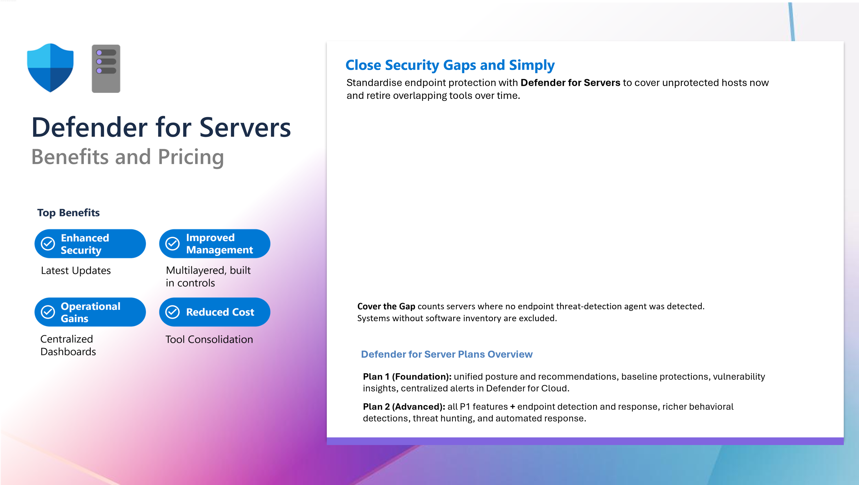

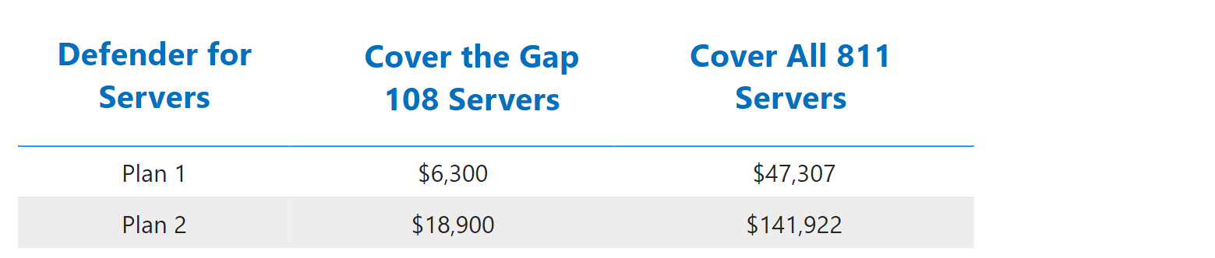

66F4AE74-3313-4E7D-B1AE-7A00FD9F96EA
Learn More

Slide 10
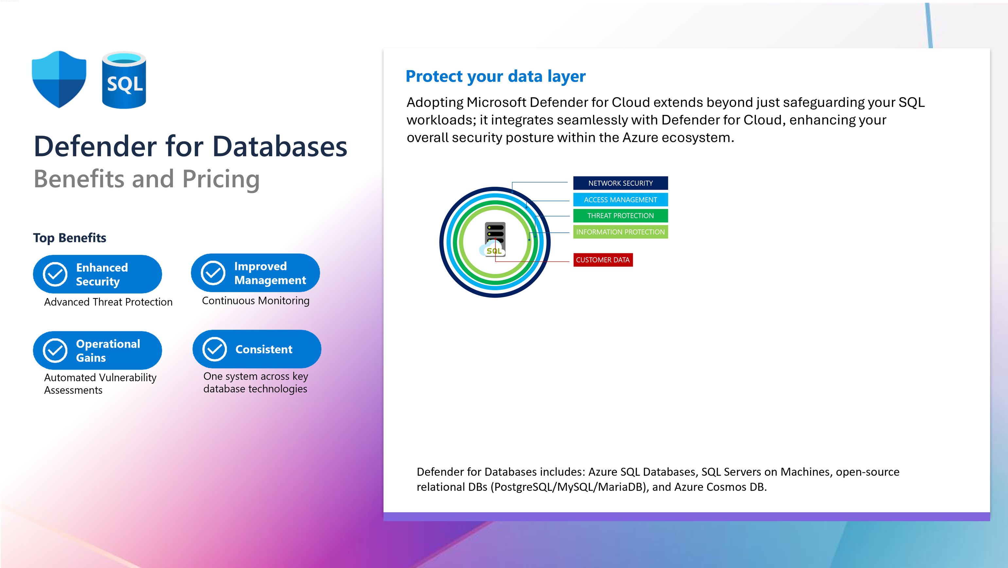
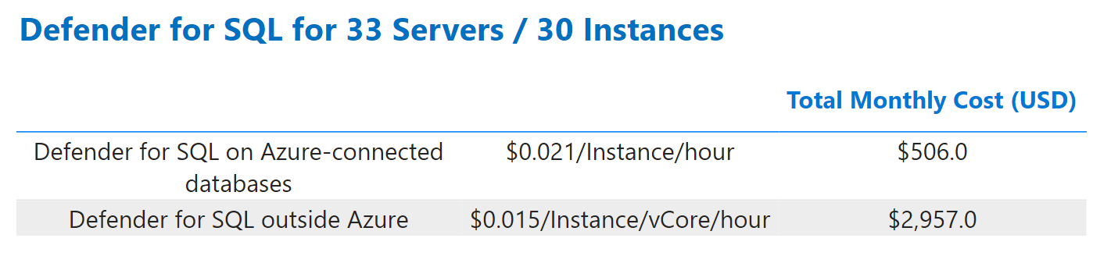
F7C8E2A5-93B1-42D0-8A7E-1C5B2D9F40E3
Learn More

Slide 11
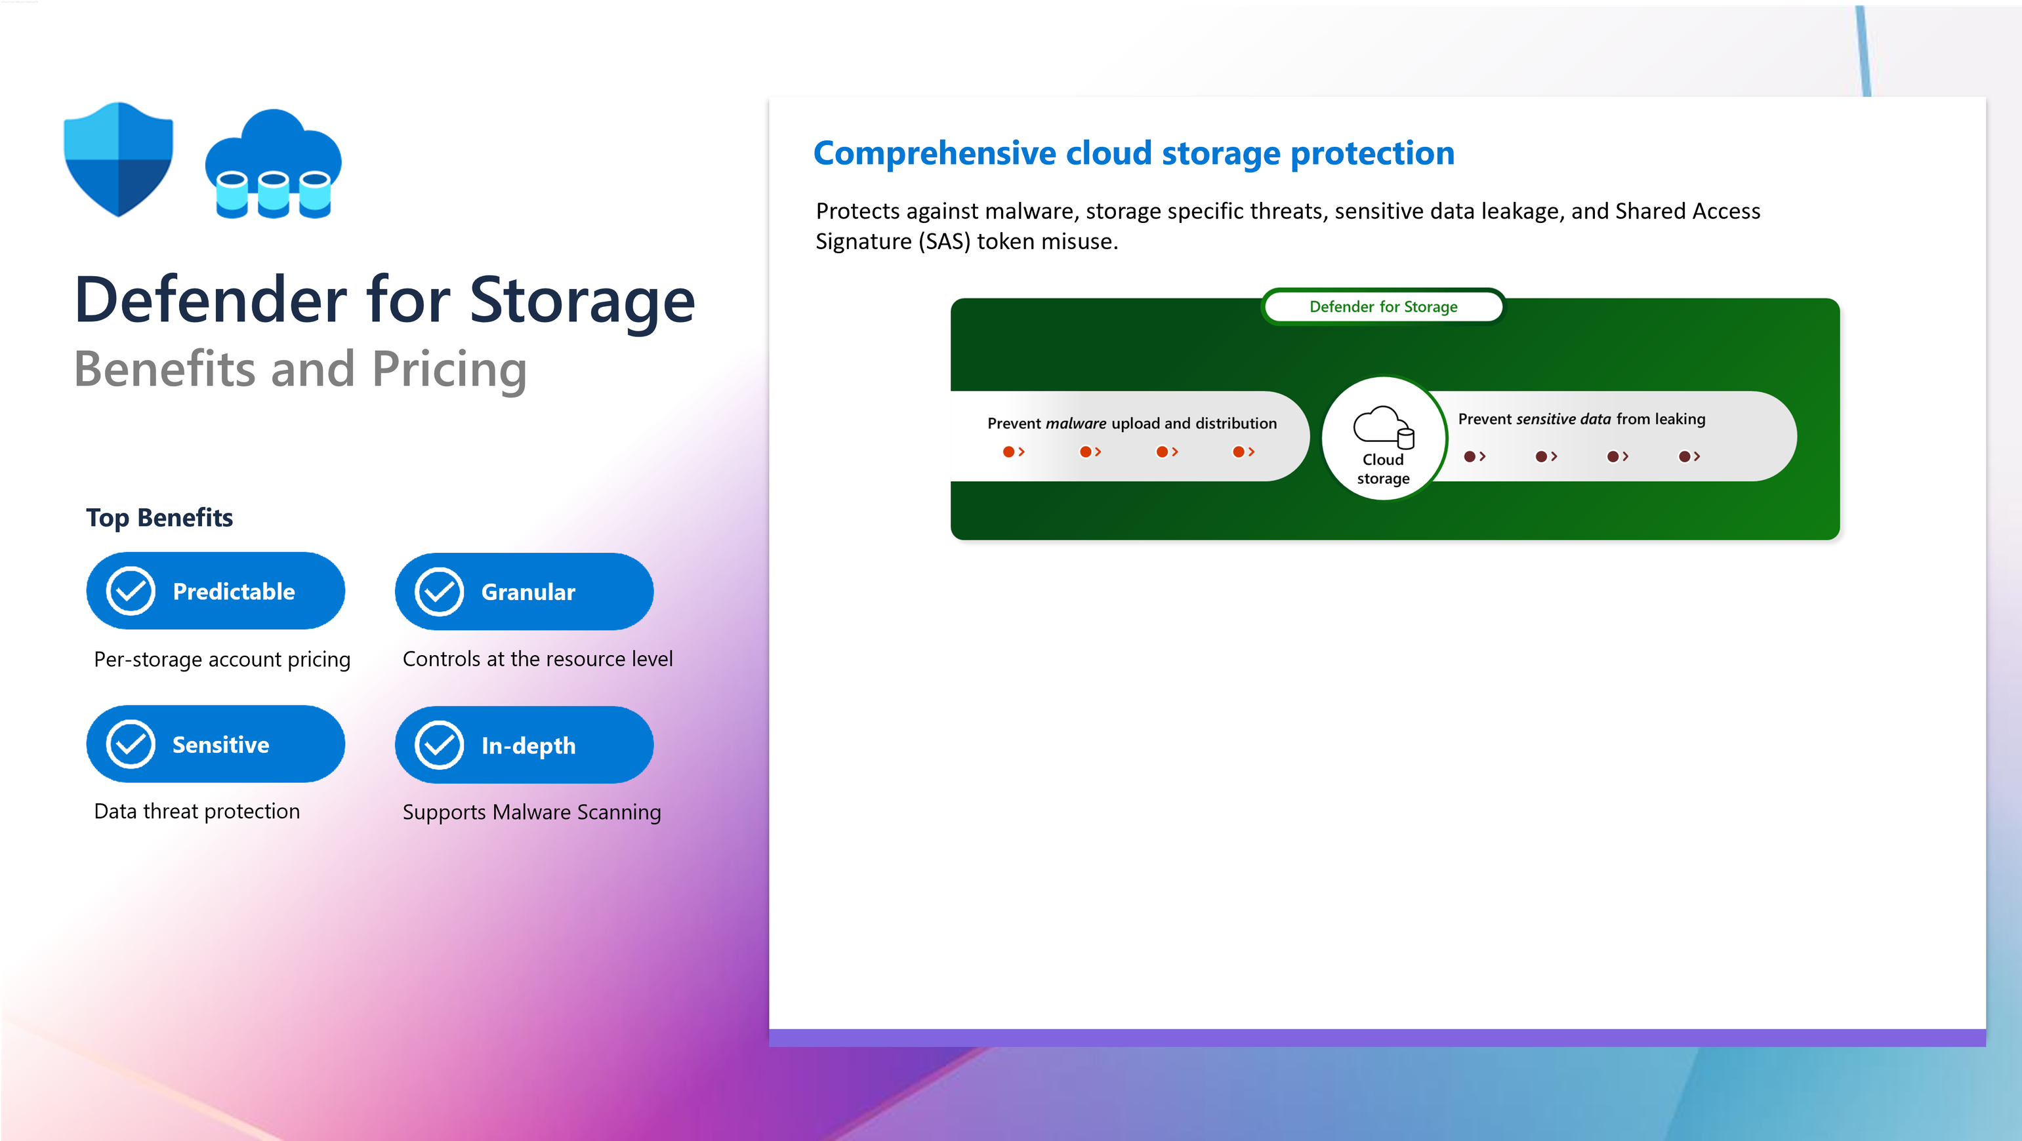
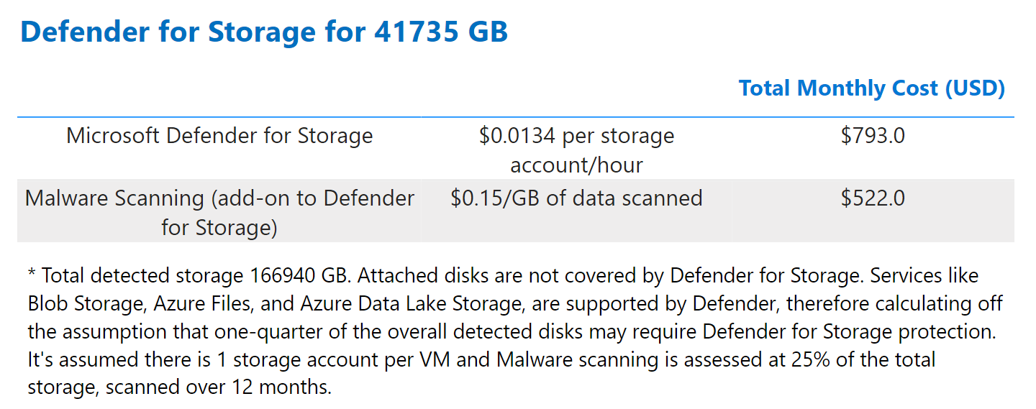
F92F3D0B-6D21-4A5D-A0E5-E62691F11E23
Learn More

Slide 12

8B2A7C19-4F3E-48D6-9B71-2E9D5C4A0F86
Azure Update Manager
Patch Management

Slide 13
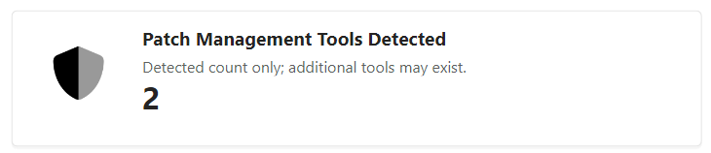
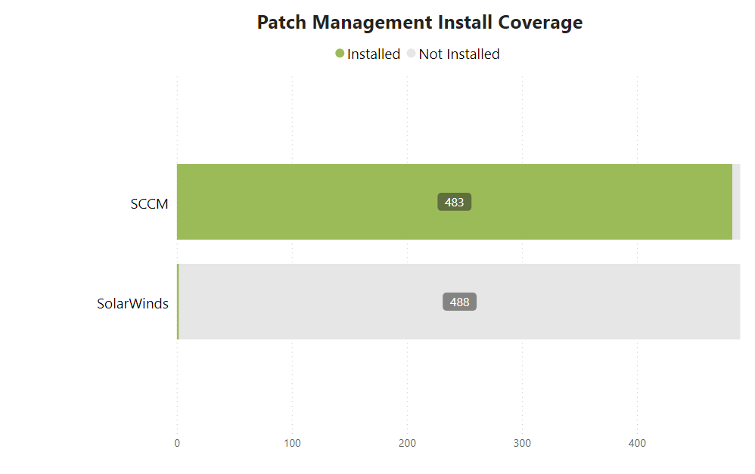
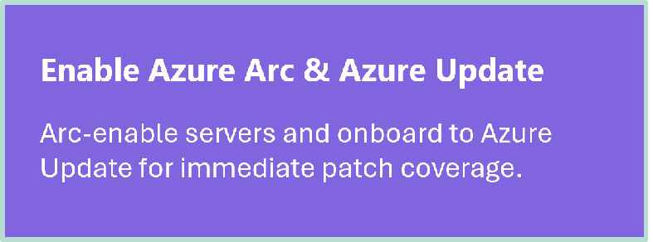
D3E7A9B1-6C25-44F8-81B0-5F92E3C7A146
Patch Management Coverage
Scans identified patch management tools in use and flagged coverage gaps and product overlap. Unpatched servers increase exploit risk and compliance drift; duplicate tools add cost and noise. Close gaps now across on-prem and multicloud by Arc-enabling servers and standardising patching with Azure Update Manager (maintenance configurations, approvals, pre/post scripts, compliance reporting). As workloads move to Azure, retire overlapping tools and use risk-based vulnerability data to prioritise patching on the most exposed systems first.
The listed patch management software has been identified; however, additional solutions may also be installed that were not detected.

Slide 14

B6F3C1E9-74D2-45B0-82A7-1F9C5E8B3D40
Extended Security Updates
Protect Out of Support Devices

Slide 15
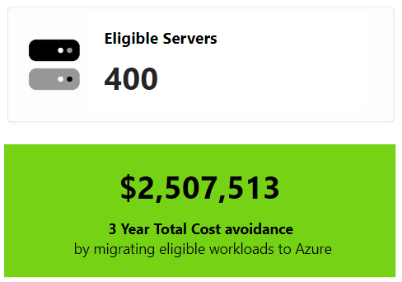
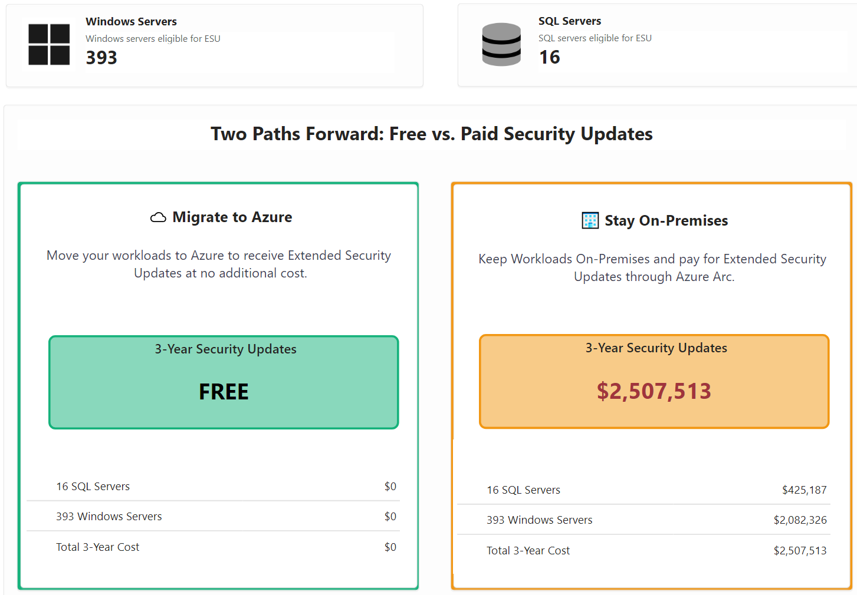
2E5A9B7C-8D3F-44C1-9E72-4F1C3A58D960
Extended Security Updates
Tooling Breakdown by Category and Server Count
Extended Security Updates (ESUs) provide critical security coverage for out-of-support Windows and SQL workloads. By migrating to Azure, you receive ESUs at no cost. For workloads that must remain on-premises, Azure Arcoffers a flexible, pay-as-you-go option to stay protected - no need for upfront licensing.
Assumption: SQL Standard core licensing applied when DMA assessment has not been completed.

Slide 16

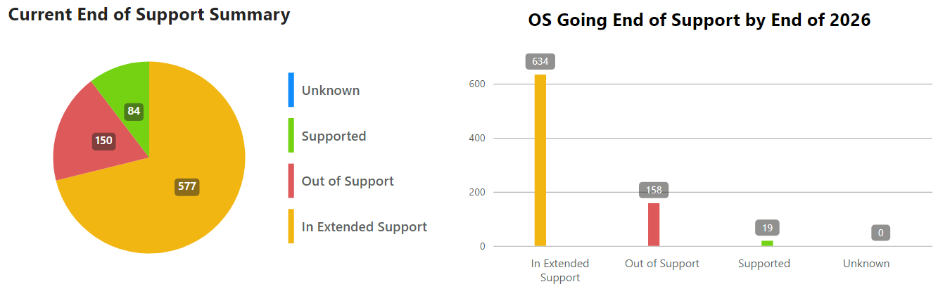
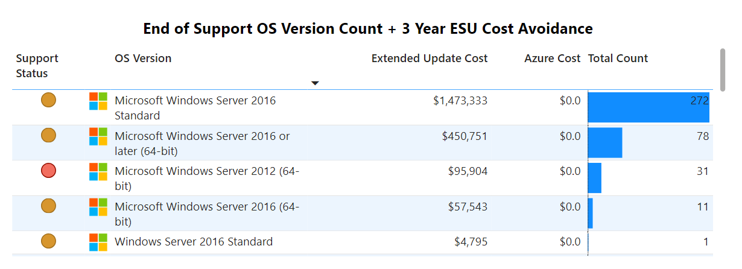


C7B2F1E5-91A6-45D4-83C0-2B8E7A9D54F1
Out of Support Server Operating Systems
Out of support Operating Systems present security risks & operational issues. Azure provides no-cost extended security updates for many operating systems, providing immediate cost reduction and security enhancement while you work through re-host/re-platform strategies.
Action to Save
Migrate servers to Azure before they go out of support to avoid Extended Security Update costs.
3 Year Cost Avoidance

Slide 17
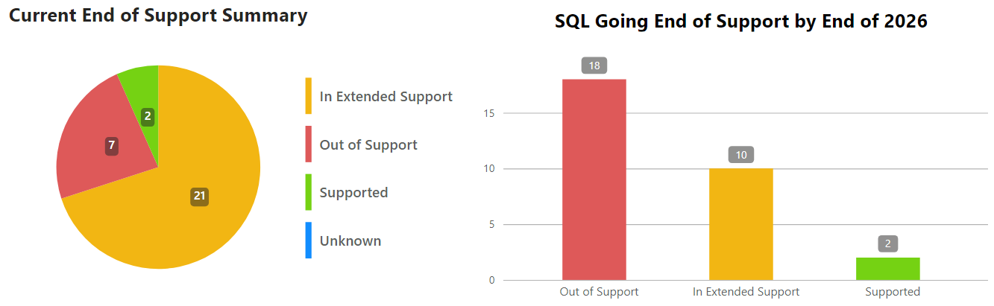
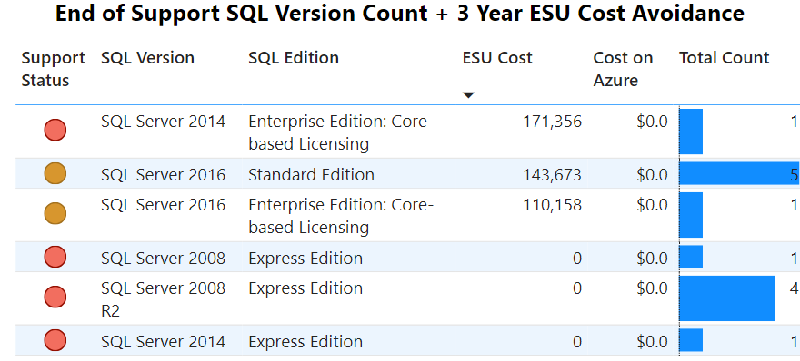


4C9A2F7B-68D1-44E3-91F0-2E7A3B5D6C18
Out of Support SQL Servers
As database versions become unsupported, they present security risks, as no new patches are provided without extended security updates (ESU). ESU for SQL 2012 will be included with Azure at no extra cost when extended support ends for those products.
Cost Avoidance
Over 3 Years
Migrate out of support and nearing end of support SQL servers to Azure

Slide 18

9E1C7B43-2A85-42F6-8D91-3F0B6C5E27A4
Azure Arc
Hybrid On-Premises and Cloud Management

Slide 19
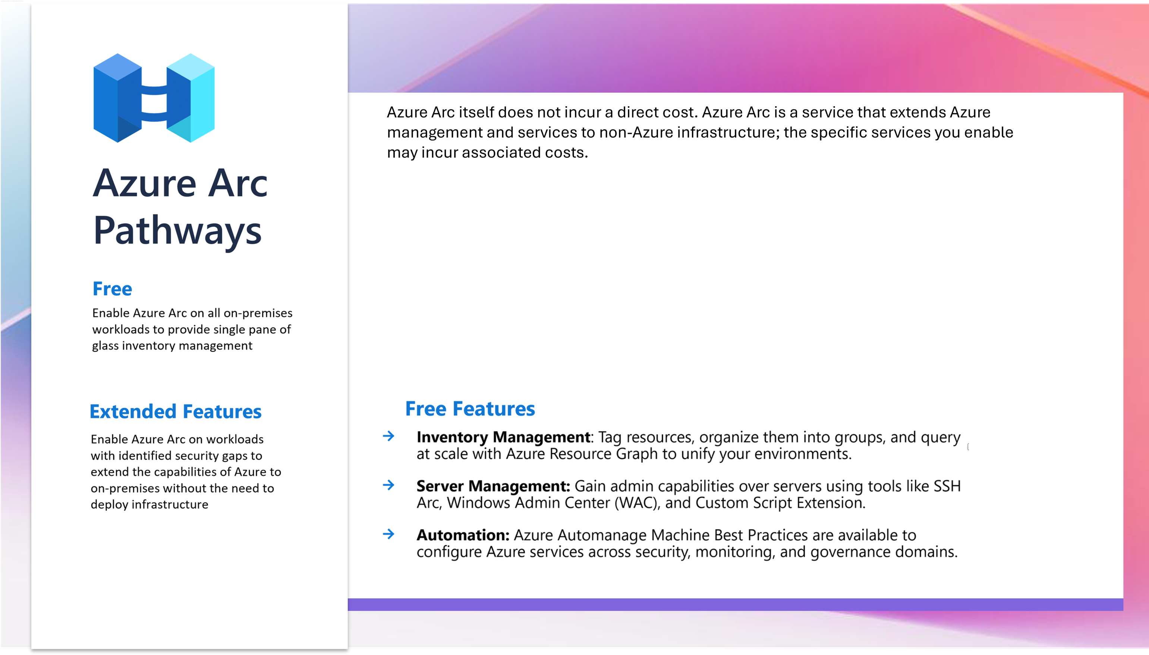
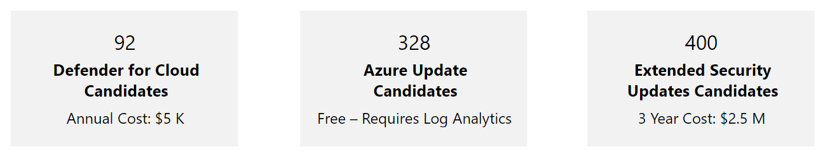
61DA9B4B-F670-4008-A4CD-1B9532FE1310

Slide 20
1991C633-99B4-483B-99BB-E41D39B24E42
Next Steps
Validate Findings -The assessment identified potential servers that are missing threat management or patching software; it is recommended to confirm the automated findings as they may not detect all software.
Enable Azure Arc - - Agree upon the candidates to add into Azure ARC - integrating Defender, Azure Update and Extended Security Updates.
Refine Security Roadmap - Consider how the full Azure Security Suite will integrate with your Security Roadmap.
Explore Microsoft Programs - Access Microsoft funding, advisory, and partner programs designed to support and accelerate your cloud migration.

Slide 21
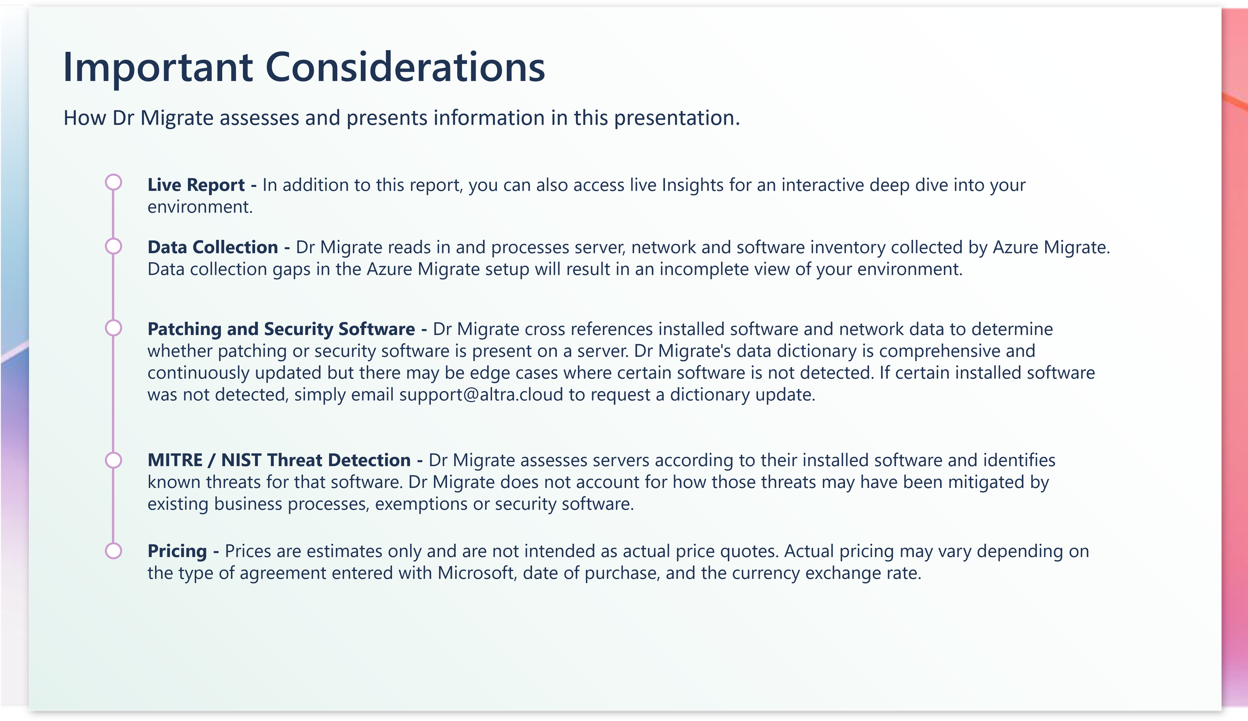
F5A2E9C7-30B4-41D8-8C3E-7B1D9F42E586

Slide 22
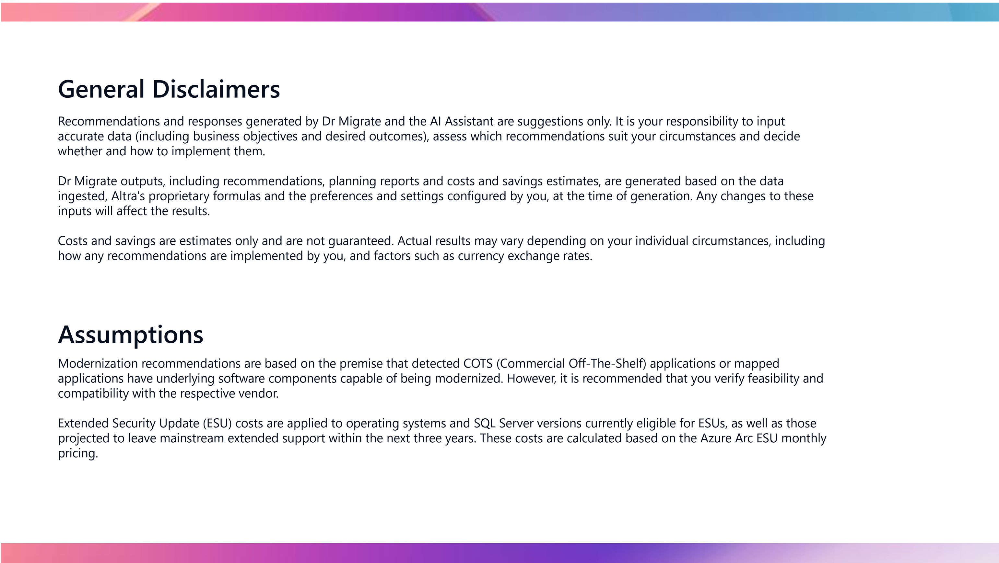
6D3B9C12-47E5-42F0-91A7-2F8C5E9B34D1

Slide 23

92C79416-8116-405E-BF73-AEFB0C113A0B

