Slide 1




81EC4D83-BCC8-4754-B6CB-25E46609DC82
Rapid Insights
Your Digital Estate
Prepared for Contoso
Report generated with 'Scope' filter set to: Complete Scope

Slide 2


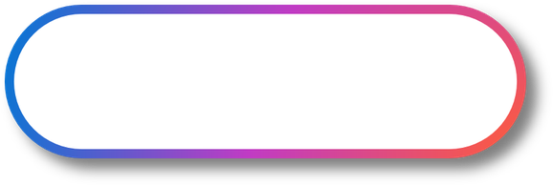
E3567592-4F90-4C88-B578-1DF8894A862D
Agenda
Executive Summary
Infrastructure
Infrastructure
Modernization
Analysis & Insights
Servers
Databases
Financial Scenarios
Storage
App Runtimes
Business Value
Optimization
Modern Workplace
Security
IT Services
Next Steps

Slide 3

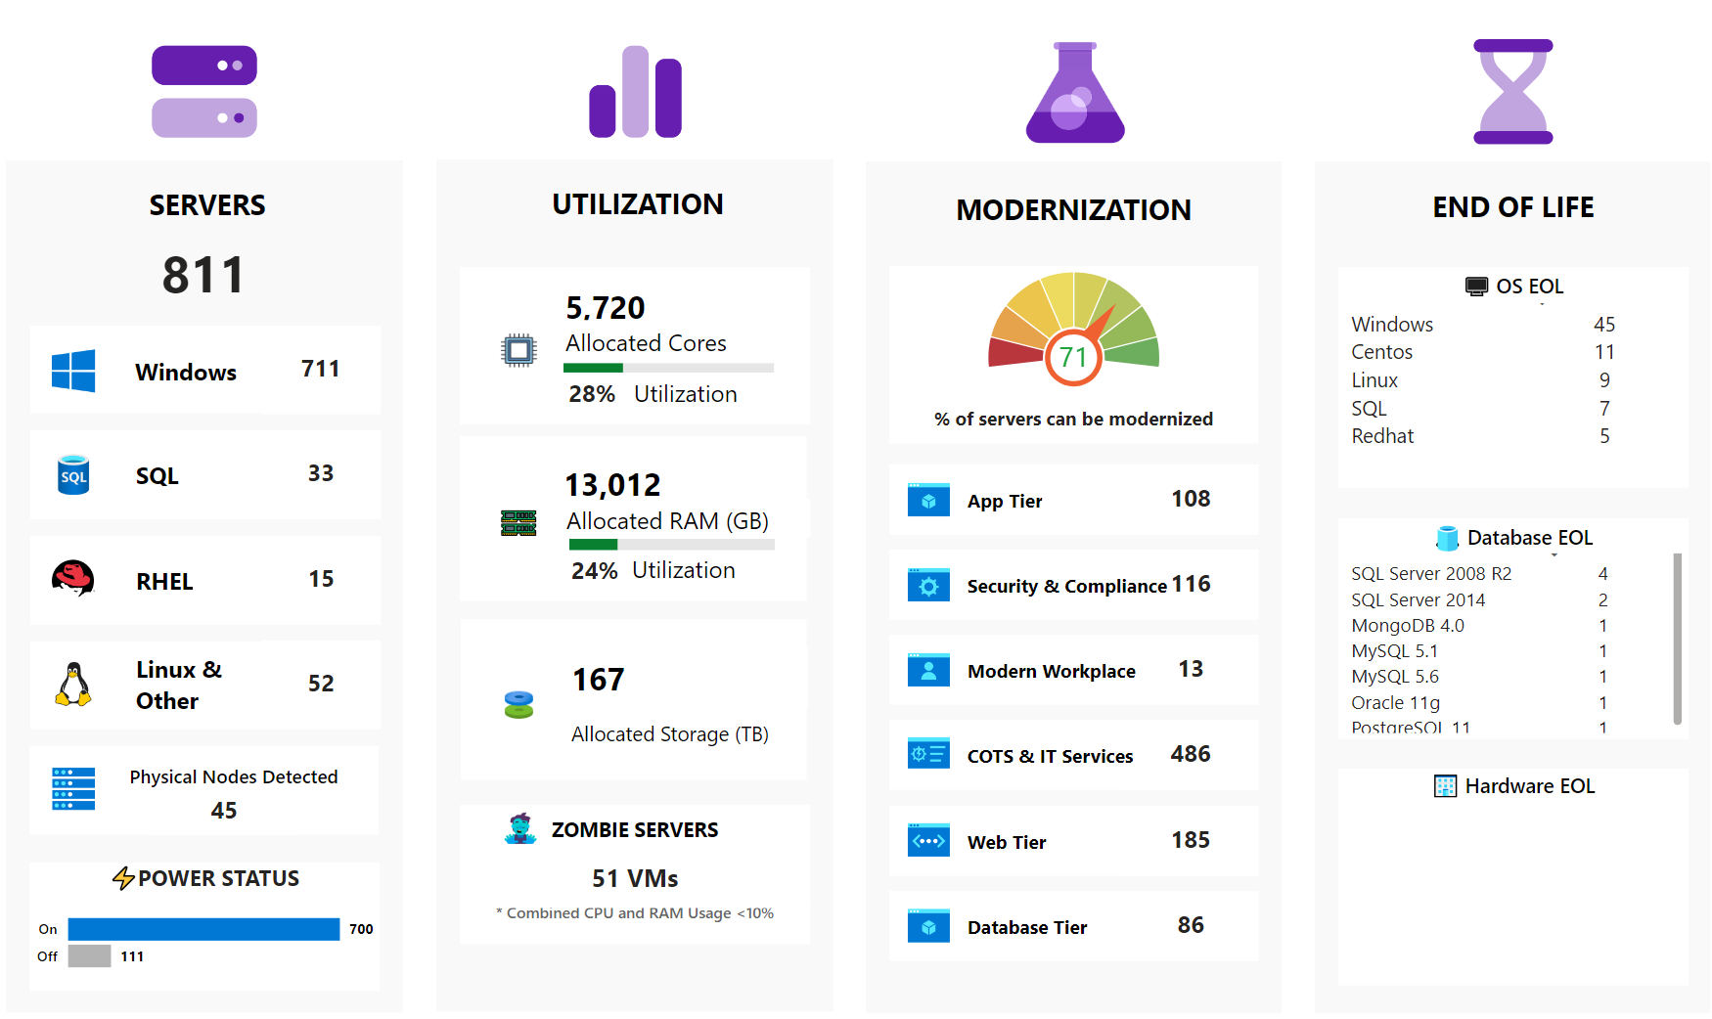
96D287BB-35CB-4DEB-A2DD-373202F48E3A
Your Estate Overview
This view summarizes the current state of your environment, highlighting infrastructure scale, efficiency, modernization potential, and end-of-life risks. These insights inform migration strategy, workload prioritization, and cost optimization opportunities across your estate.
Notes:
• Estate scale: 811 servers, 88% Windows; 45 remain on physical hardware—limiting agility and continuing CapEx spend. • Efficiency gap: Average CPU utilization 28% and RAM 24%; 51 “zombie” VMs (<10% use) and 111 powered-off servers show immediate rightsizing or retirement savings of 25-40%. • Modernization headroom: 71% of servers are viable candidates for transformation—largest opportunities in COTS/IT services (486), web tier (185) and app tier (108). Prioritizing these could accelerate move to PaaS/containers and reduce technical debt. • End-of-Life risk: 45 Windows servers and 20+ Linux variants at or nearing OS EOL, plus multiple legacy SQL/Mongo/MySQL instances. Combined with aging hardware, this exposes critical compliance and security gaps that must be addressed before 2025 audits. • Quick-win roadmap: Retire zombie workloads, right-size under-utilized VMs, and migrate EOL systems first to remove risk while funding broader modernization through cost savings. • Strategic alignment: Moving the predominantly Windows workload to Azure leverages native tooling (Azure Migrate, ARC, Defender) and reserved instances, cutting TCO while enhancing governance and cloud-native resilience. Exploratory Questions 1. Which business-critical applications sit on the EOL servers, and what is our risk tolerance if remediation slips? 2. How aggressively do we want to reinvest savings from rightsizing/zombie retirement into PaaS or container modernization? 3. What governance model and landing zone standards are needed to ensure future workloads do not drift back into low utilization or EOL status? The following has been generated by AI. Consider checking important facts.

Slide 4


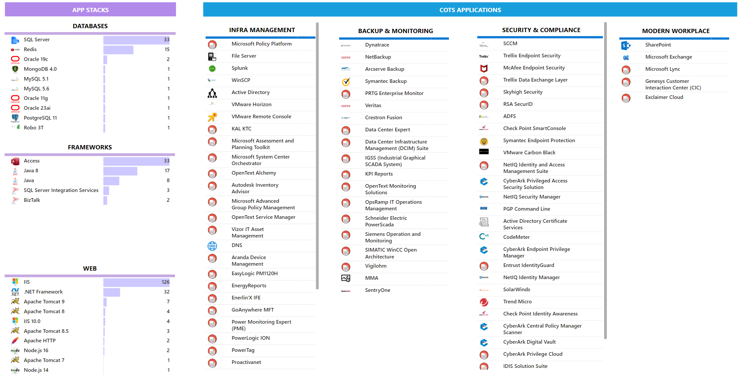
AC57C4B5-3CF5-4502-8878-4D47A504E64A
Workloads Discovered
Unlock Deeper Insights
Beyond infrastructure, discovery uncovered a wide range of software and workloads suited for modernization - from runtimes and databases to productivity tools and middleware. This provides a broad foundation for targeting cost efficiency and cloud-native consolidation.
Upload your CMDB data to enrich discovery. Dr Migrate's AI Inventory Assistant learns and refines results automatically.

Slide 5


A6F4E2C1-1D7A-4C89-8E51-9F4C71D4F5B3
Financial Scenarios
Explore three forward-looking scenarios to help shape your migration strategy.

Slide 6

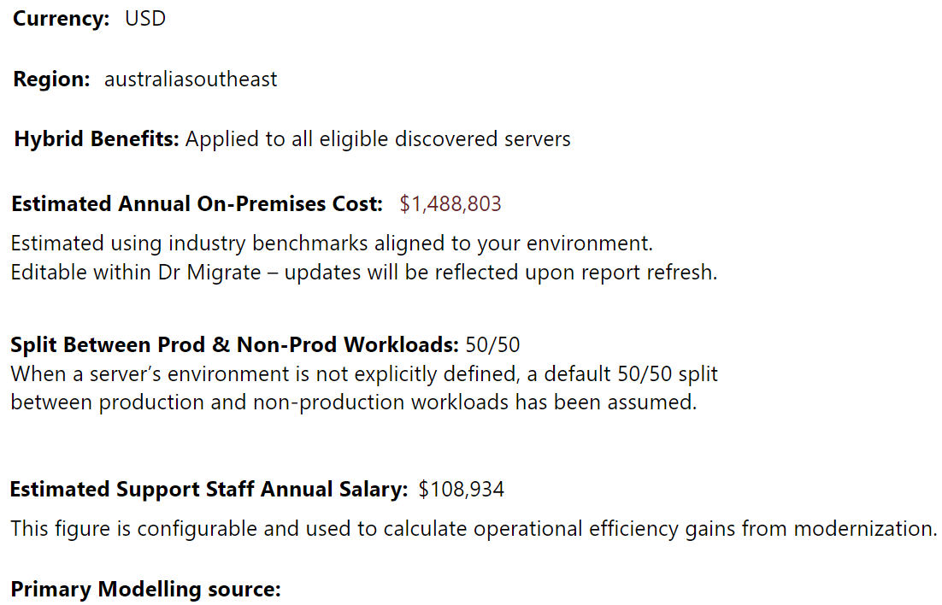
C4B17E95-0F8C-49E6-BE7C-2B16A0D8FA92
Modeling Details & Assumptions
The following inputs were used to generate the financial insights presented in this pack.
You're In Control
Cost assumptions in this report are fully configurable in Dr Migrate. You can update inputs and regenerate this report to reflect revised models.
Forrester - Total Economic Impact Report

Slide 7

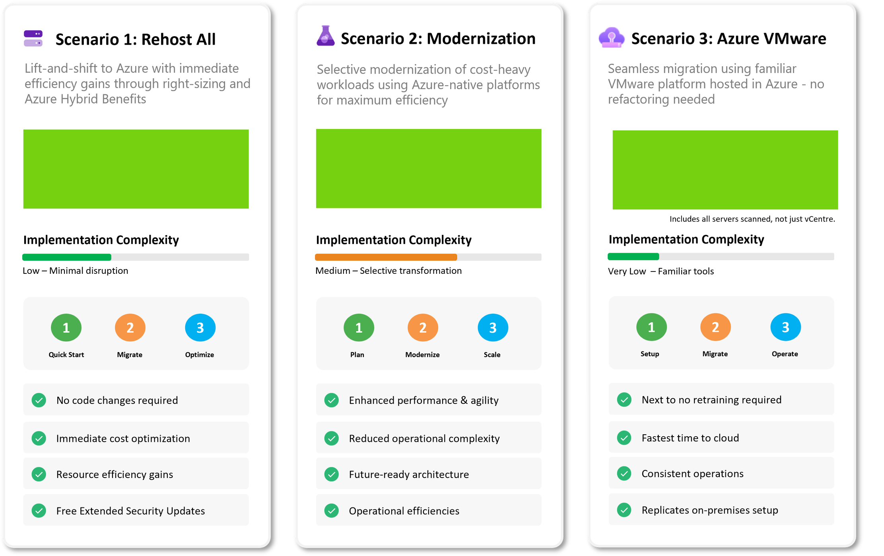



F7E9D2A8-3BC4-41E7-9F88-6A2A19ED8C4F
Migration Scenarios
These example scenarios illustrate potential migration pathways to Azure - each offering different levels of transformation, complexity, and benefit. While directional in nature, they serve as a starting point for discussion and can be tailored in the next planning phase to align with your unique strategy, timeline, and platform goals.

Slide 8
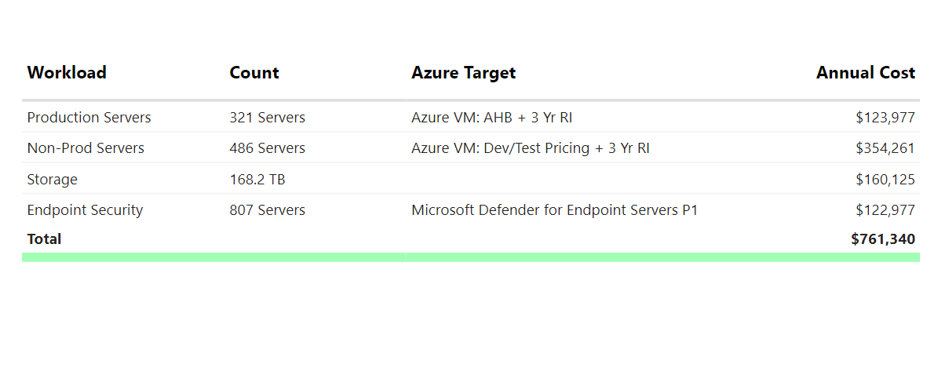
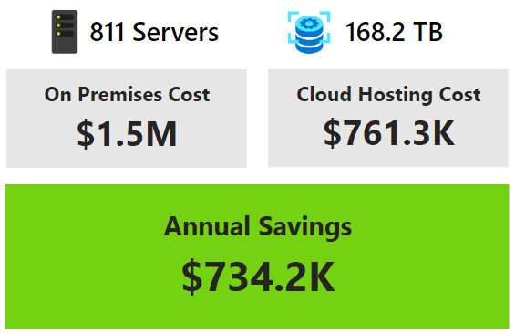
AC57C4B5-3CF5-4502-8878-4D47A504E64A
Scenario 1 Rehost All
Lift-and-shift to Azure with cost optimization through right-sizing, Hybrid Benefit, ESU avoidance, and flexible payment models.
Annual Cost Estimate Overview - Rehost All
Low Disruption, High Efficiency
Lift-and-shift with immediate savings from right-sizing and licensing benefits - no code changes, no downtime.
Notes:
• Immediate lift-and-shift of 811 servers (168 TB) to Azure cuts annual run-rate from $1.5 M to $0.76 M—a 49 % saving (~$734 K) driven by right-sizing, Azure Hybrid Benefit (license re-use), Dev/Test pricing, and 3-year Reserved Instances. • “Rehost-all” avoids Extended Security Update (ESU) fees and eliminates upcoming hardware refresh costs, providing a low-risk path to extend asset life while staying fully supported. • Operational continuity is preserved—no code change or downtime—accelerating time-to-cloud and freeing resources to focus on modernization instead of data-center management. • Built-in security uplift: Microsoft Defender for Endpoint P1 coverage for 807 servers is factored into the cost model, strengthening threat protection and compliance. • Consolidated Azure billing and flexible payment options improve budget predictability and enable OpEx funding models aligned with usage. • This baseline migration establishes a platform for subsequent modernization (PaaS, containers, analytics), enabling incremental innovation without the upfront disruption. Exploratory Questions 1. Which workloads should be prioritized for further modernization once rehosted to maximize additional savings or agility? 2. How will we reinvest the ~$734 K annual savings—security hardening, innovation initiatives, or debt reduction? 3. What governance structures are needed to sustain cost discipline and security posture as our Azure footprint scales? The following has been generated by AI. Consider checking important facts.

Slide 9
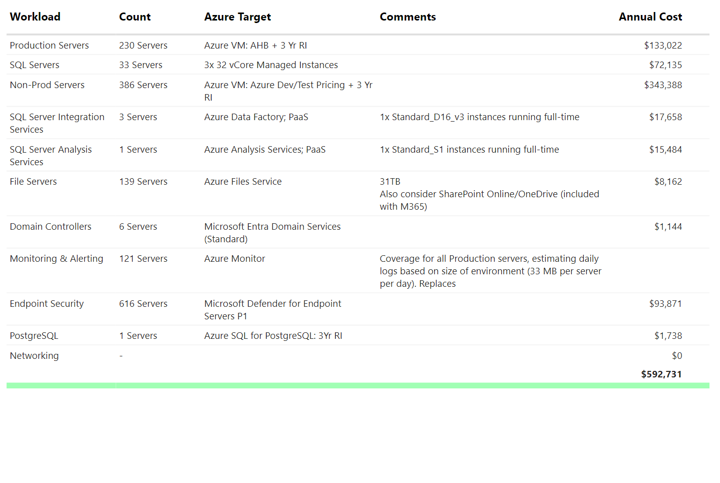
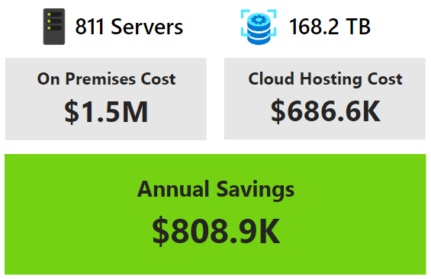
5E1822E7-4283-4777-A4D0-7BED03BD26BB
Scenario 2 Modernization
Selective modernization of cost-heavy workloads (e.g. SQL, web apps) using Azure-native platforms to reduce complexity, optimize licensing, and streamline IT operations.
Financial Overview - Modernization
Tailor This Scenario
This scenario reflects an example path. In the next planning phase, modernization opportunities will be reviewed and prioritized based on business goals and readiness.
Notes:
• Targeted modernization—focusing on SQL and web-app workloads—cuts annual run-rate from ~$1.5 M on-prem to ~$690 K in Azure, unlocking ~54 % (~$809 K) yearly savings while reducing 811 server footprints and 168 TB of storage complexity. • Cost efficiency is driven by Azure-native services: − Production VMs leverage Azure Hybrid Benefit + 3-year Reserved Instances. − SQL workloads shift to PaaS (Managed Instance, Analysis Services) to avoid licensing overhead and gain auto-scaling. • Security posture improves through Microsoft Defender for Endpoint, Azure Monitor, and Microsoft Entra Domain Services, providing unified threat protection, centralized logging, and automated compliance reporting. • Operational resilience is strengthened via cloud-native backup, high availability, and elasticity—critical for peak demand and disaster recovery. • Scenario is customizable; modernization waves can be sequenced to balance quick wins with application readiness and change-management capacity. • Savings free budget for innovation (analytics, AI) or further technical debt retirement, accelerating overall digital transformation. Exploratory Questions 1. Which high-value workloads should form the first modernization wave to maximize ROI and minimize business disruption? 2. How will we govern cost, security, and performance post-migration to sustain the projected 54 % savings? 3. What talent, automation, or partner support is required to execute modernization at the desired speed and scale? The following has been generated by AI. Consider checking important facts.

Slide 10
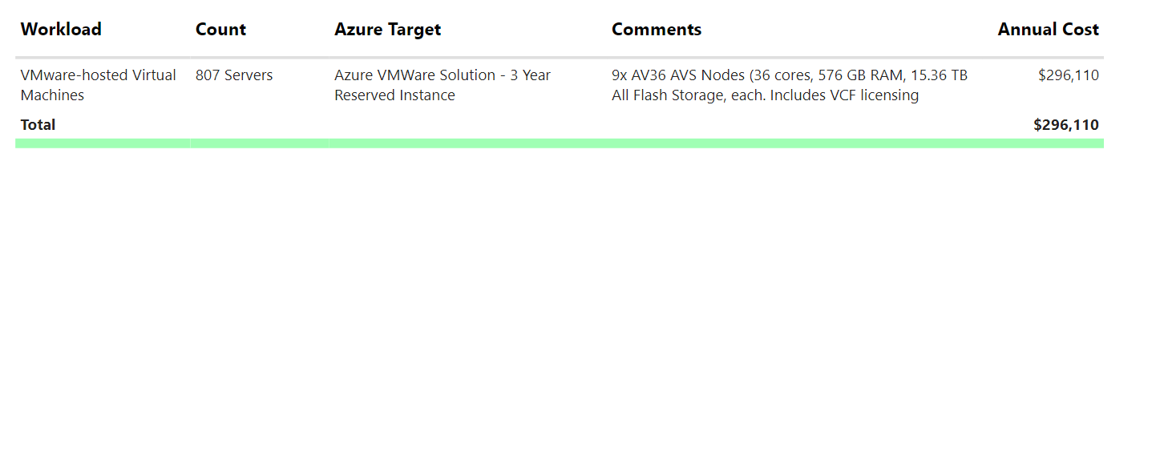
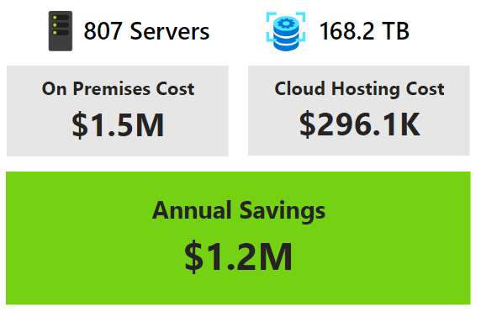
25D84C24-5C38-472E-A332-84F4333D386E
Scenario 3 Azure VMware Solution
Financial Overview - Azure VMware Solution
Take advantage of Azure's native VMware hosting to migrate your existing VMware environment as-is.
Need Speed?
Seamlessly migrate with Azure VMware Solution using a familiar VMware platform hosted in Azure - no refactoring, no retraining, no delay.
Notes:
• Migrating the 807-server, 168 TB VMware estate to Azure VMware Solution (AVS) cuts annual run-rate from $1.5 M to $296 K—an ~80 % savings (~$1.2 M per year) through 3-year reserved AV36 nodes that already include VMware Cloud Foundation licensing. • AVS enables “lift-and-shift” with zero refactoring or retraining, accelerating cloud adoption while preserving existing tools and skillsets; this minimizes project risk and shortens time-to-value. • Azure’s native resiliency, networking, and integrated security (with optional Defender for Cloud) strengthen the organization’s protection posture compared with current on-prem hosting. • Freed-up capital and operational bandwidth can be redirected to modernization initiatives—e.g., moving tier-2 apps to PaaS, adopting Azure AI/analytics, or hardening zero-trust controls—on a timeline the business controls. • The 9-node AV36 footprint provides scalable performance headroom; additional nodes can be added or removed on demand, aligning costs with consumption. • Rapid migration via AVS positions IT for future optimization—rightsizing VMs, automating backups, and leveraging hybrid management with Azure Arc—without disrupting workloads today. Exploratory Questions 1. How should we reinvest the projected $1.2 M annual savings to accelerate application modernization or security advancements? 2. What governance and network segmentation policies are required to integrate AVS securely with existing Azure resources and on-prem sites? 3. Which workloads could transition from AVS to native Azure services over the next 12–24 months for further cost and agility gains? The following has been generated by AI. Consider checking important facts.

Slide 11


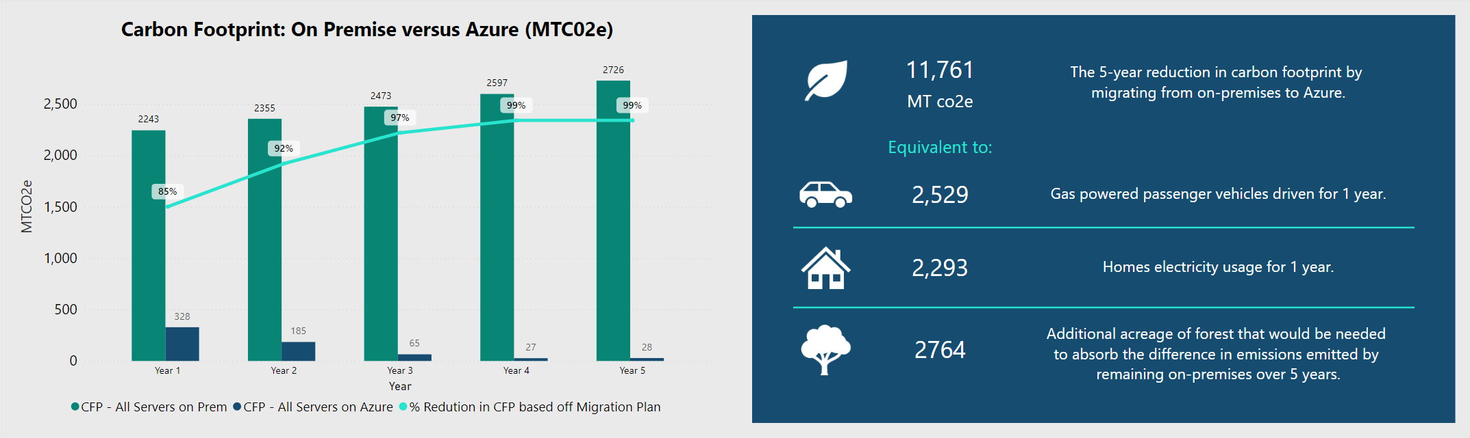
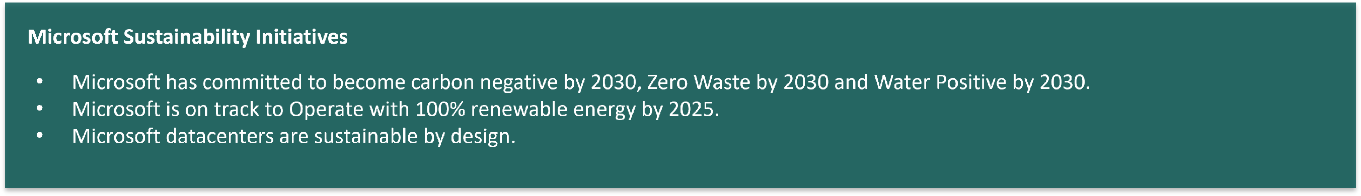
0C8898DE-7B63-4D51-85BE-78BE9F3F264E
Sustainability Results
Based on Scenario 1
Notes:
• Migrating our workloads to Azure can cut data-centre emissions by up to 85-89 % each year, avoiding 11,761 t CO₂e over five years—comparable to taking 2,529 cars off the road or powering 2,293 homes for a year. • This reduction materially advances corporate ESG targets and prepares us for tightening carbon-reporting mandates and potential carbon-pricing schemes. • Microsoft’s roadmap—carbon-negative, zero-waste, and water-positive by 2030 and 100 % renewable operations by 2025—means our hosted workloads inherit an increasingly sustainable footprint without additional capital investment. • Leveraging Azure’s sustainability metrics strengthens stakeholder trust, simplifies regulatory reporting, and positions the organisation for green financing or preferential procurement opportunities. • Remaining on-premises would require the equivalent of 2,764 acres of new forest to offset emissions—an impractical mitigation compared with cloud migration. Exploratory Questions 1. Which high-emission workloads should we prioritise for early migration to realise immediate ESG gains and potential cost offsets? 2. How can we integrate Azure sustainability data into our corporate reporting to strengthen compliance and investor relations? 3. What governance and procurement policies are needed to lock in emission-reduction benefits as we modernise the remainder of our IT estate? The following has been generated by AI. Consider checking important facts.

Slide 12

1A73C8F5-9D40-4E21-86A3-2359B4E5D21C
Server Analysis
Understand your server estate across OS, migration readiness, and support risks.

Slide 13
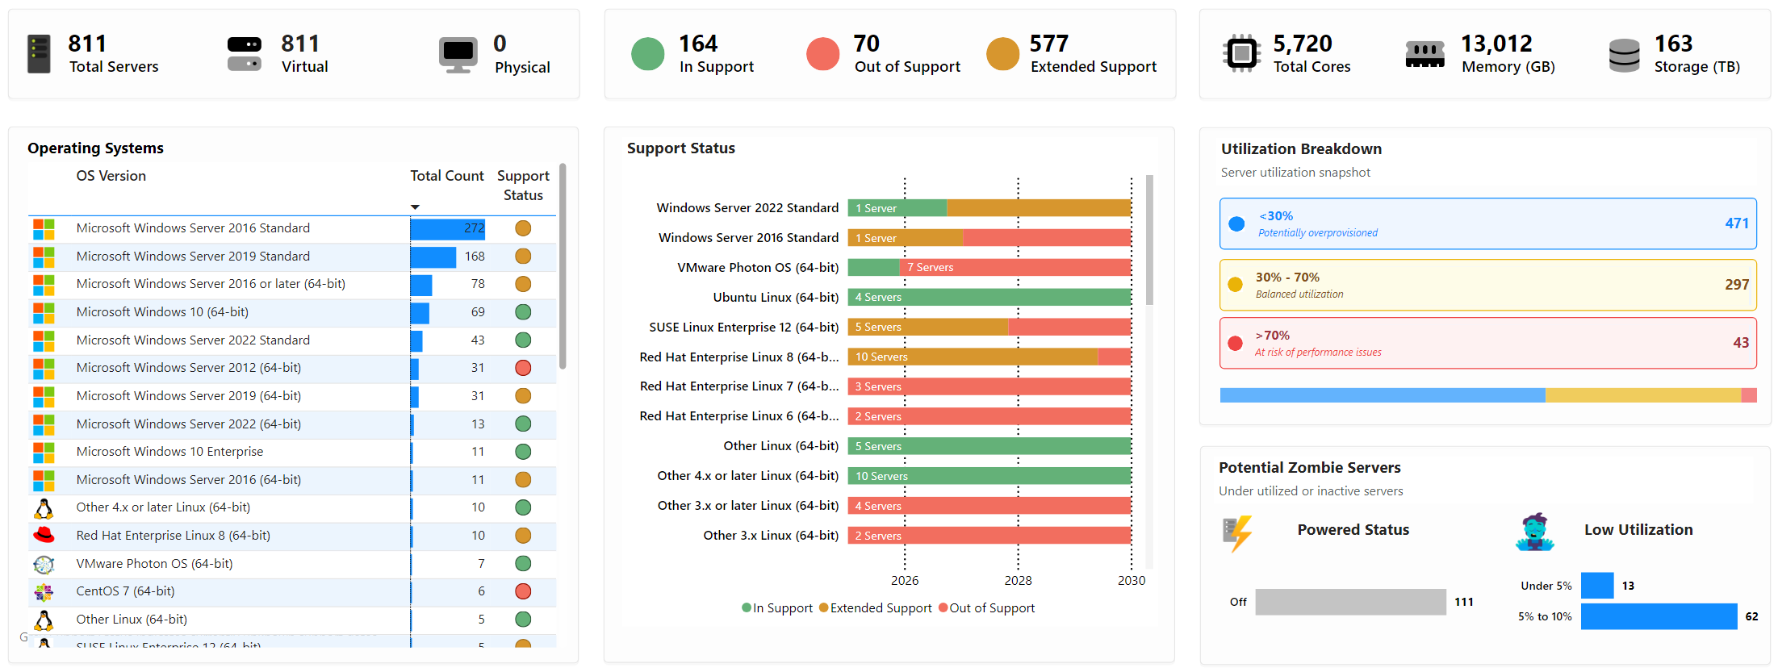
E94B0D27-6FA3-4B92-B1E7-1C4F6D9A3E5F
Server Analysis
A high-level summary of the server landscape, including operating system distribution, support status, utilization patterns, and potential opportunities to optimize or decommission underused infrastructure.
Notes:
• Estate is 100 % virtual (811 VMs, 5,720 vCPUs); no physical hardware left—making the environment technically ready for rapid cloud migration or hybrid scaling. • 80 % of servers (647) run on either Extended Support or fully out-of-support OS versions; Windows Server 2012 alone represents the largest single footprint. This exposes the business to escalating security, compliance, and support-cost risks. • Utilization is highly unbalanced: 471 VMs consume <30 % CPU, while only 43 exceed 70 %. Rightsizing or converting low-use workloads to PaaS/serverless models could unlock 30–40 % runtime savings. • 111 VMs are powered off and a further 75 run <10 % CPU—clear candidates for immediate retirement, archival, or consolidation, freeing licences and infrastructure budget. • Windows workloads dominate, positioning the organisation to leverage Azure Hybrid Benefit, free Extended Security Updates, and automated upgrade paths (e.g., 2012 → 2022 or Azure SQL). • Swift remediation is essential to avoid unplanned spend on legacy support and to strengthen the security posture ahead of any regulatory audit.
Exploratory Questions 1. Which mission-critical workloads on legacy OS should be prioritised for accelerated migration to Azure to obtain free security updates? 2. What governance model will enforce continuous rightsizing and automated decommissioning of under-utilised VMs post-migration? 3. How can we sequence application modernisation (PaaS/container adoption) to turn current over-capacity into measurable OPEX savings within the next fiscal year? The following has been generated by AI. Consider checking important facts.

Slide 14
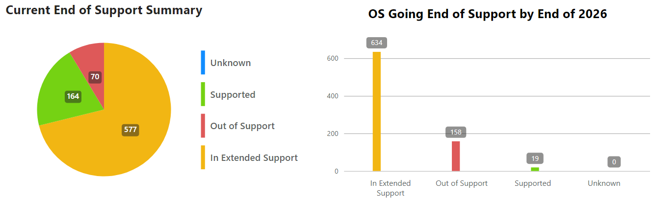
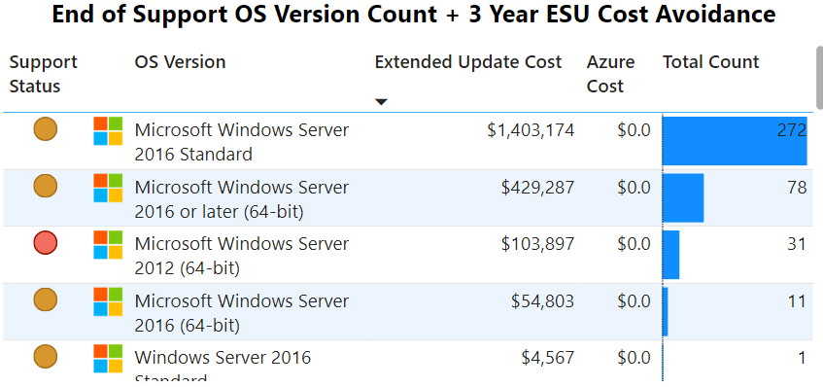

45E2850C-370D-477E-8CBD-73DC1AC370E7
End of Support Operating Systems
Out of support Operating Systems present security risks & operational issues. Azure provides no-cost extended security updates for many operating systems, providing immediate cost reduction and security enhancement while you work through re-host/re-platform strategies.
Action to Save
Migrate servers to Azure before they go out of support to avoid Extended Security Update costs.
3 Year Cost Avoidance
Notes:
• 792 servers are either already out of support (158) or will reach end-of-support status by 2026 (634), creating an immediate security and compliance gap. • Unsupported operating systems expose the organisation to un-patched vulnerabilities and potential operational outages—high-probability, high-impact risks flagged by recent audits. • Continuing on-premises would trigger c. $2 M in Extended Security Update (ESU) fees over the next three years, with Windows Server 2016 alone accounting for >90 % of this cost. • Migrating these workloads to Azure eliminates ESU charges—Microsoft provides the updates at no cost—while simultaneously strengthening the security baseline through Azure-native threat protection and monitoring. • An Azure migration buys time for orderly re-host, re-platform or modernisation without forcing immediate application refactoring, preserving business continuity. • Rapidly addressing end-of-support systems aligns with broader cloud-first and zero-trust objectives, helping satisfy regulatory requirements and board-level risk tolerances. Exploratory Questions 1. Which critical business services run on the 272 Windows Server 2016 Standard instances, and what migration wave can they enter without disrupting SLAs? 2. How can we integrate Azure security services (Defender, Sentinel) into the migration plan to maximise the risk-reduction benefit on day one? 3. What governance model will ensure ongoing lifecycle management so future end-of-support events are identified and remediated well before deadlines? The following has been generated by AI. Consider checking important facts.

Slide 15
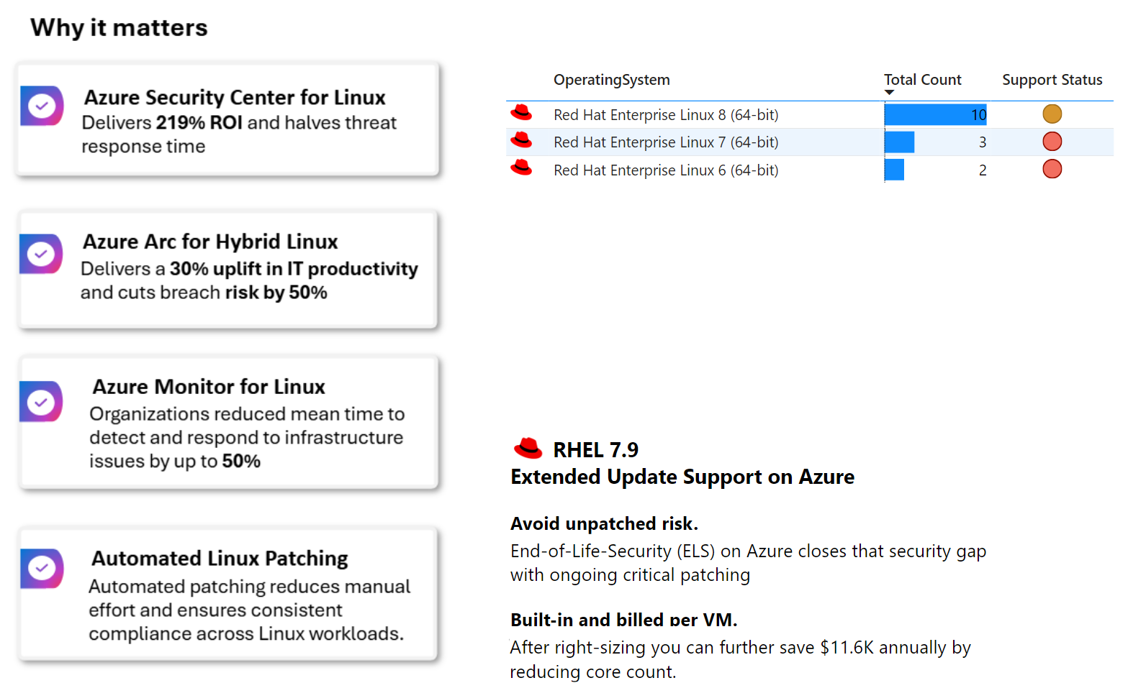
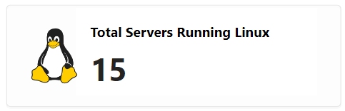
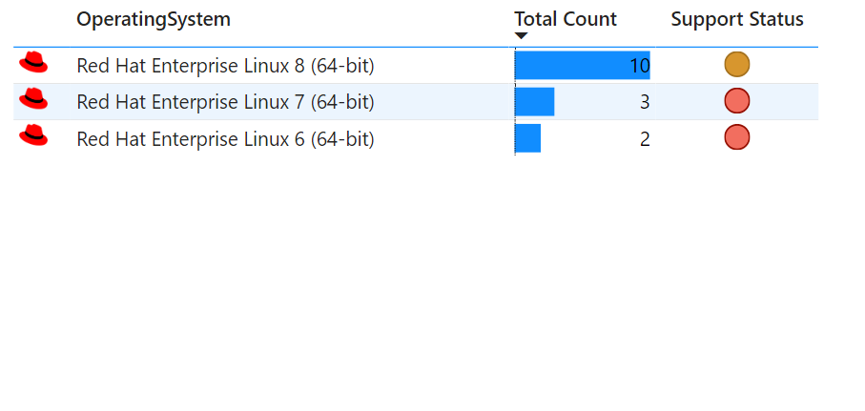
5B6F7A12-8E29-45D4-9F31-74E2D83B5F10
Azure Linux Advantages
Transform your Linux infrastructure with Azure's enterprise-grade platform, unlock cost savings, enhance security, and accelerate modernization while maintaining compliance and reducing operational overhead.
Improve Operational Efficiency
Move Linux to Azure for lower costs, stronger security, and hands-off patching.
Notes:
• Current footprint: 15 on-prem Red Hat servers (RHEL 8 x10, RHEL 7 x3, RHEL 6 x2) — two versions are nearing/at end-of-support, heightening patch and compliance risk. • Moving these workloads to Azure unlocks material business value: – Azure Security Center for Linux delivers 219 % ROI and cuts threat response time by half. – Azure Arc extends hybrid governance, boosting IT productivity 30 % and lowering operational risk 50 %. – Azure Monitor reduces mean-time-to-detect/resolve infrastructure issues up to 50 %, enabling proactive ops. – Automated Linux Patching eliminates manual effort and enforces uniform compliance across all VMs. • Azure’s RHEL 7.9 Extended Update Support closes the post-EOL security gap; billing is per-VM and can be right-sized to save an additional $11.6 K annually by trimming core counts. • Consolidating Linux workloads on Azure therefore advances three strategic objectives: cost optimization (license/core savings + operational efficiency), strengthened security posture (continuous patching & threat analytics), and accelerated modernization under a single, cloud-native management plane. Exploratory Questions 1. What is our target timeline to migrate the RHEL 6/7 servers before full end-of-support, and who owns the remediation plan? 2. How can we leverage Azure Arc governance policies to enforce consistent security baselines across both cloud and remaining on-prem Linux assets? 3. Which cost-right-sizing and automation opportunities (e.g., core reduction, autopatching) should be prioritized to capture the projected $11.6 K annual savings? The following has been generated by AI. Consider checking important facts.

Slide 16
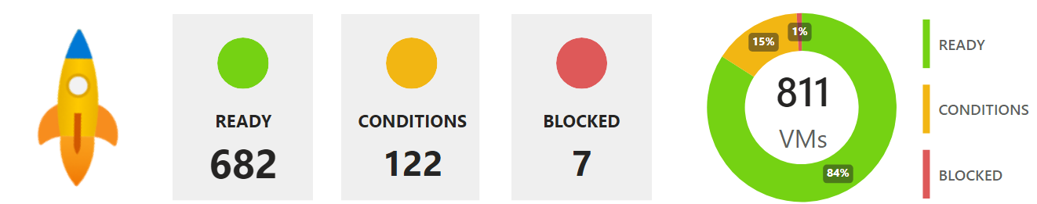
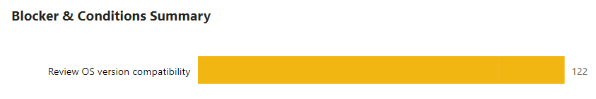
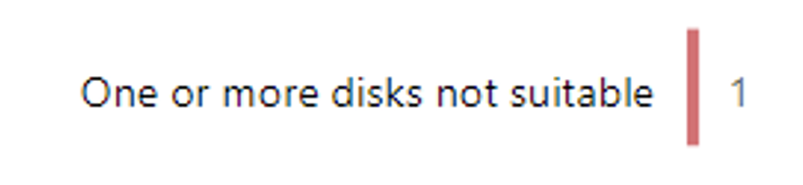
7E4F2C91-3B6A-4A0F-82E7-C2F19D47B9A6
Server Migration Readiness
Each server is assessed for its technical readiness to run in Azure. Servers that are 'Ready' will confidently run in Azure without issues. Any conditions or blockers per VM are detailed in the online report.
Action
'Ready' to migrate servers represent possible low-hanging fruit that can be moved to Azure without issue. Explore 'Rapid Migration First Wave Candidates' to find out more.
7
Notes:
• 811 virtual machines have been assessed; 84 % (682 VMs) are technically “Ready” for Azure, offering an immediate fast-track to cloud migration with minimal remediation. • Only 1 % (7 VMs) are “Blocked,” indicating a very small footprint requiring deeper remediation or alternate hosting. • 15 % (122 VMs) are flagged with “Conditions”; the dominant issue is outdated or unsupported OS versions, a solvable dependency that can be addressed through in-place upgrades or image modernization. • Secondary issues—discovery gaps (6 VMs) and disk suitability (1 VM)—are low-effort fixes and should not materially delay migration timelines. • Prioritizing the “Ready” cohort enables a rapid first-wave move to Azure, accelerating time-to-value, freeing on-prem capacity, and reducing immediate operational risk. • Addressing OS compatibility in the “Conditions” group concurrently establishes a clean modernization path and prevents future security exposure. • Overall readiness profile supports an aggressive, low-risk migration schedule while keeping remediation costs contained. Exploratory Questions 1. Which business units own the 682 “Ready” VMs, and how quickly can we align them to a rapid migration wave? 2. What is the cost-benefit of upgrading OS versions versus replacing workloads with PaaS alternatives for the 122 “Condition” VMs? 3. How will we govern and fund remediation for the 7 “Blocked” VMs to avoid technical debt post-migration? The following has been generated by AI. Consider checking important facts.

Slide 17
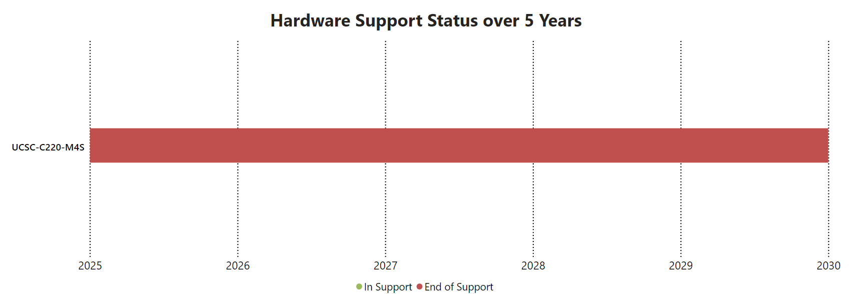
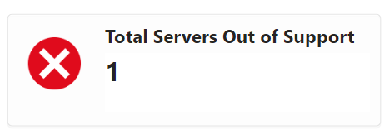
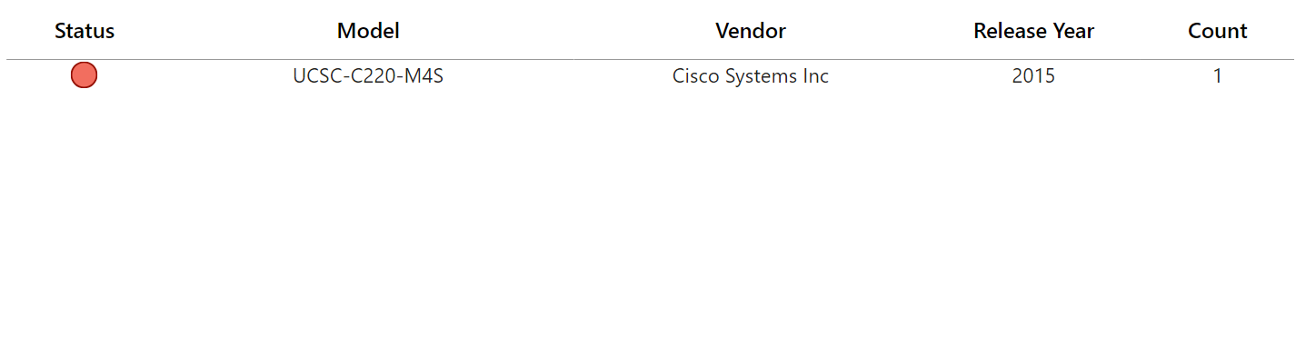
B21E8C35-6F47-44E9-94A0-13F72C8B50E2
Hardware Lifecycle
Expired warranties and unsupported systems mean more downtime, higher effort, and emergency capex. Azure shifts you to a predictable, modern model.
Operational Risk
Legacy infrastructure drives cost, risk, and complexity. Azure enables a more resilient, supportable environment.
NB: It is assumed hardware is purchased within 5 years of the release date and with 3 years of warranty. Powered down machines do not report make or model. Does not factor in if extended warranty was purchased.*

Slide 18
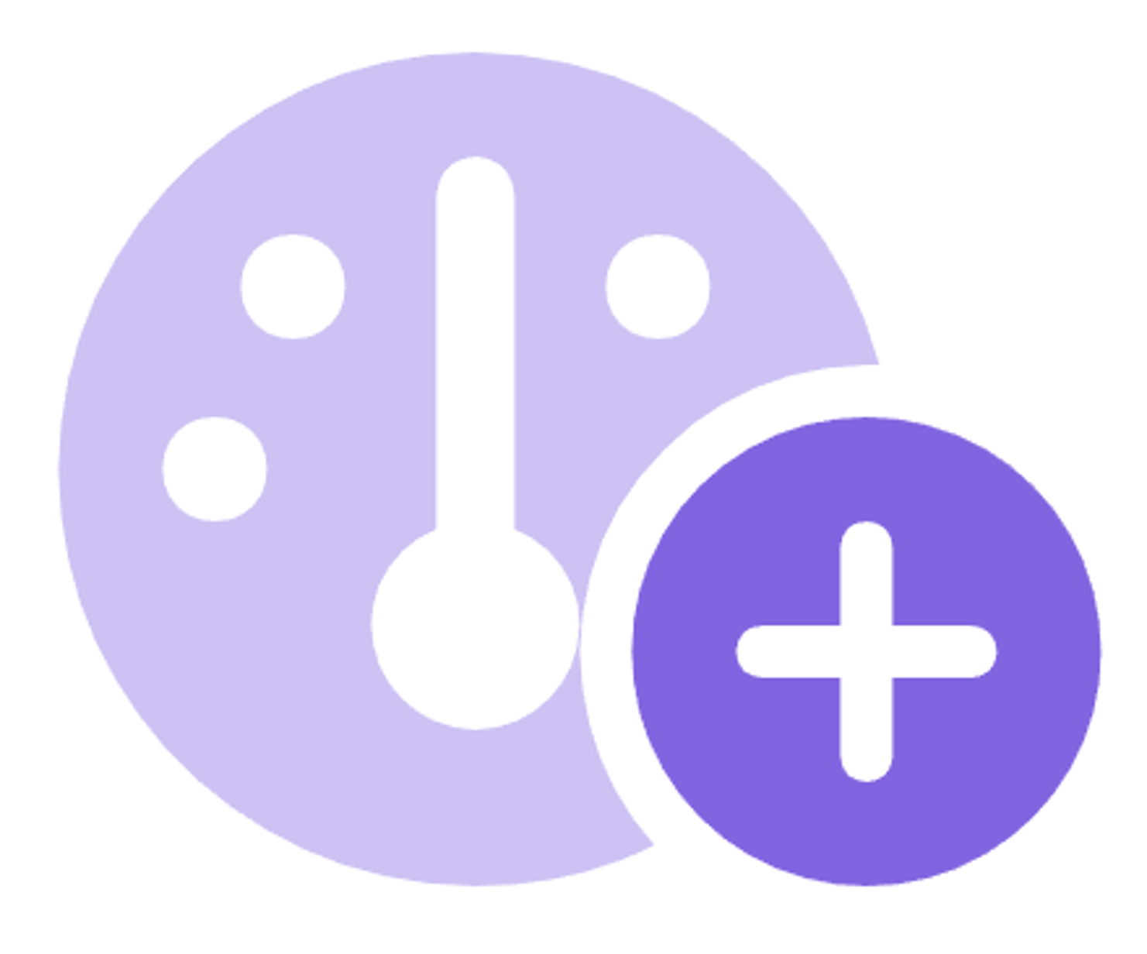
D47A9F6E-1B25-432C-89D4-5A3F7E2C1B8D
Optimization
Identify opportunities to optimize cost and efficiency through right-sizing and licensing adjustments

Slide 19
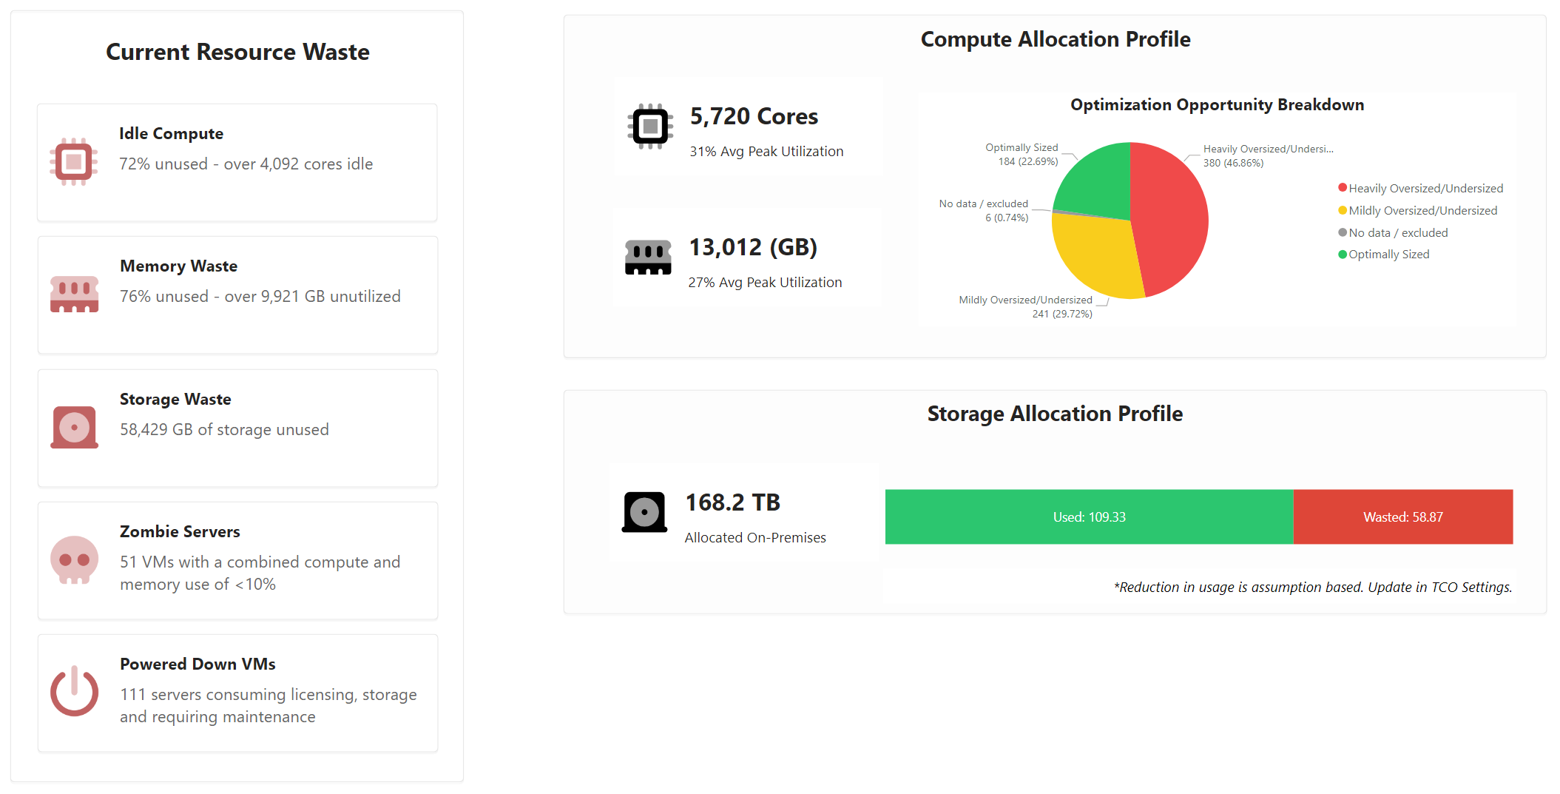
9C8F4B72-5E16-4763-80D2-A6B7C41F23E1
Right Sizing - Resource Waste
This page highlights underutilized compute, memory, and storage resources, revealing opportunities to right-size, optimize costs, and eliminate waste.
Notes:
• Under-utilization is systemic: 72 % of CPU (≈4,100 cores) and 76 % of RAM (≈9.9 TB) sit idle, while 35 % of on-prem storage (≈59 TB) is unused—indicating immediate cost-takeout potential through right-sizing or workload consolidation. • Nearly half of the estate (49 %) is heavily over- or under-sized; only 16 % of servers are optimally provisioned. Automated scaling policies and fit-for-purpose VM families could materially reduce run-rate spend and improve performance. • Zombie workloads are creeping in: 51 VMs consume <10 % of resources and 111 servers are powered down but still drive licensing and support fees—both create avoidable OPEX and elevate security exposure from unpatched assets. • Average peak utilization is just 31 % for compute and 27 % for memory, suggesting capacity can be reduced or shifted to consumption-based Azure offerings (e.g., Azure VM Scale Sets, serverless PaaS) without impacting SLAs. • Rightsizing and decommissioning could release funding for modernization initiatives while tightening the security posture by removing dormant attack surfaces. Exploratory Questions 1. What governance and automation (e.g., Azure Advisor, Policy) are needed to continuously right-size and prevent future waste? 2. How quickly can we re-invest the savings into cloud-native refactoring or security hardening efforts? 3. Which business-critical workloads require performance baselining before any size reductions or migrations? The following has been generated by AI. Consider checking important facts.

Slide 20
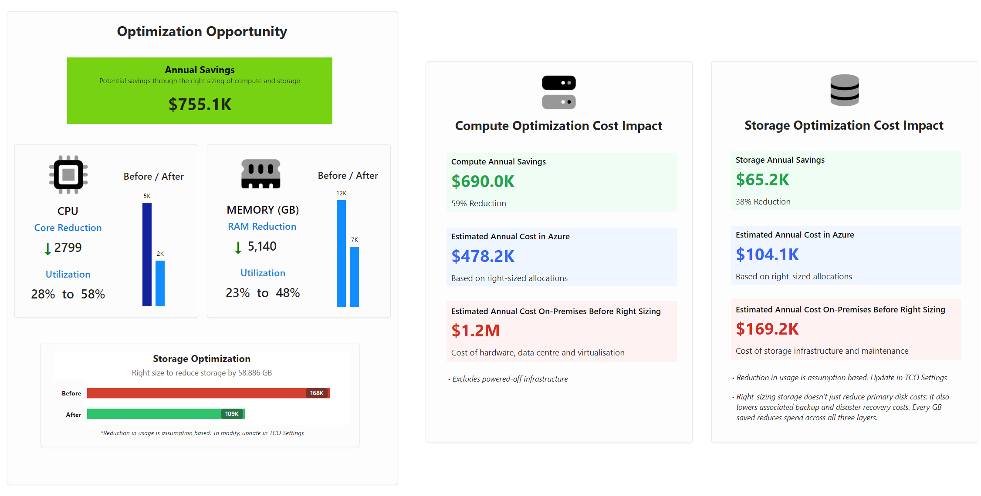
3F72B6E1-0C94-4DA8-91E3-8D25C47B1F9A
Right Sizing - Optimization
This optimization view reflects a scenario where all workloads are rehosted to Azure virtual machines. Savings shown are based on right-sizing compute, memory, and storage allocations under that model
Notes:
Key Insights for Executive Decision-Making • Immediate right-sizing of current workloads on Azure can cut annual run-rate costs by ~$755K—an overall reduction of ~55% versus the existing on-premises footprint. • Compute is the largest lever: trimming excess vCPU capacity (-2,799 cores) boosts utilization from 28% to 58% and delivers ≈$690K in yearly savings. • Memory optimization (-5.1 TB) and targeted storage reduction (-88 TB) further raise utilization to ~48% and generate an additional $65K in storage savings while reducing backup and DR overhead. • Net Azure spend after optimization is projected at ~$582K p.a. (Compute $478K, Storage $104K) versus $1.37M on-prem, freeing capital for higher-value modernization or security initiatives. • Optimization achieves quick ROI without refactoring code; it also creates a lean baseline that simplifies future moves to PaaS/container services and eases compliance monitoring. • Rightsizing strengthens security posture by shrinking attack surface (fewer exposed resources) and enabling Azure governance tooling (policy, cost guardrails, asset visibility). Exploratory Questions 1. Which governance model and tagging policies will we use to keep resources right-sized post-migration and avoid cost-creep? 2. How will we reinvest the ~$755K annual savings—accelerated application modernization, enhanced cyber controls, or both? 3. What is the timeline for extending optimization principles (reserved instances, autoscaling, PaaS adoption) to the remaining workload portfolio? The following has been generated by AI. Consider checking important facts.

Slide 21

8C1D9A47-6F32-45B2-85E0-94F3B28A6E15
Modernization
Identify opportunities to optimize cost and efficiency through right-sizing and licensing adjustments

Slide 22
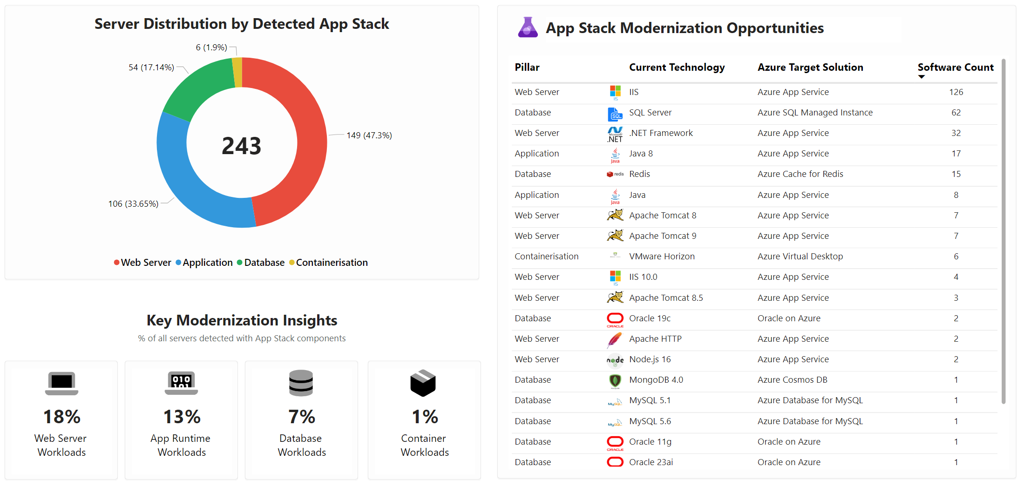
A27D4F3B-9C60-4957-AD83-71F29C5D4B01
App Stack Modernization Snapshot
This snapshot provides a consolidated view of the current application stack, mapping key runtime, database, and container technologies to their recommended Azure modernization targets. Server counts help prioritize where modernization efforts can deliver the greatest impact.
Notes:
• 243 servers host identifiable application workloads; 80% are web or application tiers, making them prime candidates for Azure PaaS migration and rapid OPEX reduction. • 126 IIS instances alone—over half the web tier—could be consolidated onto Azure App Service, eliminating OS patching and enabling autoscale. • 62 SQL Server deployments can move to Azure SQL Managed Instance, cutting licence costs, simplifying HA/DR, and aligning with Microsoft’s evergreen support model. • Legacy runtimes are prevalent: .NET Framework (32 servers), Java 8 (17), Apache Tomcat 8/9 (10). Modernizing to managed PaaS mitigates imminent end-of-support and security exposure. • Self-hosted Redis (15) and MongoDB/MySQL/Oracle workloads offer quick wins via Azure Cache for Redis and respective managed databases, reducing operational overhead. • Container adoption is negligible (1% of estate), signaling a gap in cloud-native readiness and an opportunity to accelerate AKS or App Service for Containers to future-proof the platform. • Targeting the top five modernization moves (IIS, SQL Server, .NET, Java, Redis) addresses >75% of detected software, delivering maximum impact with focused effort. • Prioritized migration sequencing and ROI modelling are needed to balance quick wins with deeper refactoring demands. Exploratory Questions 1. Which IIS and SQL workloads drive the greatest business value and can be fast-tracked to PaaS in the next 6–9 months? 2. What governance and skill-building steps are required to scale container adoption and avoid repeating current technical debt? 3. How will we mitigate security and compliance risks from legacy runtimes during the transition period? The following has been generated by AI. Consider checking important facts.

Slide 23
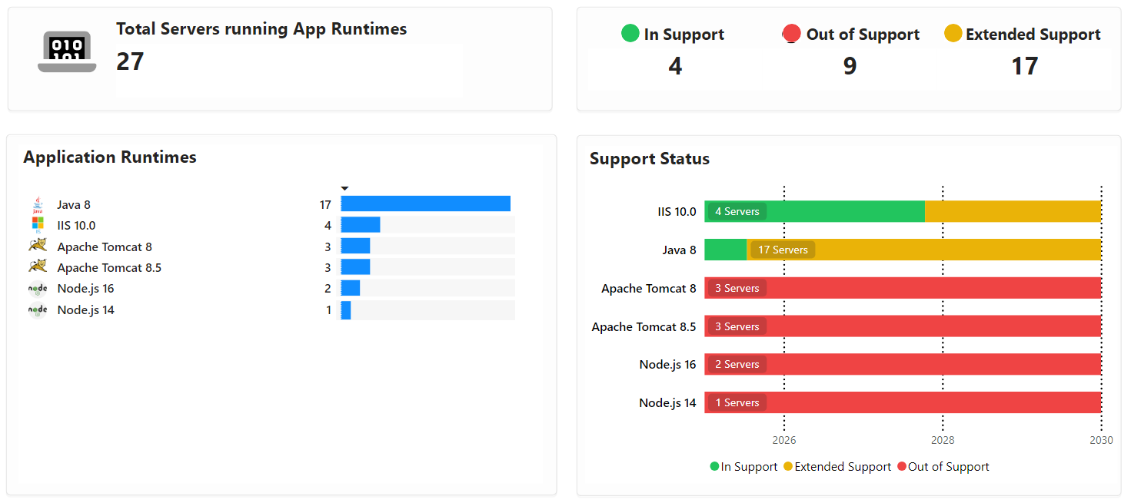
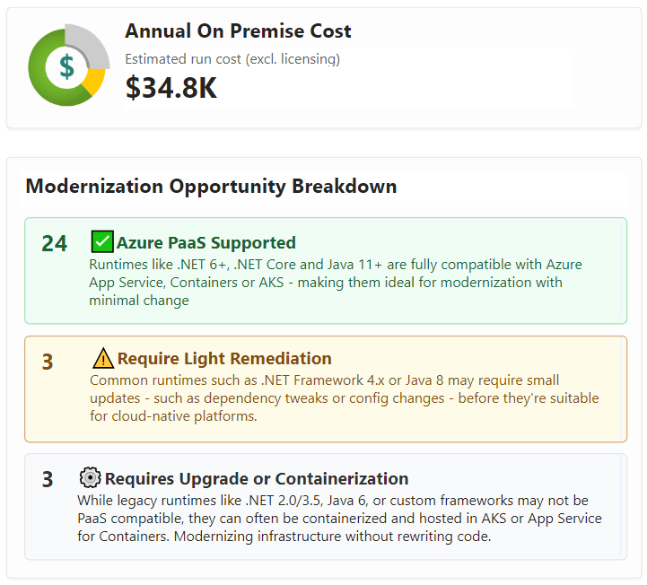
E5B39C72-1A8F-42C7-93B4-0D82FA6C4E97
App & Web Runtime Landscape
This analysis identifies all application runtimes present across the environment, highlighting technology diversity, usage footprint, and supportability risks. Understanding runtime distribution helps shape modernization priorities and platform alignment decisions.
Validate Modernization Fit
Run Microsoft AppCat to assess application suitability, and import the results into Dr Migrate for deeper analysis and planning.
*Filtered to show Runtimes compatible with App Service Plans
Notes:
• 27 servers host six different app/web runtimes; 85 % (23/27) sit in extended or out-of-support status—creating increasing security and compliance risk. • Java 8 dominates (17 servers) but is already beyond mainstream support, making it the largest single source of technical debt. • 24 of the identified runtimes are natively supported on Azure App Service, Containers, or AKS, enabling a rapid PaaS-first migration with minimal code change. • Only three runtimes require light dependency updates (e.g., .NET 4.x or newer Java) before they qualify for cloud-native hosting, and another three need upgrade or containerization—keeping overall remediation scope limited and predictable. • Current on-premises run-cost is estimated at ~$34.8 K per year (licensing only); shifting the 24 PaaS-ready workloads to Azure could convert fixed CapEx into elastic OpEx while reducing legacy licensing spend and operations overhead. • Consolidating runtimes onto modern PaaS also mitigates end-of-life exposure and positions the app portfolio for DevOps automation, faster release cycles, and zero-trust controls. Exploratory questions 1. Which mission-critical apps are tied to the nine out-of-support runtimes, and what is the acceptable risk window for leaving them unpatched? 2. How much cost avoidance can we realize by decommissioning on-prem licences once the 24 PaaS-eligible workloads move to Azure? 3. What timeline and resources are needed to execute the light remediation and containerization for the remaining six runtimes to achieve full cloud alignment? The following has been generated by AI. Consider checking important facts.

Slide 24
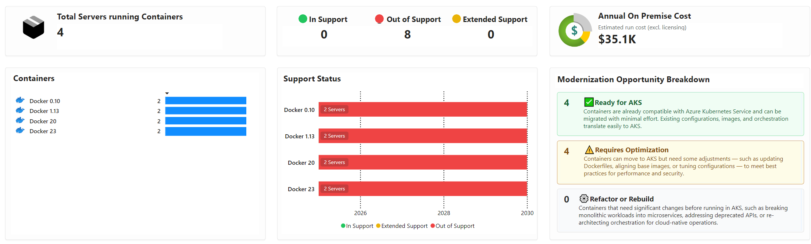
4C0D1A8E-56F9-47B6-8C3A-71B8D2E4F529
Container Landscape
This analysis surfaces containerized workloads running across the estate, including legacy database engines and modern platforms. Visibility into container spread supports informed decisions on replatforming, security posture, and AKS modernization opportunities.

Slide 25
FA9B7E13-248C-405D-9E76-1B4A5C93E2D8
Database Landscape
This snapshot highlights your current database footprint, including product mix, support status, cost, and performance. It surfaces key modernization opportunities, especially for out-of-support or inefficient workloads.
Notes:
• 54 on-prem database servers span nine products, yet 89 % of workloads sit on SQL Server and Redis—allowing a focused, high-impact modernization path. • 32 servers (≈60 %) run unsupported versions such as SQL Server 2008/2014 and PostgreSQL 11, posing immediate security, compliance, and audit risks. • Current run cost is $135.7K per year before licences; shifting to Azure PaaS could trim 30–40 % TCO, eliminate future hardware refresh, and deliver built-in resilience and patching. • Performance data shows most key databases consume <30 % CPU and I/O, indicating significant over-provisioning; rightsizing or consolidating in Azure can further cut spend and reduce attack surface. • Quick wins: migrate SQL workloads to Azure SQL Managed Instance and move Redis to Azure Cache to gain extended support, automated security (Defender for SQL), and backup automation. Evaluate retiring or re-platforming the six remaining niche databases to simplify operations. Exploratory Questions 1. What level of risk are we willing to accept while 32 unsupported servers remain on-prem? 2. Which low-utilization workloads can be decommissioned or combined before migration to shrink scope and cost? 3. Should we prioritise a rapid lift-and-shift for speed, or invest in PaaS refactoring to maximise long-term value and resilience? The following has been generated by AI. Consider checking important facts.

Slide 26

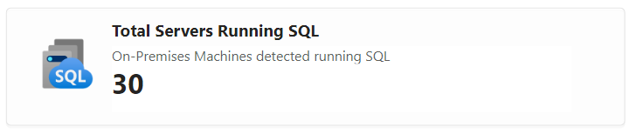
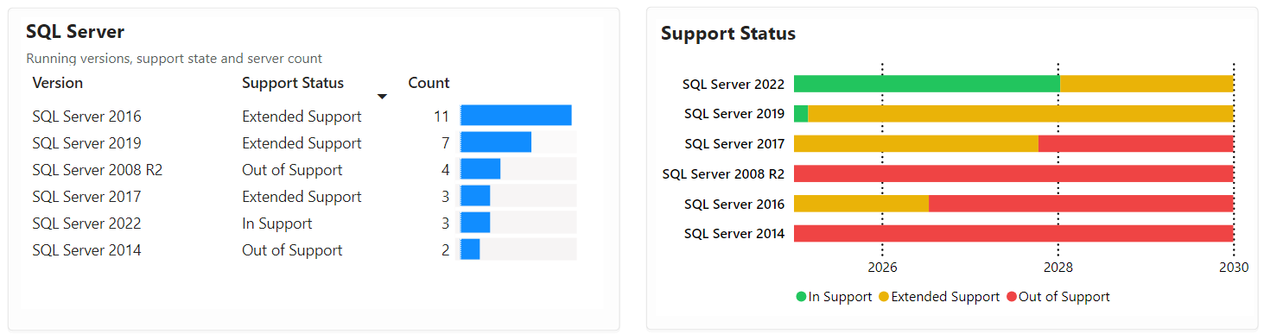
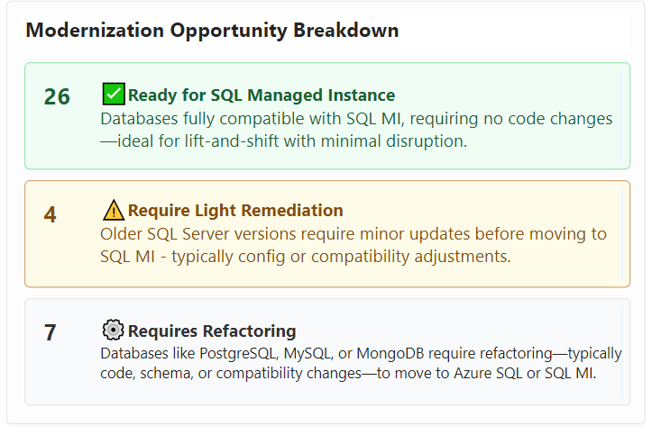
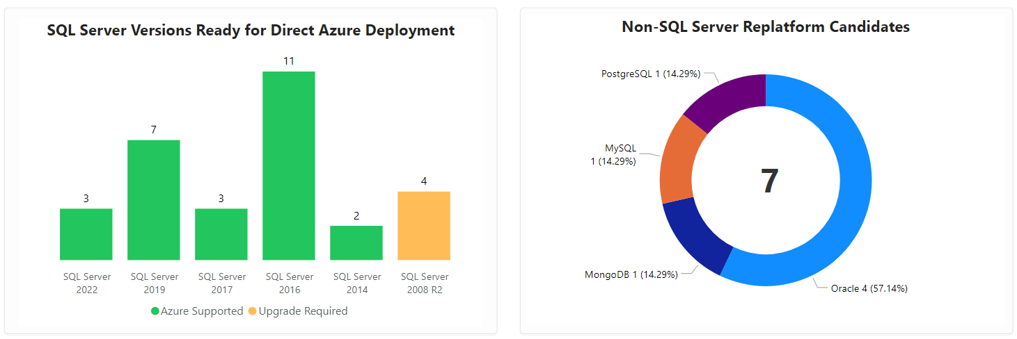
7E3C92F1-5B47-4930-8B64-3F1A2C7E95D0
SQL Inventory
Servers
Low Disruption, High Efficiency
Lift-and-shift with immediate savings from right-sizing and licensing benefits - no code changes, no downtime.
Notes:
Key Insights for Cloud & Data Platform Strategy • 30 on-prem SQL Servers identified; 87% (26) are already fully compatible with Azure SQL Managed Instance—enabling a rapid lift-and-shift with no code changes and minimal downtime. • The estate skews older: 11 servers run SQL Server 2016 (entering end of mainstream support), and 4 servers (2008 R2/2014) are already out of support—creating immediate security and compliance exposure. • Four additional servers require only light remediation (patches or minor configuration tweaks) before cloud migration, keeping effort and risk low. • Seven workloads on non-SQL engines (Oracle 4, PostgreSQL 1, MySQL 1, MongoDB 1) will need refactoring or re-platforming, offering a strategic pause to standardize on PaaS and reduce heterogeneous licensing costs. • Consolidating the compatible 26 servers onto Managed Instance unlocks quick wins: automated patching/backups, high availability, and potential licensing savings via Azure Hybrid Benefit. • Servers on 2016 or earlier versions demand an upgrade path—either before migration or via in-place upgrade in Azure—to avoid extended-support fees by 2026. • Overall, the data estate is primed for low-disruption modernization, but delaying action heightens security, compliance and cost risks. Exploratory Questions 1. What is the target timeline to retire all out-of-support SQL versions and avoid extended-support costs? 2. How will we prioritize the 7 heterogeneous databases—standardize on Azure services or retain best-of-breed platforms? 3. Which governance and cost-management controls should accompany a rapid lift-and-shift to ensure ongoing optimization post-migration? The following has been generated by AI. Consider checking important facts.

Slide 27
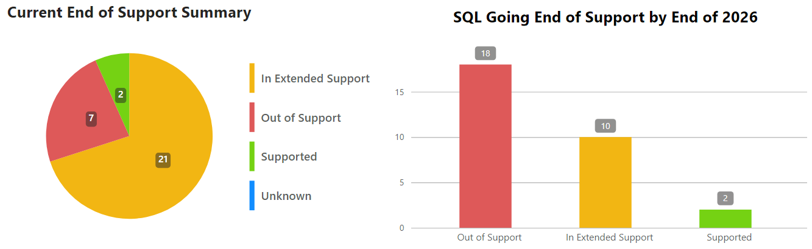
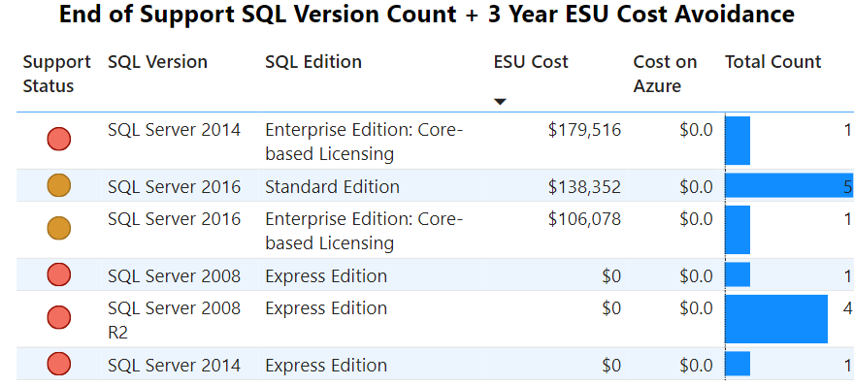

772BE553-6AB9-469B-BE2F-A483A6216BC9
Out of Support SQL Servers
As database versions become unsupported, they present security risks, as no new patches are provided without extended security updates (ESU). ESU for SQL 2012 will be included with Azure at no extra cost when extended support ends for those products.
Cost Avoidance
Over 3 Years
Migrate out of support and nearing end of support SQL servers to Azure
Notes:
Key Insights for Executive Decision-Making • 18 SQL Server instances are already unsupported and another 10 enter end-of-support by 2026, creating a significant security and compliance gap. • Remaining on-premises would require ~$424K in Extended Security Updates (ESU) over three years just to stay patched; Azure provides the same ESU at no cost. • Migrating these workloads to Azure eliminates the ESU spend, reduces vulnerability exposure immediately, and aligns with the broader cloud-first strategy. • Moving to Azure SQL Managed Instance or Azure SQL Database can further cut licensing and infrastructure costs, streamline patching, and enable elastic scaling—driving additional OPEX savings and performance gains. • Proactive migration helps retire technical debt, improves audit posture, and positions the organization to leverage advanced Azure security services (Defender for Cloud, Sentinel) without retrofit effort. • Delaying action extends risk windows, may trigger unbudgeted ESU fees, and limits the organization’s ability to modernize data platforms needed for analytics and AI initiatives. Exploratory Questions 1. Which critical workloads running on out-of-support SQL versions should be prioritized for rapid migration to Azure in the next 6–9 months? 2. How can we align funding and resources to capture the $424K ESU cost avoidance while accelerating data-platform modernization? 3. What governance and security controls must be established upfront to ensure migrated databases immediately meet compliance and resiliency standards? The following has been generated by AI. Consider checking important facts.

Slide 28
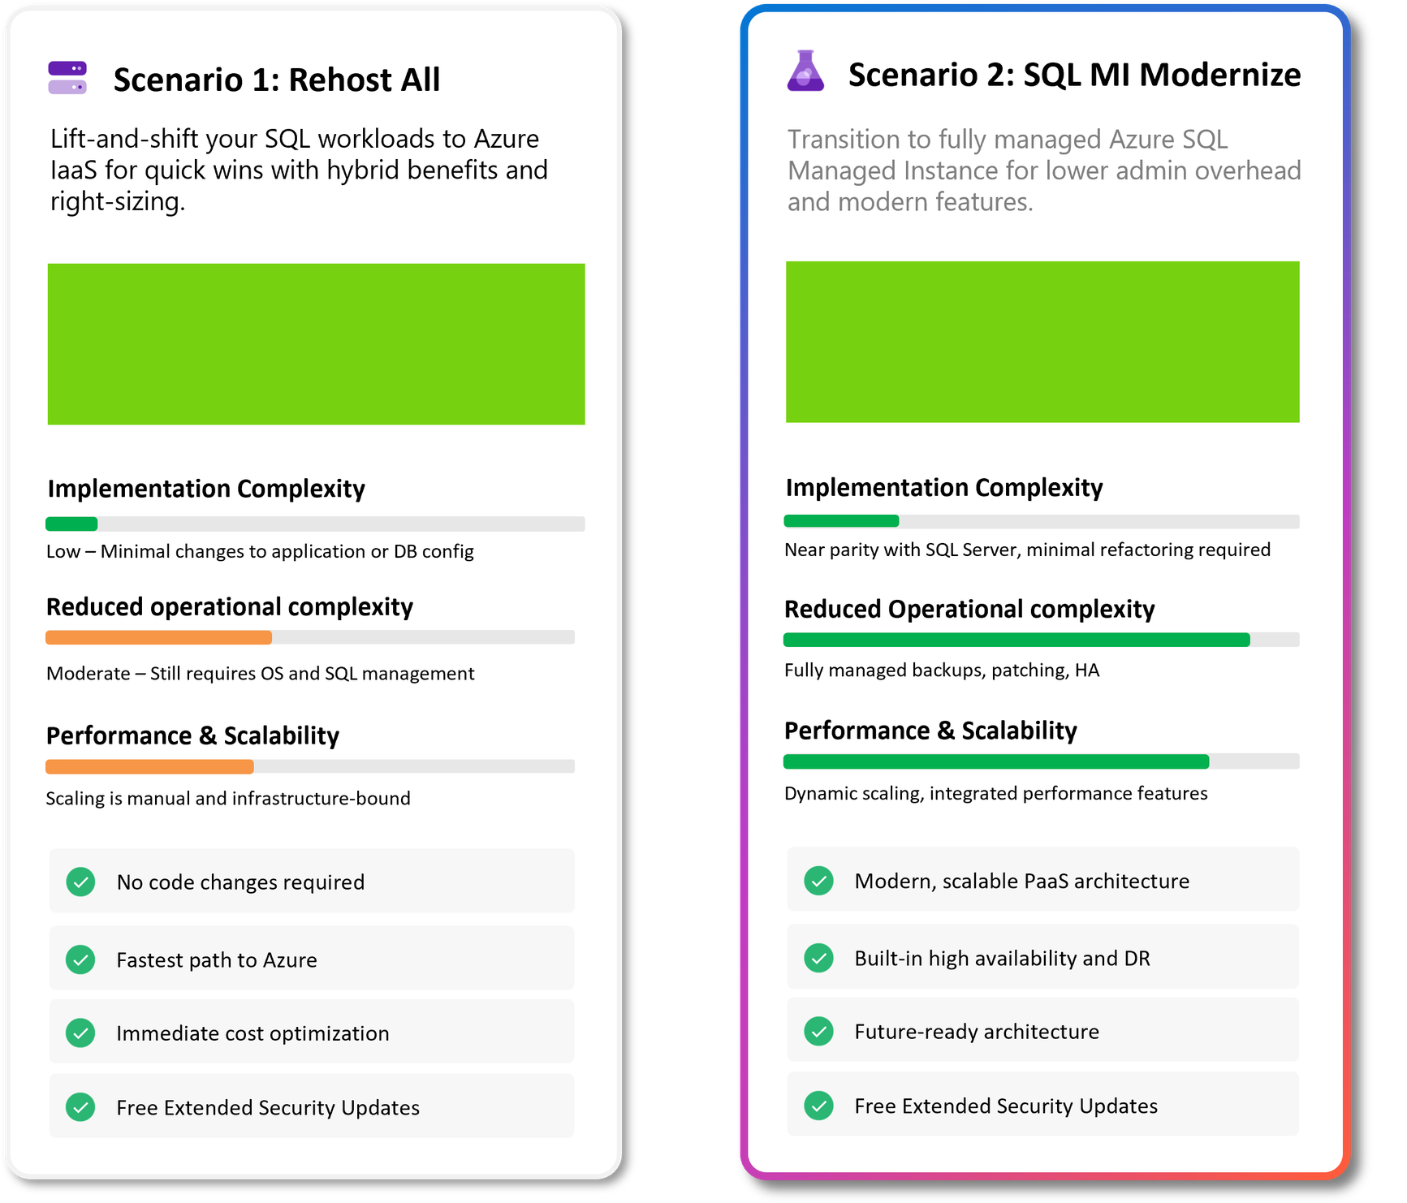


12A4C5B8-8F62-437C-9E3B-6F7D1A9C0B52
SQL Migration Scenarios
These example scenarios illustrate potential migration pathways to Azure with SQL - each offering different levels of transformation, complexity, and benefit. While directional in nature, they serve as a starting point for discussion and can be tailored in the next planning phase to align with your unique strategy, timeline, and platform goals.
Notes:
• Estate: 30 on-prem SQL servers are candidates for Azure migration; two clear pathways surface. • Rehost (IaaS VMs) – Lowest disruption: lift-and-shift with Hybrid Benefit, no code changes. – Immediate annual OPEX reduction ≈ $34 K through right-sizing and license reuse. – Residual effort: teams still manage OS, patching, backups, and manual scaling; technical debt remains. – Ideal as a rapid cost-relief or interim move that secures free Extended Security Updates while larger transformation plans mature. • Modernize to Azure SQL Managed Instance (PaaS) – Near-parity with SQL Server enables minimal refactor but unlocks fully managed backups, patching, HA, and DR. – Smaller direct savings (~$1.5 K/yr) yet significant indirect savings by offloading administration and reducing outage risk. – Provides elastic scaling, built-in security, and a future-ready platform for additional PaaS services or data innovation. Strategic Considerations • Align choice to business timeline: Rehost accelerates migration; Modernize accelerates value and resilience. • Hybrid approach—rehost first, then modernize critical or growth workloads—can balance speed, risk, and ROI. • Both options extend security support, but only PaaS materially enhances cyber-resilience and operational agility. Exploratory Questions 1. Which workloads justify higher platform resilience and managed services today versus a staged modernization later? 2. How do current DBA and infrastructure skillsets influence our appetite for continued OS/SQL management? 3. What is the acceptable trade-off between immediate cost savings and longer-term innovation velocity? The following has been generated by AI. Consider checking important facts.

Slide 29

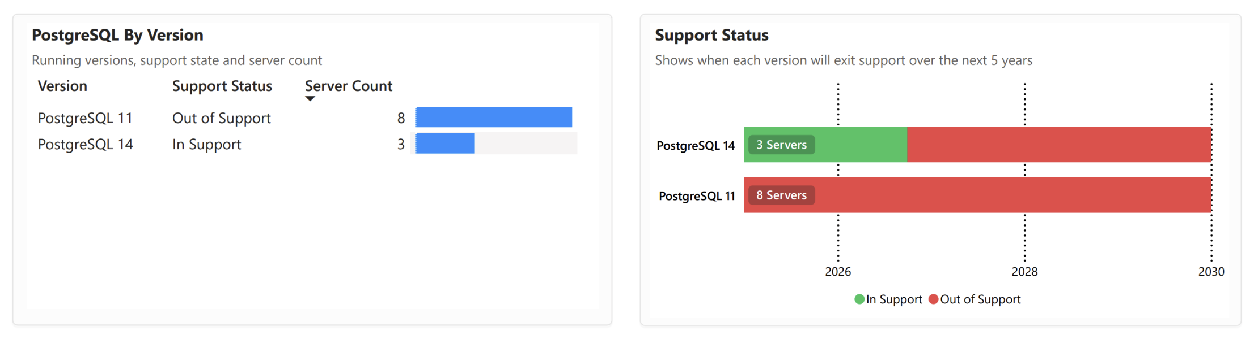
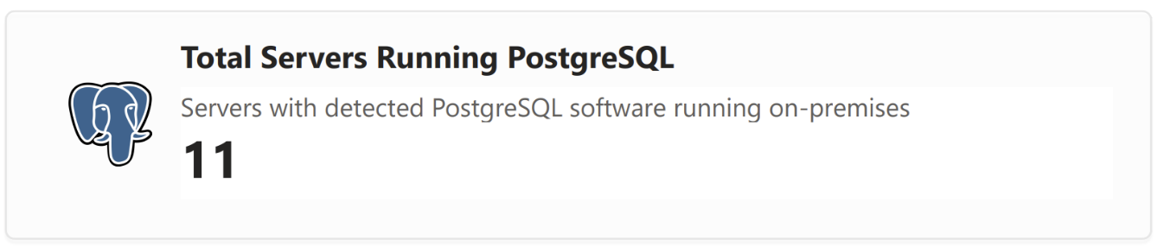
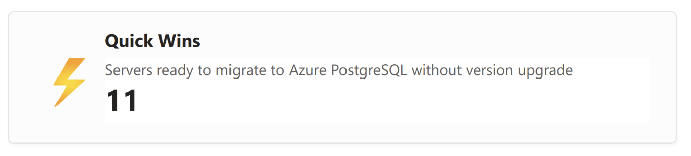
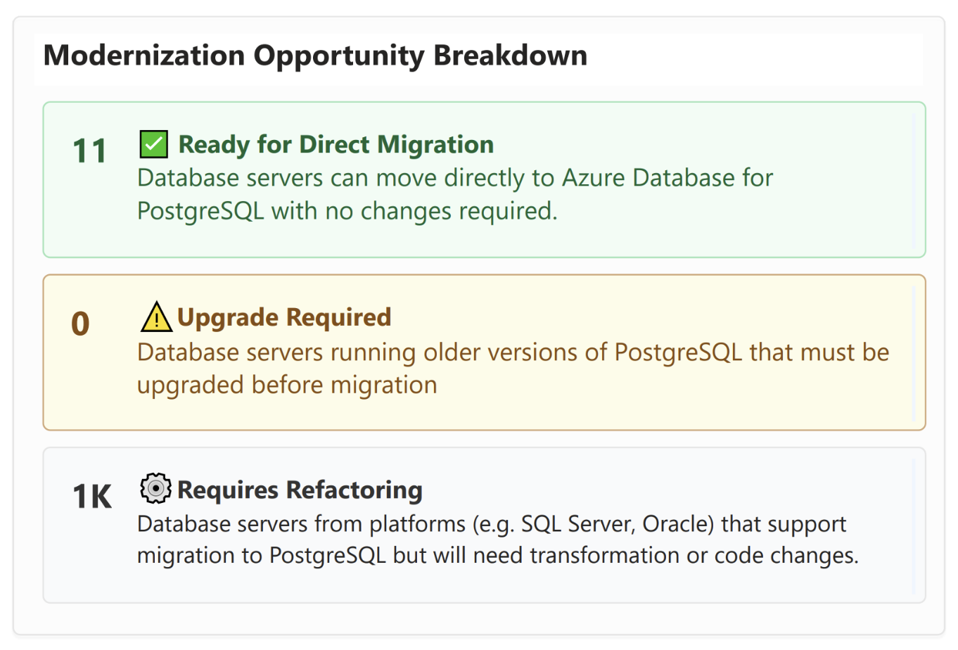
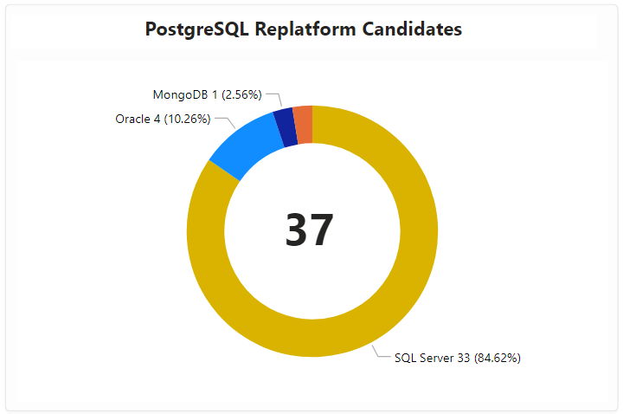
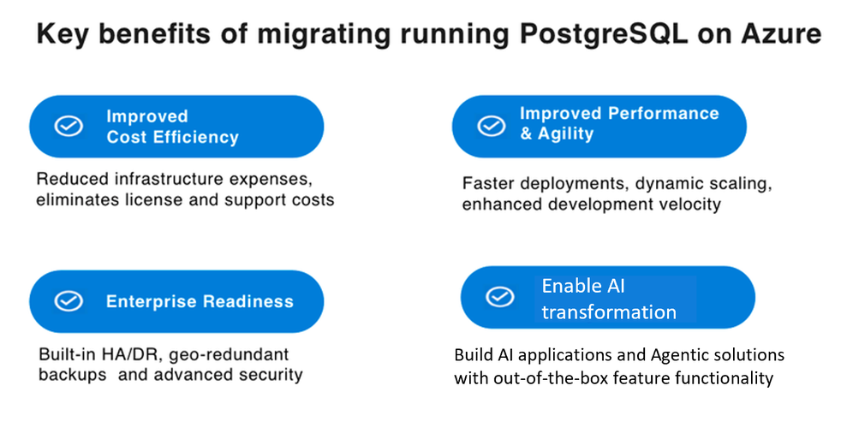
3E9F1B7A-4C6D-49E2-BF13-8A7D5C2E1F90
PostgreSQL Inventory
Get a clear view of your PostgreSQL footprint, support status, and modernization readiness.
Notes:
There are 11 on-premises PostgreSQL servers, with all 11 ready for direct migration to Azure without requiring upgrades.
Support status shows 8 servers running PostgreSQL 11, which is already out of support, and 3 servers running PostgreSQL 14, which remains supported until 2026.
Migration presents a quick win to reduce risk exposure while improving operational efficiency by moving out-of-support workloads into a secure, managed environment.
Beyond these 11 servers, 37 workloads from other platforms (mainly SQL Server at ~85%, Oracle at ~10%, and a small MongoDB footprint) are candidates for replatforming to PostgreSQL.
Azure migration provides cost efficiency, enhanced performance, enterprise-grade reliability with built-in HA/DR and geo-redundant backups, and opportunities to enable AI-driven transformations using advanced platform capabilities.
Exploratory Questions
Which of the out-of-support PostgreSQL 11 workloads are business-critical and should be prioritized in the migration schedule?
How can the replatforming candidates be sequenced to align with modernization and cost-saving goals?
What governance and monitoring processes need to be in place to optimize Azure PostgreSQL performance post-migration?

Slide 30
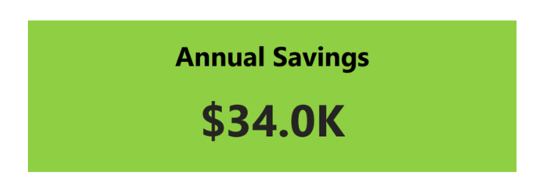
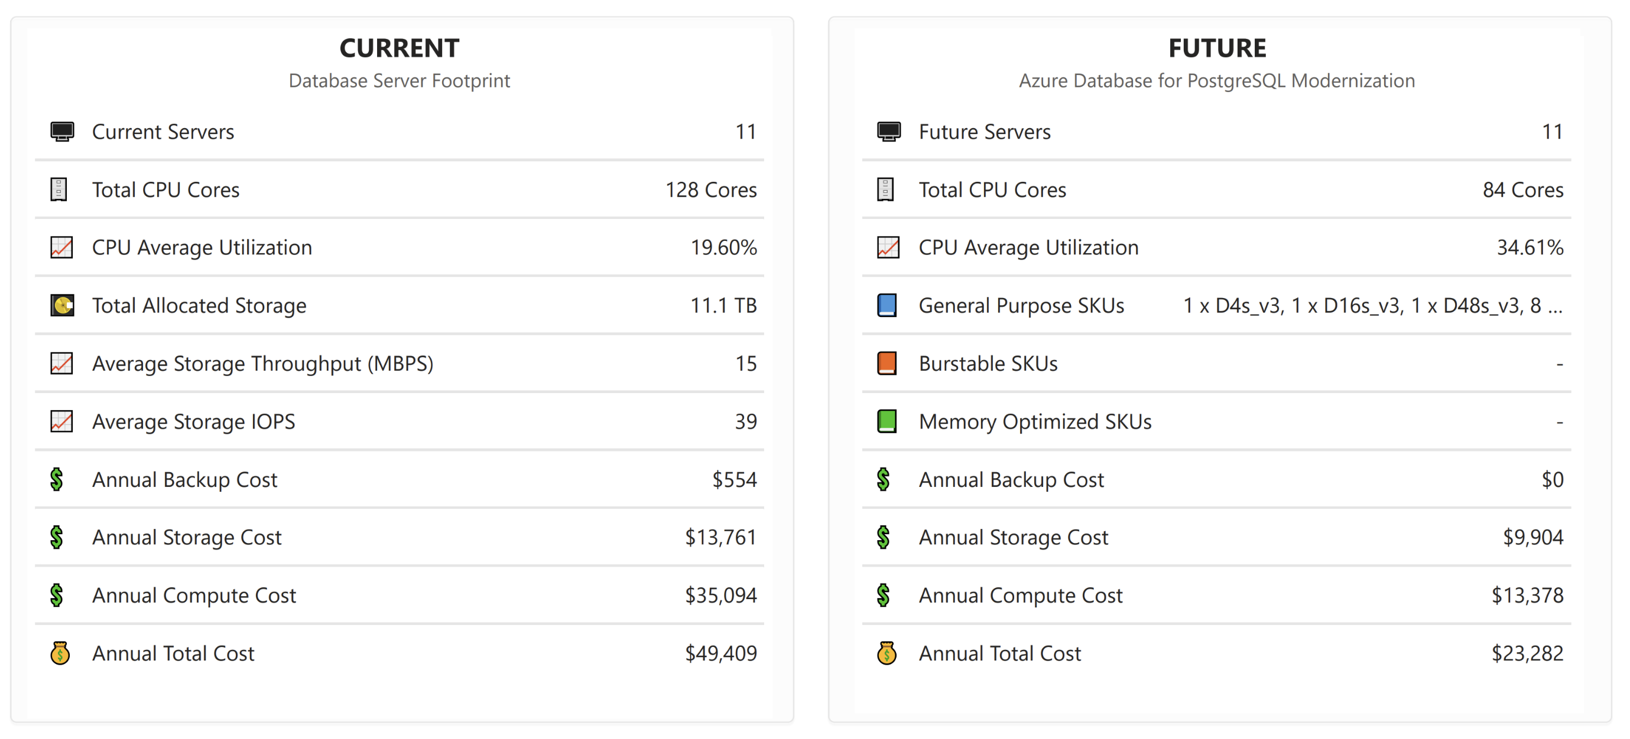
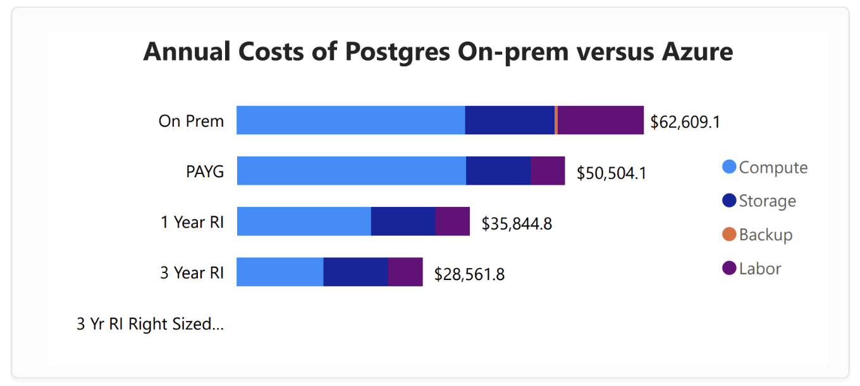
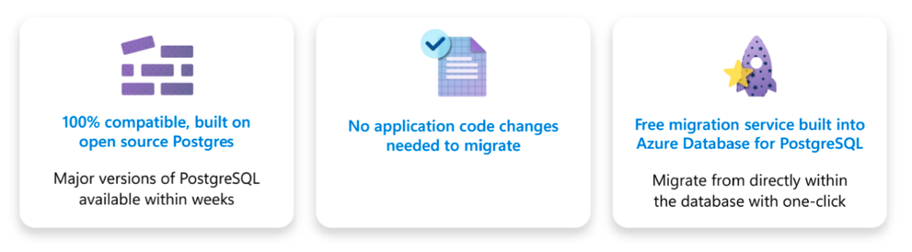
B2D7E1C4-8F3A-47AD-91BC-6A0E9D2F4C85
PostgreSQL to Azure PostgreSQL Scenario
Shifting PostgreSQL workloads to Azure delivers immediate savings and better CPU utilization with fewer cores. Built-in migration tooling and platform-native benefits accelerate modernization with minimal disruption.
*Non-PostgreSQL are not included in this scenario
See What's Driving These Savings
Explore real-world PostgreSQL Modernization results here.
Notes:
Migrating PostgreSQL workloads from on-premises to Azure reduces annual costs from roughly $49,400 to $23,300, delivering approximately $34,000 in yearly savings.
CPU cores required drop from 128 to 84, improving utilization efficiency from 19.6% to 34.6% and optimizing infrastructure use.
Backup and storage costs decrease, with backup costs eliminated entirely and annual storage expenses reduced by about 28%.
Azure’s built-in migration tooling and platform-native features streamline modernization, minimizing operational disruption during the transition.
Maintaining compatibility with open-source PostgreSQL ensures existing applications work seamlessly, avoiding the need for code changes.
Exploratory Questions
How can these savings be reinvested to support other modernization initiatives across the environment?
What governance should be in place to maintain high utilization efficiency after migration?
How can the migration process be leveraged as a blueprint for other database workloads?

Slide 31

B8D14E3F-26A9-4827-9D63-7E50C41F2A89
Modern Workplace Services
Empowering productivity, collaboration, and security through integrated digital experiences.

Slide 32
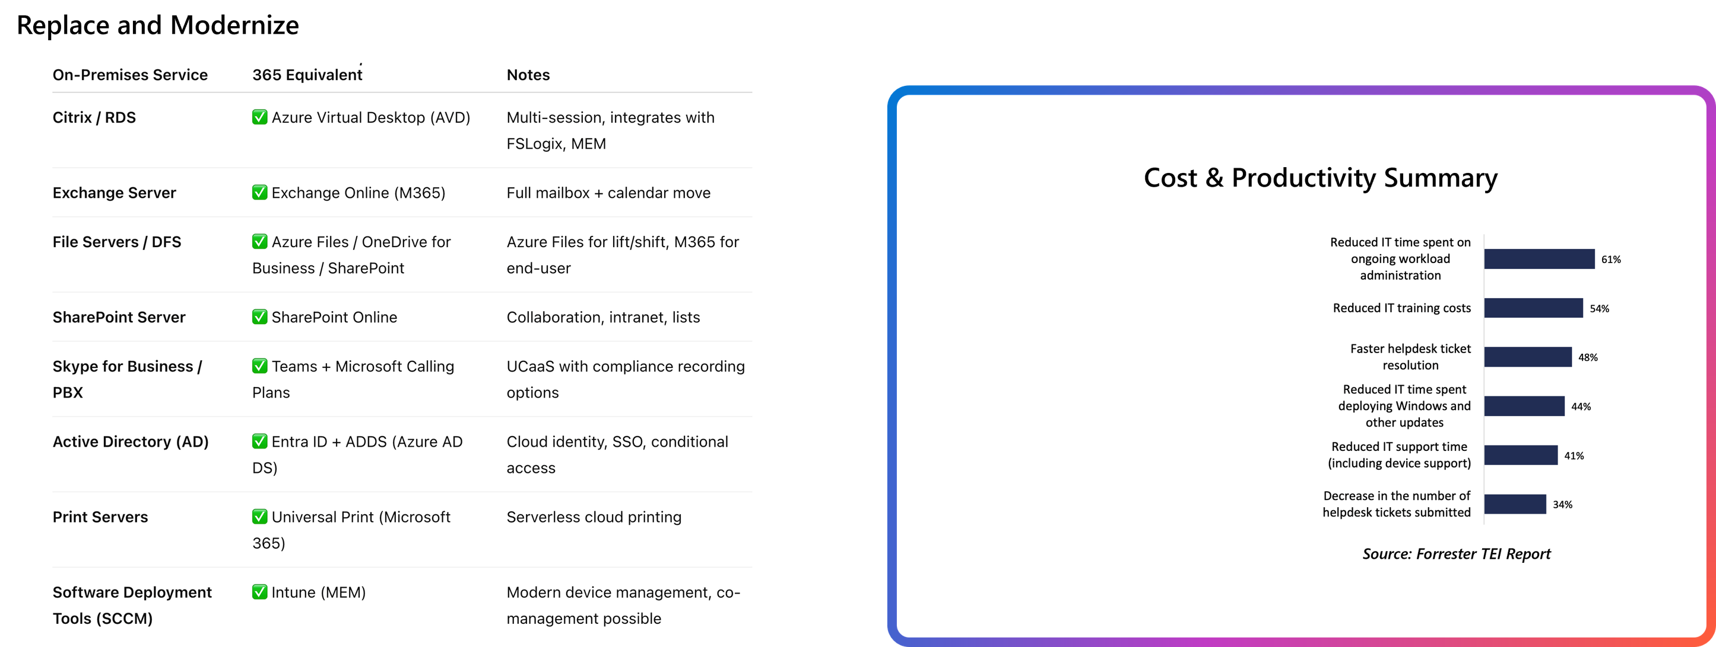

6F39B7A2-5D0C-46C1-8A74-93B1E2D7C540
Modern Workplace
This snapshot outlines your current workplace services, mapping legacy infrastructure to Microsoft 365 equivalents. It highlights cost, support, and management savings - surfacing key opportunities to streamline and modernize.
Notes:
• Retiring eight on-prem workloads (RDS, Exchange, file, SharePoint, Skype/PBX, AD, print, SCCM) and adopting Microsoft 365/Azure equivalents removes ~40 servers and unlocks an estimated $60.7 K in annual infrastructure savings. • Cloud services—AVD, Exchange Online, Azure Files/OneDrive, SharePoint Online, Teams Calling, Entra ID, Universal Print, and Intune—provide built-in scalability, multi-session support, unified device management, and serverless print, creating a modern platform for hybrid work. • Forrester benchmarks show material productivity benefits: – 63 % less IT time spent on routine admin – 54 % lower training costs – 48 % faster help-desk resolution – 34 % fewer tickets submitted These efficiencies free IT capacity for innovation and speed up user support. • Security posture strengthens through Entra ID-based conditional access, SSO, and zero-trust policies, while removing legacy server vulnerabilities and end-of-support risks. • A phased migration is feasible: lift file shares to Azure Files first, then transition user services to M365 to minimize business disruption and align spending with value realization. • Teams with Calling Plans replaces traditional PBX/Skype, delivering UCaaS with native compliance recording and reducing telephony OPEX. Exploratory Questions 1. Which legacy workloads present the highest security or support risk today, and should therefore be prioritized in the migration roadmap? 2. How can we reinvest the forecasted $60 K+ annual savings to accelerate additional modernization (e.g., analytics, automation)? 3. What change-management actions (training, adoption programs) are required to realize the full productivity gains outlined? The following has been generated by AI. Consider checking important facts.

Slide 33

2B9E7D15-43C8-46F1-A91C-8D24F9A3C7E5
Enhanced IT Services
Modernize IT productivity, management and compliance

Slide 34


C7A13D9F-9F28-4E0B-872A-3B59E6D4F120
IT Tooling Sprawl
Multiple overlapping tools across the server environment increase cost, complexity, and risk. Consolidating to native Azure services simplifies operations and reduces overhead.
Fewer Tools = Less Work
Moving to native Azure services reduces the effort spent managing agents, credentials, patching schedules, and multi-vendor integration.
Notes:
Key Insights • 21 separate security, monitoring, backup, and patch-management tools are installed across only 113 servers—an unusually high ratio that drives cost, complexity, and inconsistent coverage. • Security tooling alone accounts for ~80% of server agents; monitoring and backup are fragmented across numerous low-usage products, creating gaps and duplicated effort. • Every additional agent introduces license fees, patching cycles, credential management, and potential attack surface—heightening operational risk and audit exposure. • Azure-native services (Defender for Cloud, Azure Monitor, Azure Backup/Site Recovery, Update Management) cover the same functional needs while embedding identity, policy, and compliance controls. • Consolidating to these native services can eliminate 70-80% of current third-party tools, reducing vendor spend, simplifying operations, and unifying security telemetry—critical for Zero-Trust, automated patching, and future DevSecOps adoption. • Recommendation: Launch a phased tool-rationalization program tied to migration waves, with clear exit plans for redundant licenses and metrics for cost avoidance, MTTR, and compliance posture. Exploratory Questions 1. Which upcoming license renewals offer the quickest ROI if we switch to Azure-native equivalents now? 2. How will a single security and monitoring platform accelerate our progress toward Zero-Trust and regulatory certifications? 3. What governance and KPI framework is required to prevent tooling sprawl as we scale further in Azure? The following has been generated by AI. Consider checking important facts.

Slide 35



F3B7A2C9-50D1-42E6-8E9F-5C8A47D29B61
From Sprawl to Simplicity
Replace fragmented on-prem tools with streamlined, cloud-native solutions - simplifying operations, reducing cost, and unlocking modern capabilities.
Notes:
• Current estate shows 21 disparate on-prem IT tools; six high-touch workloads alone run duplicate backup, monitoring, and patching platforms. • Replacing them with native Azure services (Backup, Monitor, Application Insights, Update Management) enables: – Centralised, policy-driven backup & DR across VMs, SQL and file shares, removing manual tape/agent management. – Unified observability for applications, databases, and infrastructure, eliminating multiple licence fees and data silos. – Automated, compliance-aligned patching for servers and endpoints, reducing vulnerability exposure and labour hours. • Expected outcomes: 20-40% OpEx reduction from licence retirement and tool rationalisation; faster incident response through single-pane monitoring; and improved security posture via consistent cloud controls. • Consolidation is a low-risk, high-impact first step toward broader cloud modernisation, freeing budget and talent for strategic initiatives such as analytics or AI. Exploratory Questions 1. Which legacy contracts renew in the next 6-12 months, creating an immediate window to shift spend toward Azure native services? 2. How can we phase tool consolidation to coincide with our migration roadmap, ensuring quick wins without interrupting critical operations? 3. What governance model is needed to maintain cost and security benefits once monitoring and backup are centralised in Azure? The following has been generated by AI. Consider checking important facts.

Slide 36

9E4B6F82-71A5-4C0D-B9D3-2A18E5F74C93
How Azure Reduces Operational Overhead
Azure modernization doesn't just reduce cost - it unlocks scale. Fewer hours, fewer tickets, more systems under management. Less admin, more impact.
Notes:
Key Takeaways (≈150 words) • Azure modernization generates outsized returns—200-478% ROI across IaaS, PaaS, and hybrid management—with payback in as little as six months, freeing budget for innovation. • Migrating core workloads to Azure VMs delivers the highest economic impact (478% ROI) while cutting infrastructure management effort by 37% and doubling admin throughput. • Moving to Azure App Service, SQL Managed Instance, and Integration Services accelerates application delivery by up to 50%, lowers infrastructure costs by 40%, and lifts DBA/developer productivity by 40%, supporting faster time-to-market. • Azure Arc imposes unified governance across on-prem, edge, and multi-cloud estates, improving IT-ops productivity by 30% and reducing breach risk by 50%—a critical control as the attack surface expands. • Overall, Azure-native tooling allows each administrator to manage 2× more systems and storage capacity, redirecting skilled staff toward higher-value projects rather than routine upkeep. Exploratory Questions 1. Which workloads offer the quickest 6–15-month payback, and how can we sequence migrations to maximize near-term ROI? 2. How will we redeploy the 30–50% productivity gains—cost takeout, accelerated innovation, or enhanced governance? 3. What governance and change-management actions are required to fully leverage Azure Arc’s security and compliance benefits? The following has been generated by AI. Consider checking important facts.

Slide 37

8A71D2E6-39C5-4BFA-9D27-1C0B3E4F85A2
Security Services
Modernize IT productivity, management and compliance

Slide 38

0F4C5A92-7E36-41D9-8C4B-6A27F3B9E510
Security Coverage & Exposure Overview
A consolidated view of security posture across the server fleet, highlighting supportability gaps, unprotected systems, overlapping toolsets, and opportunities to streamline and harden your environment.
Notes:
• 70 servers are already on unsupported OSs and a further 577 will move to extended support soon—over 600 assets will require immediate upgrade or migration to avoid escalating licensing fees and unpatchable vulnerabilities. • 108 servers have no security agent installed, leaving critical blind spots for threat detection and compliance reporting. • Current endpoint posture shows 18.2 % of servers lack threat-protection coverage and 18.5 % are outside patch-management scope—any breach could propagate rapidly across almost one-fifth of the estate. • Tool sprawl is significant: 28 different security products are deployed, with clear overlap in threat protection, patching, IAM and SIEM. This dilutes effectiveness, inflates OpEx and complicates incident response. • Consolidating on native Azure security and management services (Defender for Cloud, Azure Arc, Sentinel) can simultaneously reduce costs, close coverage gaps and streamline governance while positioning workloads for cloud or hybrid migration. • Remediating unsupported OSs and enforcing agent compliance before cloud onboarding will lower technical debt and enable a smoother roadmap to modernization, zero-trust, and potential GenAI initiatives. Exploratory Questions 1. Which workloads on unsupported or soon-to-expire OSs are viable candidates for rapid re-platforming to Azure PaaS or container services? 2. What cost and risk reduction can we realize by rationalizing the 28 security tools into an Azure-centric platform, and what is the target timeline? 3. How will we enforce ongoing agent compliance (e.g., via Azure Policy or Arc) to prevent future coverage drift after migration? The following has been generated by AI. Consider checking important facts.

Slide 39

A9E5F72D-81B4-45C1-92D7-0C36B8F4A29E
Security Tool Sprawl
Multiple endpoint, identity, and security monitoring tools found across the server estate. Consider rationalizing where possible to reduce complexity and overhead.
Notes:
• Security landscape is highly fragmented: 28 distinct tools are deployed across endpoint, identity, SIEM, and patch management, creating operational complexity and inconsistent protection. • Endpoint security alone uses six overlapping products, yet coverage is uneven—two legacy agents (Trellix, McAfee) run on >450 servers each, while four others protect <15 servers combined. • Patch management is split between SCCM (483 servers) and a lightly-used SolarWinds instance, increasing maintenance overhead and audit scope. • Identity & Access Management is spread across 10 tools; multiple privilege-management and federation solutions introduce redundant licensing and expand the attack surface. • Only one SIEM platform is present, but it monitors just three servers, indicating limited centralized detection and response capability. • Nine “other” security utilities (Skyhigh, Check Point, RSA, CyberArk cloud, etc.) add rule conflicts and raise risk of misconfiguration. • Tool sprawl drives higher licensing costs, complex upgrades, and slower incident response; it also hampers a unified move to Azure native security (Defender, Sentinel, Entra ID). • Consolidation could free budget for modernization, simplify compliance reporting (e.g., ISO, PCI), and enable consistent policy enforcement across hybrid and multi-cloud estates. Exploratory Questions 1. Which security functions could be transitioned first to Microsoft Defender or Sentinel to reduce overlap without disrupting critical workloads? 2. What cost-savings and resilience targets should we set to justify a phased retirement of low-value or legacy tools? 3. How can we align IAM consolidation with Zero-Trust and cloud-first strategies to streamline both on-prem and Azure environments? The following has been generated by AI. Consider checking important facts.

Slide 40



D2E8A7C3-9B15-49E4-85C2-7A19F3E0B64D
Reducing Security Tool Overlap
This is an opportunity to simplify operations, cut costs, and improve coverage by consolidating around Microsoft's integrated security stack.
Notes:
Key Takeaways • Tool sprawl: 28 overlapping security products drive unnecessary licence, infrastructure and support costs while fragmenting threat visibility. • Consolidation path: Replacing on-prem tools (e.g., SCCM, Trellix/McAfee, Symantec, Carbon Black, SolarWinds, Check Point) with Azure-native services—Defender suite, Sentinel SIEM, Entra ID, Firewall, Key Vault, Update Management—creates a single, integrated security stack. • Financial upside: Retiring duplicate licences and decommissioning server infrastructure is projected to cut OpEx 20-40 %, while Microsoft E5 bundling further reduces net spend. • Security uplift: – Unified telemetry and automated response shorten mean-time-to-detect/respond. – Cloud-based patching and endpoint protection extend coverage to remote/hybrid users without VPN dependency. – Entra-based identity, privileged access and certificate services advance Zero-Trust objectives and reduce audit gaps. • Operational efficiency: Fewer vendors, simpler procurement and one pane of glass (Sentinel) free staff capacity for higher-value initiatives and support future cloud modernization. Exploratory Questions 1. Which legacy security contracts or hardware refresh cycles expire soonest, allowing rapid cost take-out? 2. What phased migration roadmap (by tool category, business unit or region) best balances quick wins with change-management risk? 3. How will we track and report consolidated platform ROI—both financial and risk-reduction—to sustain executive sponsorship and budget? The following has been generated by AI. Consider checking important facts.

Slide 41


6E14B9A3-2D87-4F1C-9E5A-3B7C8D20F594
Extended Security Updates
Tooling Breakdown by Category and Server Count
Extended Security Updates (ESUs) provide critical security coverage for out-of-support Windows and SQL workloads. By migrating to Azure, you receive ESUs at no cost. For workloads that must remain on-premises, Azure Arcoffers a flexible, pay-as-you-go option to stay protected - no need for upfront licensing.
Notes:
Key Takeaways • 400 Windows and SQL servers will exit mainstream support; without action we must purchase Extended Security Updates (ESUs). • Migrating these workloads to Azure grants ESUs at zero cost, avoiding $2.42 M over three years—funds that can offset migration or modernization investments. • Remaining on-prem and buying ESUs via Azure Arc costs the full $2.42 M (≈ $424 K for SQL, ≈ $1.996 M for Windows) and still leaves ageing infrastructure and higher cyber-risk. • Azure migration not only eliminates ESU fees but immediately improves security posture, compliance, and positions workloads for further cloud-native transformation (PaaS, containers, AI services). • Azure Arc offers a flexible, pay-as-you-go safety net for any workloads that truly must stay on-prem, allowing a phased, hybrid approach without upfront licensing. • Timing is critical: delaying migration past support deadlines exposes the organisation to unpatched vulnerabilities and forfeits the identified cost avoidance. Exploratory Questions 1. Which of the 400 servers have genuine technical or regulatory constraints preventing cloud migration, and what is the business case for addressing those constraints? 2. How should we reinvest the $2.42 M cost avoidance to accelerate application modernization or bolster security capabilities? 3. What executive sponsorship and cross-functional resourcing are needed to ensure migration completes before support expiry dates? The following has been generated by AI. Consider checking important facts.

Slide 42

B3C72E19-45A8-47F0-8D26-1E5B9A34C7F2
Next Steps
Turn assessment findings into a clear, prioritized migration and modernization plan.

Slide 43

E1B5C93F-7A2D-4C86-9F30-5B7D2E4A19C8
Opportunity Snapshot
The following insights highlight tangible opportunities to reduce cost, simply operations and modernize legacy systems. They will be explored and prioritized further during the migration strategy planning phase.
Infrastructure
Modernize
Enhance Services
Notes:
Key Insights for Executive Action • Immediate cost-out: Rightsizing and retiring “zombie” servers can release ≈$782 K OPEX per year. • Compliance & security: Moving end-of-support operating systems to Azure avoids ≈$2 M in extended-security fees over three years and eliminates a growing vulnerability surface. • Fast migration runway: 682 servers are lift-and-shift ready, enabling rapid cloud adoption while longer-term modernization is planned. • Modernization scale: 2,075 workloads qualify for PaaS; shifting them can cut admin effort by 37 % and accelerate feature delivery. • Data platform uplift: Consolidating SQL instances onto Azure SQL reduces licensing/maintenance and begins a controlled path to managed databases. • Tool rationalization: Retiring 80 third-party IT tools and collapsing six security products into Microsoft Defender for Cloud simplifies governance, lowers spend, and improves threat visibility. • Resilience & unified ops: 20.6 TB is already earmarked for Azure Backup, and Azure Arc can provide single-pane management across on-prem and multi-cloud estates. Exploratory Questions 1. Which workloads should be prioritized to capture the first $782 K savings without disrupting business operations? 2. How will we structure funding and incentives to accelerate the PaaS modernization of 2,075 candidates? 3. What governance model will oversee tool consolidation and ensure security, compliance, and cost objectives are met post-migration? The following has been generated by AI. Consider checking important facts.

Slide 44
1991C633-99B4-483B-99BB-E41D39B24E42
Next Steps
Workshop 1: Capture Goals Review Rapid Insights to confirm scope and capture migration goals
Workshop 2: Workload Planning Apply migration treatments, generate migration waves
Review Migration Strategy Plan Finalize and present a tailored migration plan and business case aligned to your organization's goals
Explore Microsoft Programs Access Microsoft funding, advisory, and partner programs designed to support and accelerate your cloud migration.

Slide 45


Slide 46

A5D2F7B9-38C1-4E9A-86F2-0B47C1D3E592
Notes:
• New “Application-Level Insights” consolidates all critical data—cost, infrastructure, software versions, usage patterns, and risk scores—into a single view per application, accelerating assessment and decision cycles. • Automated discovery maps each app to its full stack (servers, databases, OS, services), exposing hidden dependencies and potential migration blockers before they disrupt timelines. • End-to-end flow diagrams reveal how apps interact with one another and with shared platforms across runtime, data, network, and security layers, enabling confident refactoring or re-platforming plans. • Built-in modernization fit analysis highlights which workloads are ready for lift-and-shift, containerization, or PaaS adoption, helping prioritize high-value quick wins. • Real-time cost and performance metrics (e.g., memory under-utilization, idle VMs) identify immediate optimization opportunities that can cut run-rate infrastructure spend by up to 35-40%. • Centralized insights strengthen security posture by surfacing outdated OS versions, excessive inbound/outbound connections, and other attack-surface indicators early in the migration journey. • Single-click drill-downs reduce reliance on tribal knowledge, supporting faster alignment between app owners, infrastructure teams, and executives. Exploratory Questions 1. Which high-cost, low-risk applications surfaced by the tool should be fast-tracked for modernization to realize near-term savings? 2. How will the newly uncovered dependency chains influence our phased migration roadmap and potential downtime windows? 3. What governance or tagging updates are required to keep these insights current post-migration for continuous optimization? The following has been generated by AI. Consider checking important facts.

Slide 47

3F8E9C1B-2D74-44A6-9B15-7E2C5A40D9F3
Notes:
Key Insights for Cloud Strategy • Automated 6R engine rapidly classifies each workload as Rehost, Re-platform, Re-architect, Replace, Retain, or Retire—compressing weeks of manual analysis into hours and giving an instant modernization roadmap. • Early scan reveals high-value PaaS fits (Azure App Services, SQL MI, Functions) and several SaaS/ISV replacement options, offering quick wins in cost, agility, and license reduction. • Dashboard quantifies business benefits—speed-to-market, 30-40 % OPEX reduction, stronger resilience, and tighter security—providing clear ROI evidence for funding decisions. • 657 VMs remain “Unassigned,” indicating discovery gaps; ingesting full CMDB and license data is essential to avoid stranded assets and unexpected support costs. • Security view highlights workloads running end-of-support stacks (legacy Java, PHP, Access) that elevate cyber and compliance risk, allowing targeted remediation before migration. • Outputs can feed Azure Migrate, Landing Zone design, and FinOps models, aligning technical execution with budget governance and continuous optimization. Exploratory Questions 1. Which 6R paths (e.g., PaaS moves vs. SaaS replacement) should be prioritized next fiscal year to unlock the greatest cost and agility gains? 2. What additional data sources or resources are needed to classify the remaining unassigned VMs and finalize the migration budget and timeline? 3. How will we embed these modernization insights into ongoing DevOps and security governance to sustain benefits post-migration? The following has been generated by AI. Consider checking important facts.

Slide 48

C1B74E2F-95A8-4C30-8D2E-7F41B3A9E526
Notes:
• The new Wave Planning & Application Complexity tool auto-generates a migration roadmap based on real network topology and business-unit alignment, cutting manual planning effort and reducing sequencing errors. • Built-in effort & complexity scoring highlights “quick-win” applications, allowing us to migrate low-risk workloads first, accelerate time-to-value, and de-risk later, high-impact waves. • Flexible sequencing lets teams reorder waves by owner, data-centre location, software life-cycle stage, or technical complexity—giving the business options to meet regulatory deadlines, M&A milestones, or capacity constraints. • Customisable waves ensure each release aligns with executive priorities and budget cycles, while providing clear checkpoints for governance, testing, and change-management sign-off. • The complexity radar surfaces hidden inter-dependencies (e.g., cross-network traffic, HA configurations, disaster-recovery links) early, enabling proactive mitigation plans and right-sizing of Azure landing zones. • Overall impact: faster migration velocity, higher delivery confidence for partners, and a data-driven basis for cost, risk, and resource forecasting across the cloud programme. Exploratory Questions 1. Which low-risk, high-ROI applications can we target in Wave 1 to demonstrate early business value? 2. How will complexity scoring influence our resourcing model and partner engagement strategy? 3. What governance checkpoints should be embedded between waves to manage security, compliance, and budget oversight? The following has been generated by AI. Consider checking important facts.

Slide 49

4D2A7F8B-63E9-47C1-90B3-2A5F1E8D7C94
Notes:
• Independent TCO assessment shows that migrating 46 applications (585 servers, 202 TB) to Azure can cut annual run-rate from $2.1 M to $0.78 M—an immediate 63 % savings and a $1.3 M cash release each year. • Savings are driven by: – Retiring non-critical workloads and consolidating servers. – Rightsizing and adopting 3-year Reserved Instances and Hybrid-Use Benefits. – Shifting suitable workloads to managed PaaS services, reducing OpEx while improving agility. • Compute costs plunge from $1.44 M on-prem to $0.09 M in Azure; storage and ops costs also drop sharply, freeing budget for innovation. • Embedded sustainability analysis indicates lower energy consumption and carbon output, directly supporting ESG and green-IT commitments without additional spend. • The optimized cloud footing provides a financial stair-step for further modernization (containerization, serverless) while mitigating near-term budget and capacity risks. Exploratory Questions 1. Which high-impact workloads should be prioritized for PaaS or serverless to compound the current savings and speed innovation? 2. How can the $1.3 M annual benefit be reinvested to accelerate security hardening and advanced data analytics in Azure? 3. What governance model (FinOps, Cloud Center of Excellence) is needed to preserve right-sizing discipline and track ESG gains post-migration? The following has been generated by AI. Consider checking important facts.

Slide 50

F904B0EB-6E0E-44A0-B28B-B6F325EFBCF8

Slide 51

92C79416-8116-405E-BF73-AEFB0C113A0B

