Slide 1




4EAB1E31-E20D-4A5A-88A0-262E5757FFDA
Migration Strategy Plan
Prepared for Contoso
Sample Report

Slide 2



77139A84-7F86-46C9-9565-9E73AFAE56A3
Agenda
Executive Summary
Plan
Scope
Goals
Financials
Applications
Approach
6R Treatments
App Sizing
Wave Planning
Next Steps

Slide 3



1DDBE28A-37FB-40BF-8351-1557056BA761
Scope & Financials
Review migration scope and projected TCO

Slide 4

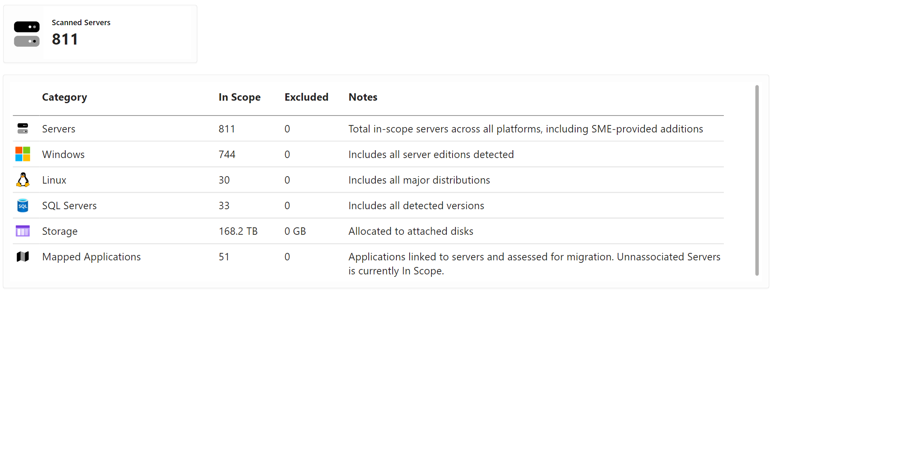
772C7E37-1D78-46A2-ADBB-07C93366E230
Planning Scope
This view summarizes the current state of your environment, highlighting infrastructure scale, efficiency, modernization potential, and end-of-life risks. These insights inform migration strategy, workload prioritization, and cost optimization opportunities across your estate.

Slide 5

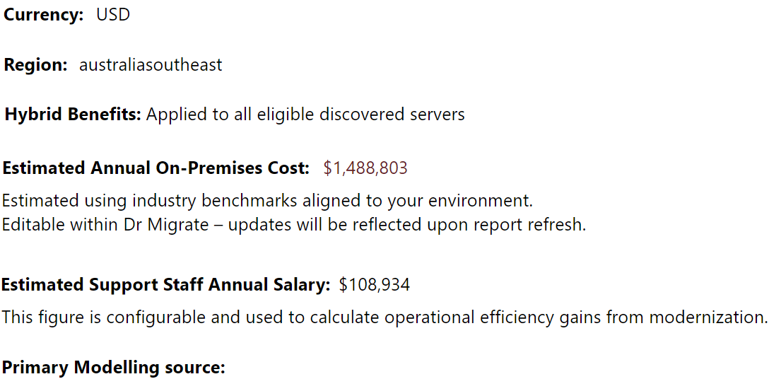

059E4661-284A-444F-B948-5C07A047F9CA
Modelling Details & Assumptions
The following inputs were used to generate the financial insights presented in this pack.
You're In Control
Cost assumptions in this report are fully configurable in Dr Migrate. You can update inputs and regenerate this report to reflect revised models.
Forrester - Total Economic Impact Report

Slide 6


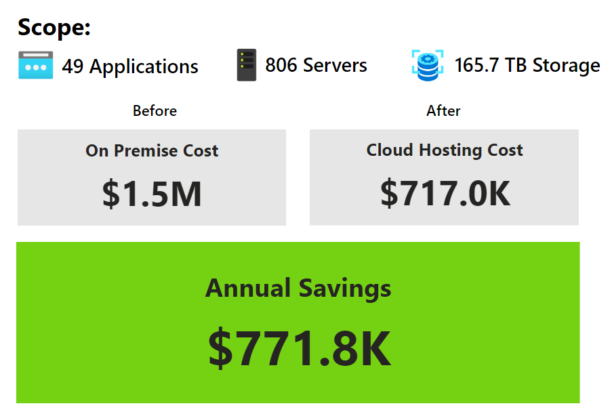
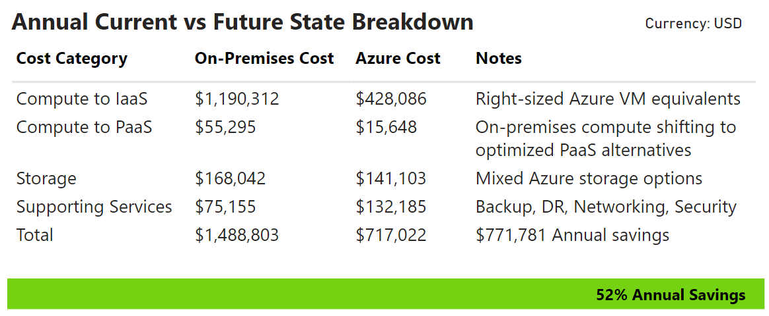

F8D3C9A1-6B2E-4F75-A7D9-1C4B8E2F0A3C
TCO Summary
This report provides an executive-level snapshot of the optimization and modernization planning completed for the environment.
By aligning workloads to the most efficient Azure platforms and leveraging modernization opportunities, the analysis highlights significant savings potential alongside operational improvements.

Slide 7
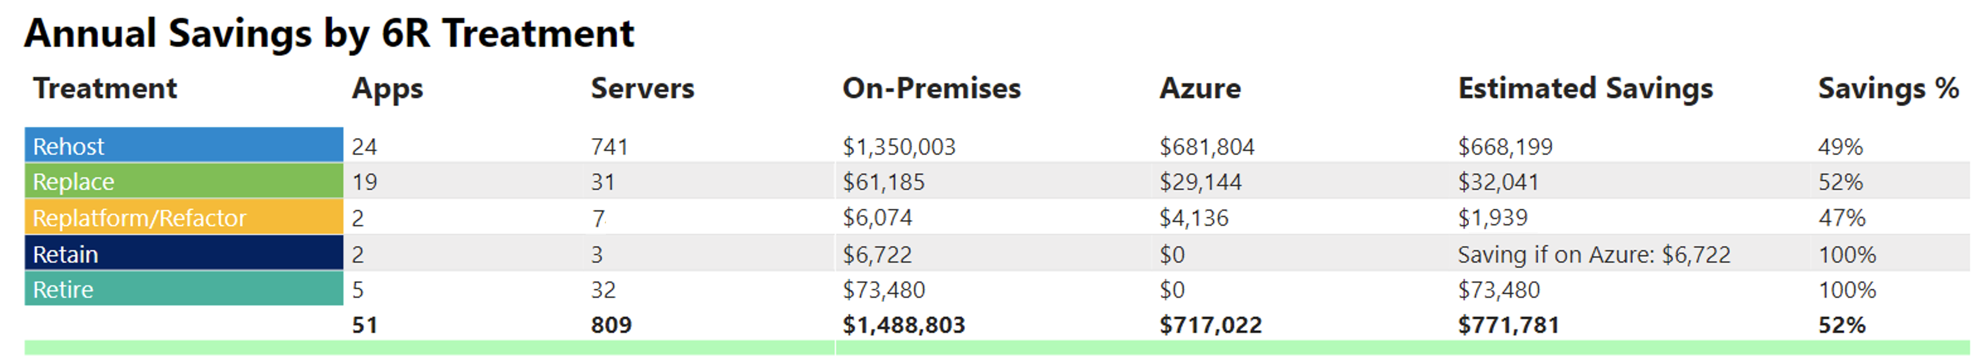

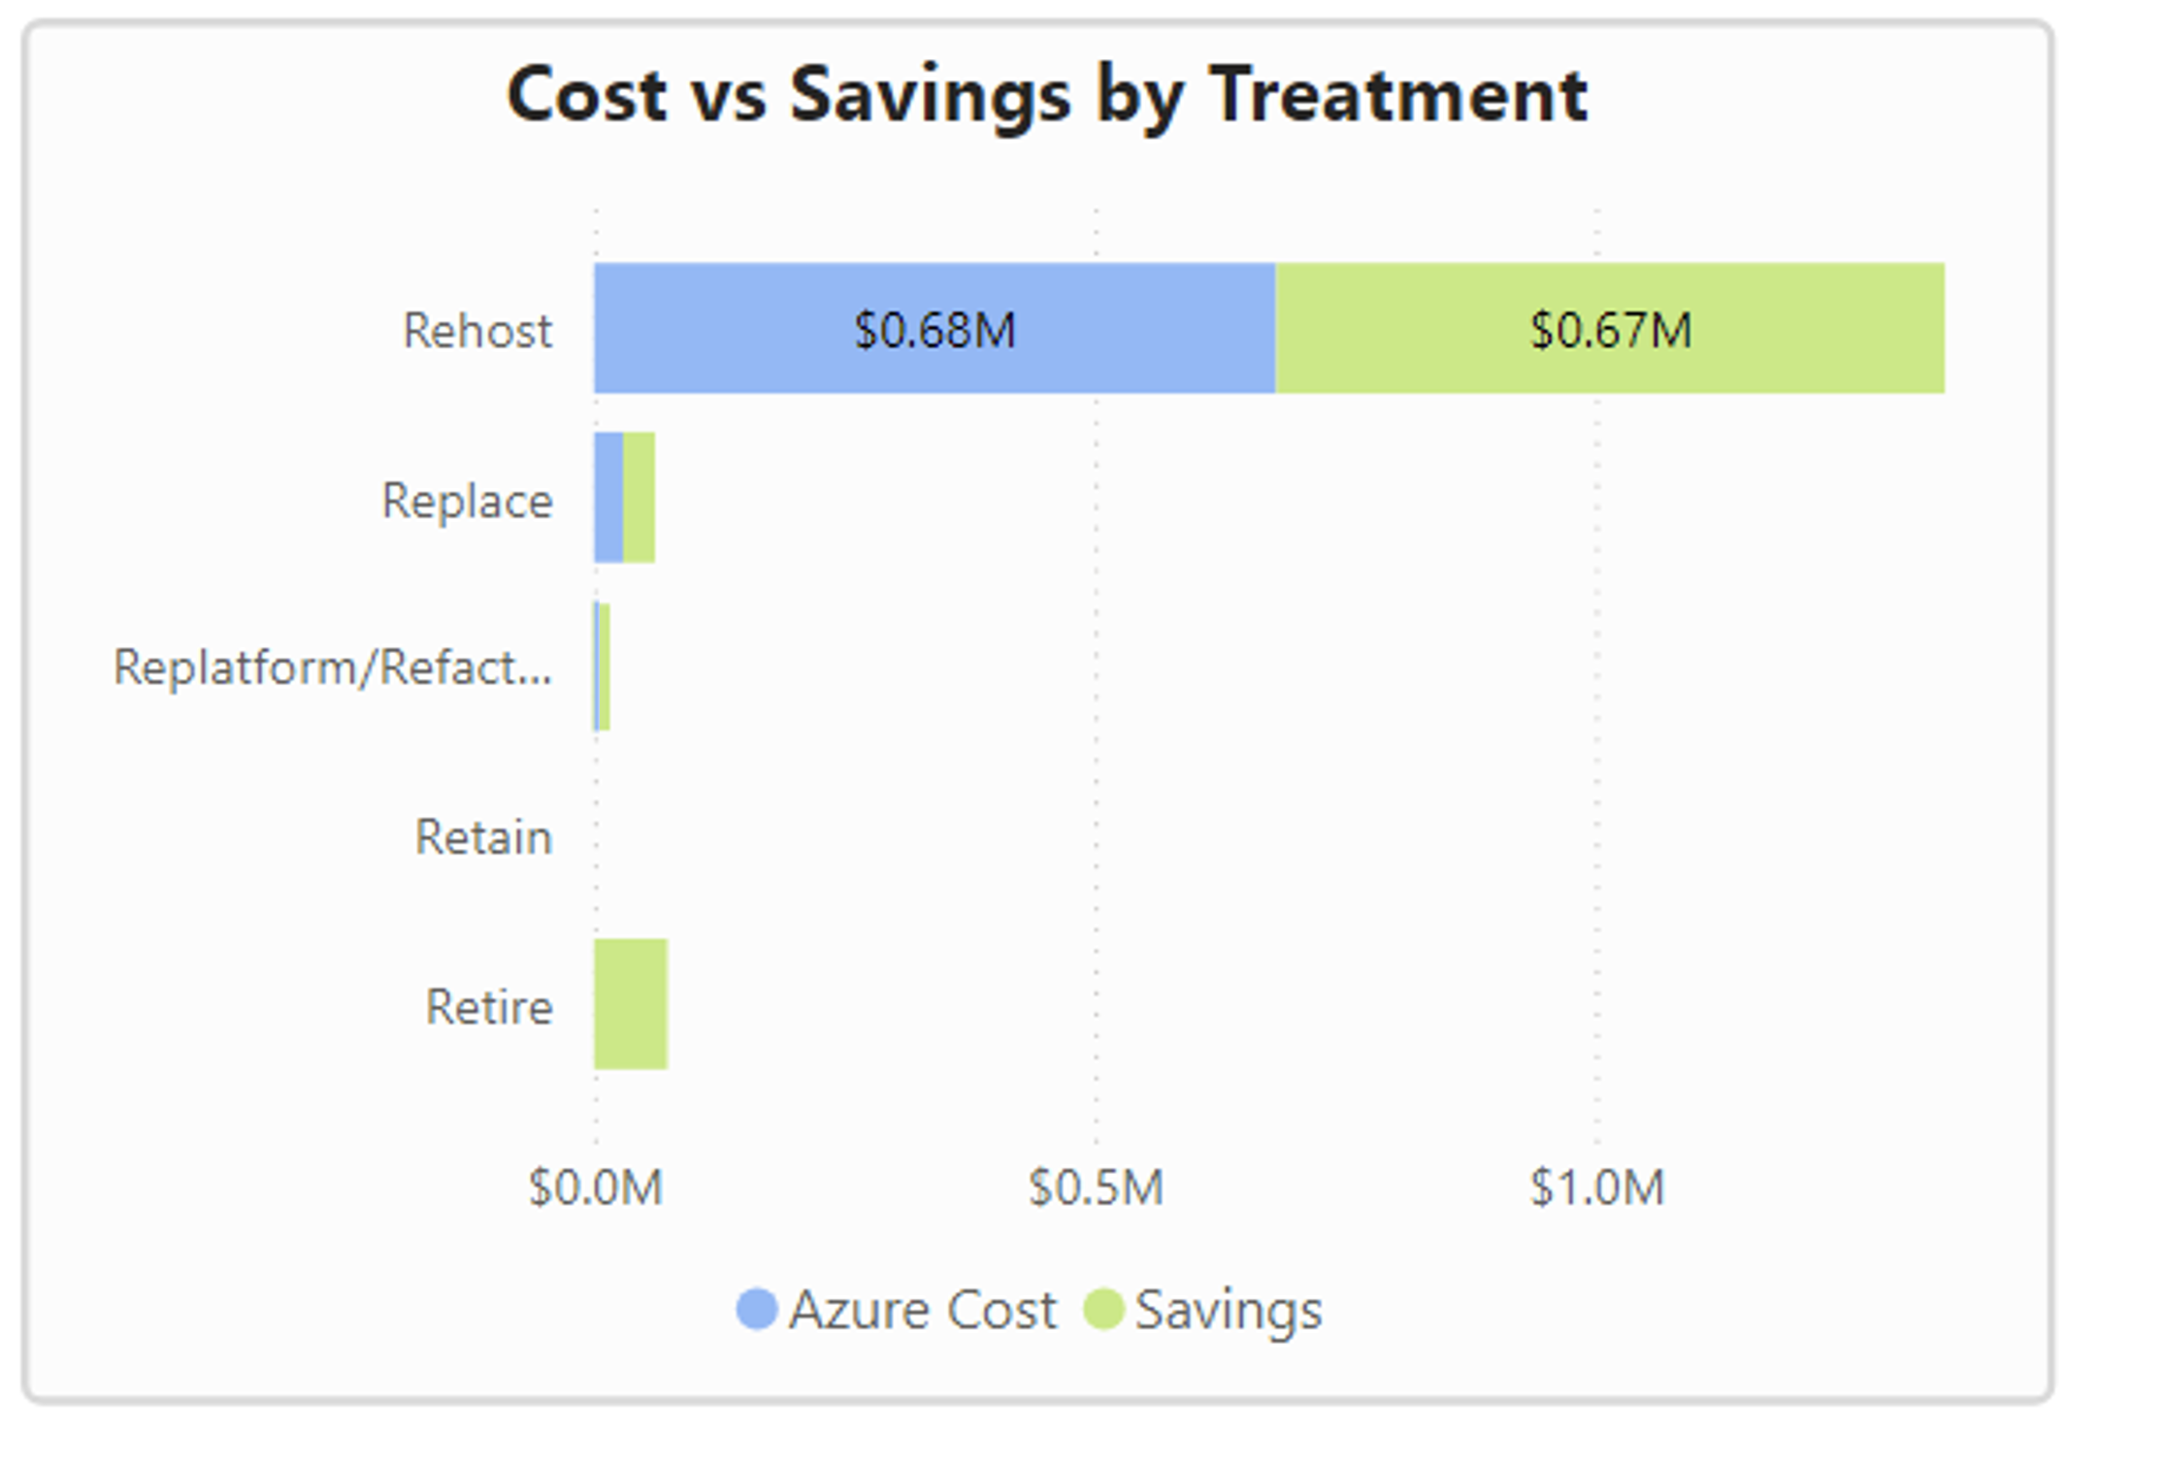
D2DF3B71-F394-4BC8-9035-A5ED9CD749EA
Cost Distribution by Treatment
This view breaks down the total cost savings by each 6R migration treatment. By grouping applications by their assigned treatment, you can see how each migration approach impacts cost - both in absolute dollar savings and as a percentage reduction from on-premises spend.

Slide 8

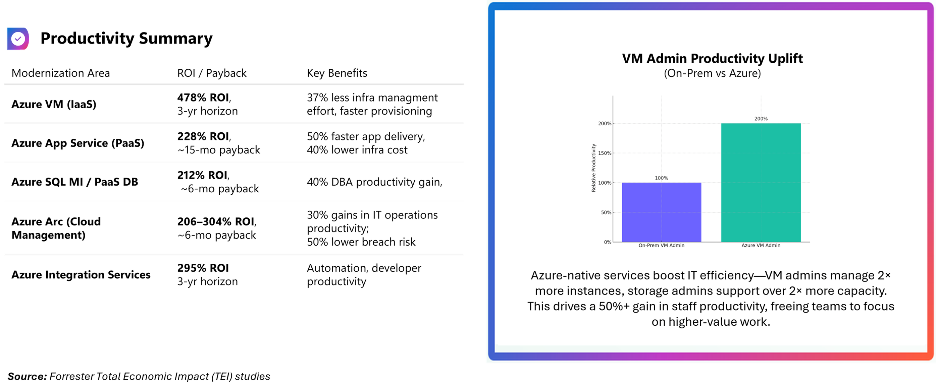
20C91939-BCA1-417C-B41F-2137ECE591F7
How Azure Reduces Operational Overhead
Azure modernization doesn't just reduce cost - it unlocks scale. Fewer hours, fewer tickets, more systems under management.
Less admin, more impact.

Slide 9

D9AE2187-72D0-4D1B-AC1D-251C214D251A
Strategic Migration Plan
Detailed roadmap outlining priorities, timelines, and migration actions.

Slide 10
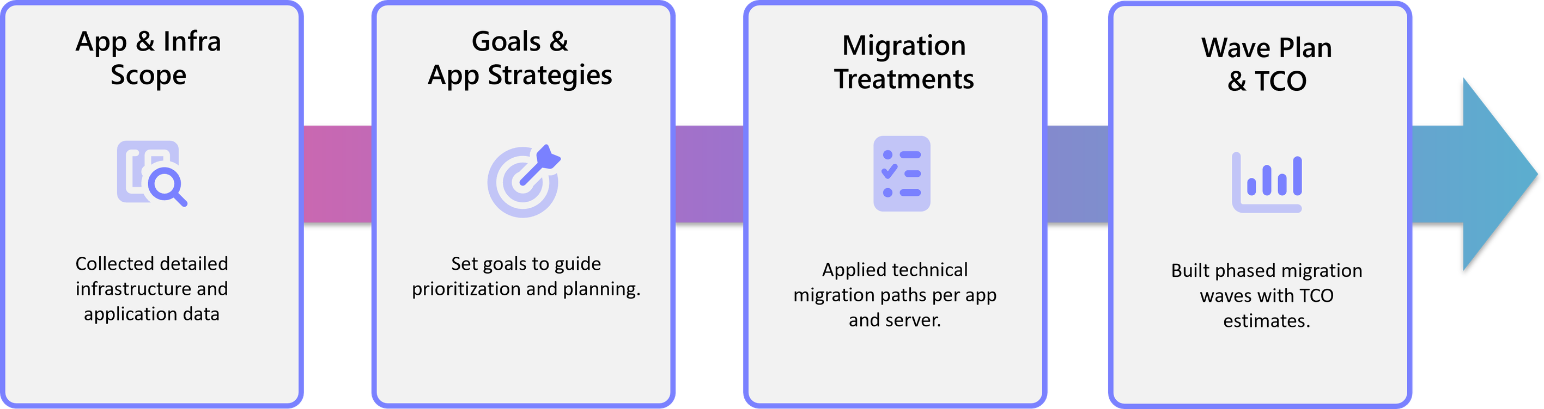
A0927E0C-B409-4F05-8088-BA2B88AA888E
How the Plan Was Developed
A structured, insight-driven process was applied to analyze the current environment, identify modernization and optimization opportunities, and deliver a migration plan that aligns with business priorities, technical objectives, and cost efficiency goals.

Slide 11
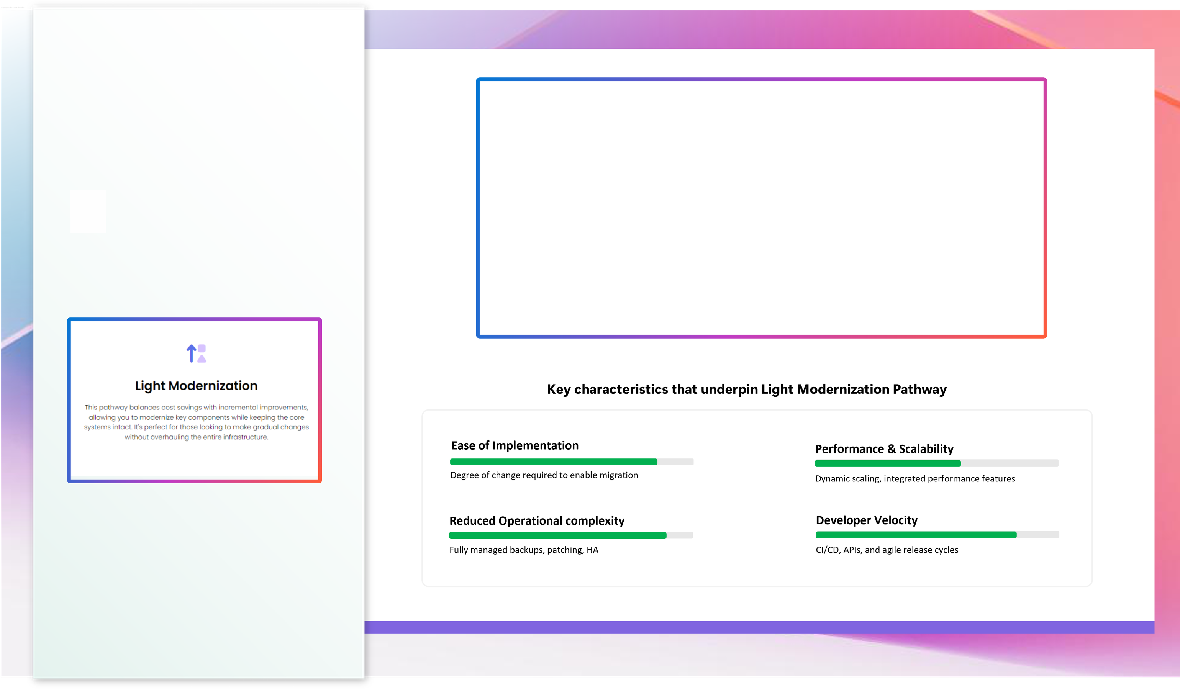
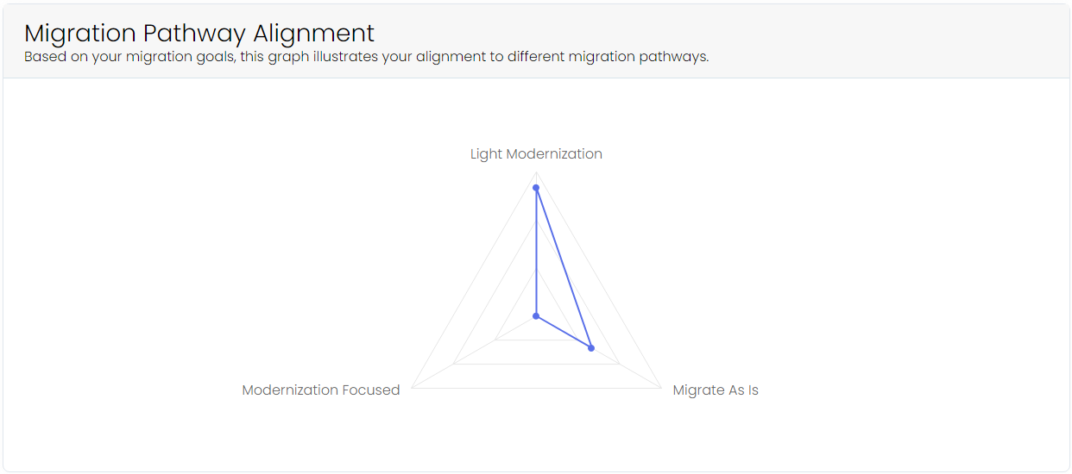
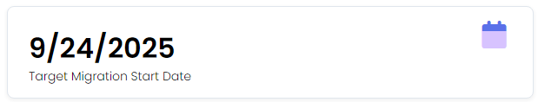
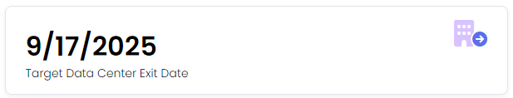
38EF4471-FFF9-4810-AF5D-AE6E45592708
Migration Goals & Pathway
Based on the goals captured, a migration pathway has been identified that aligns with your broader business priorities.
This helps ensure that all planning and decisions remain consistent with your strategic direction.

Slide 12
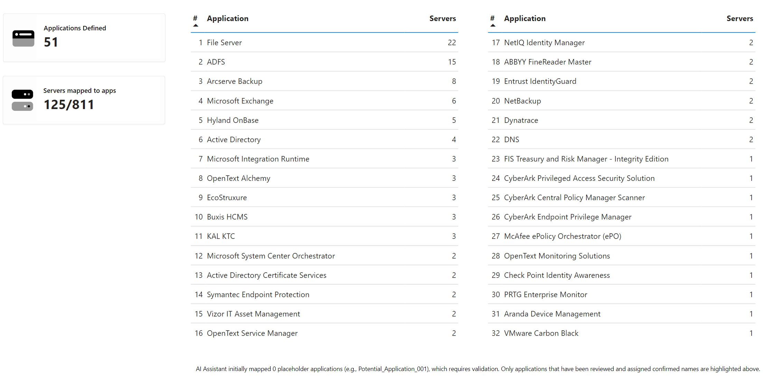
5D008A8E-2EF0-4E2D-81AB-FCEE43026A94
Defined Applications
Your server inventory has been transformed into an application-centric view, mapping each workload to its hosting servers and dependencies. This provides the foundation for applying clear 6R strategies and developing precise, workload-level migration plans.
Unmapped servers can be reviewed and added to the plan at any point.

Slide 13
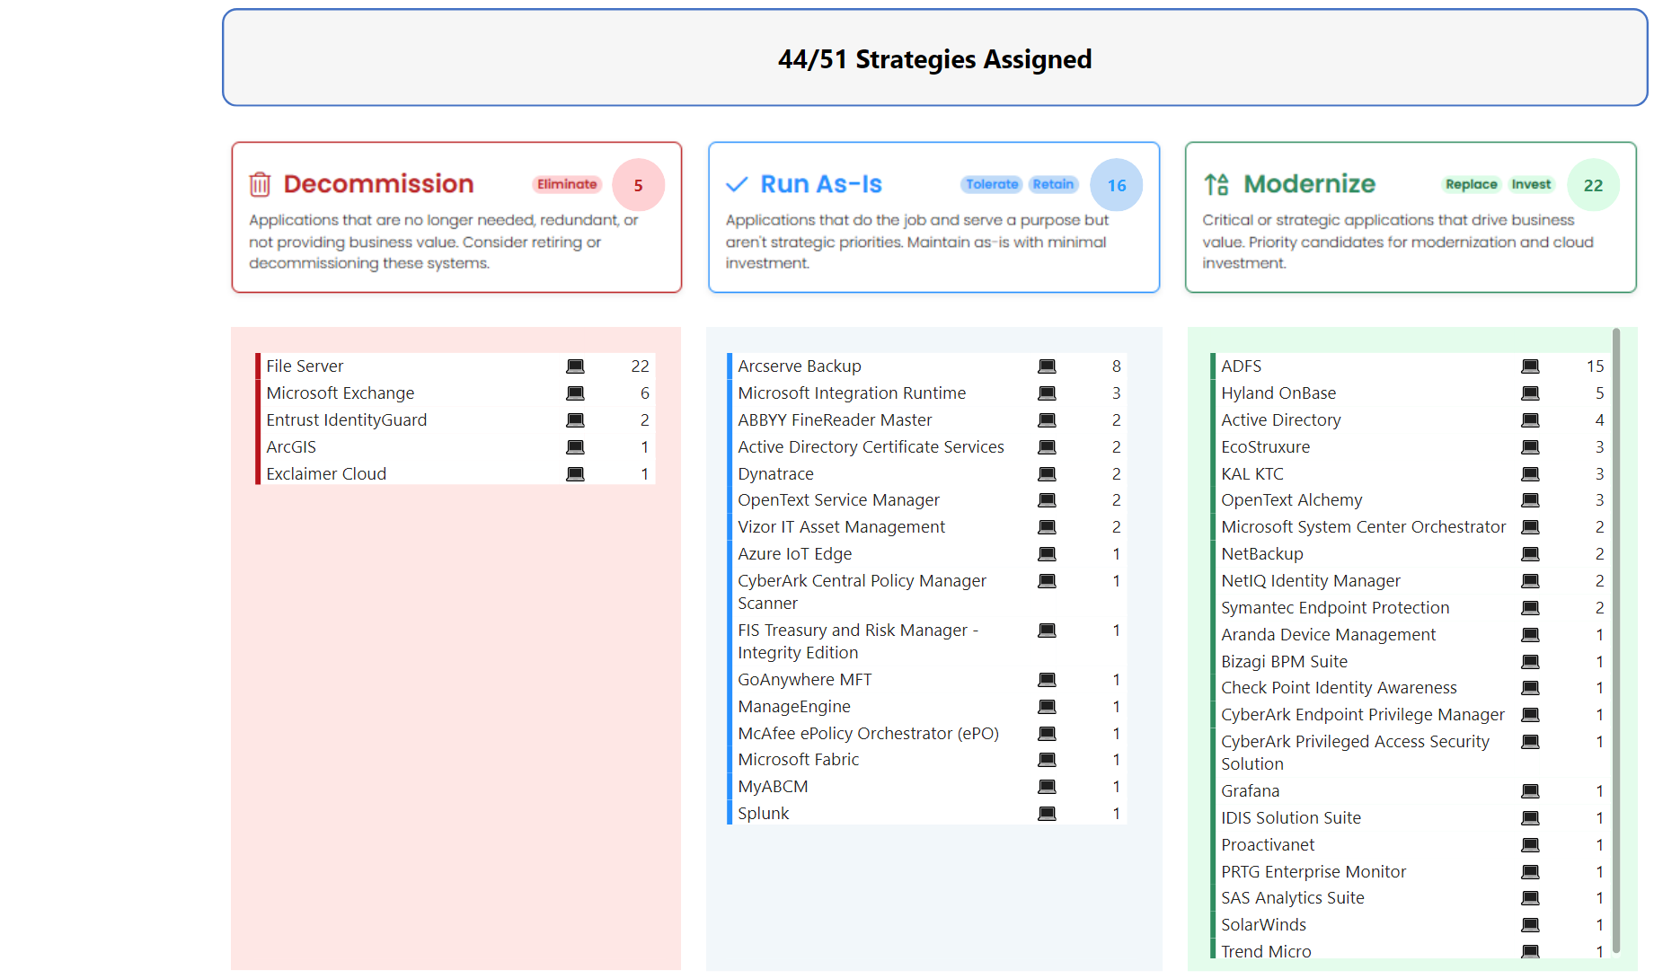
CDF9C190-FDA7-4F7A-B328-E395BB0E4F58
Application Strategy Rating
By aligning each application to a defined long-term strategy, we gain a clear view of its future role. This insight drives smarter prioritization, ensuring modernization efforts and migration investments are focused where they deliver the greatest value.

Slide 14
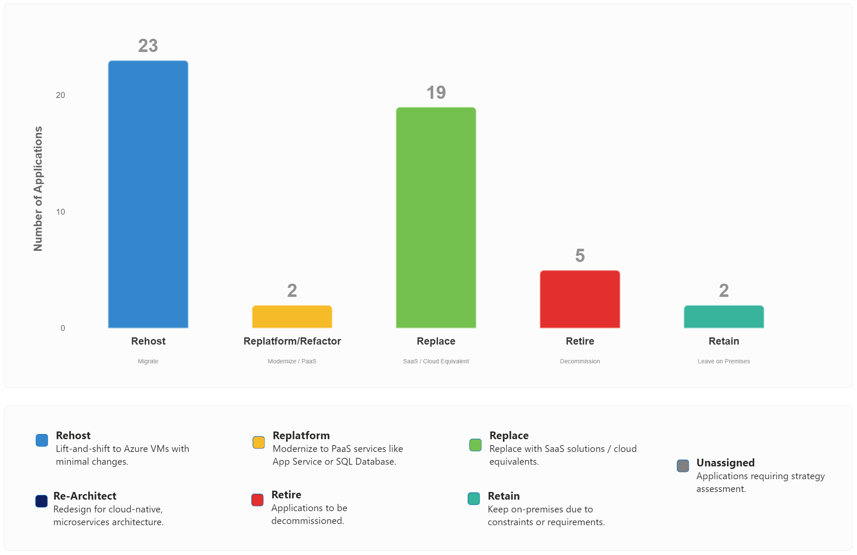
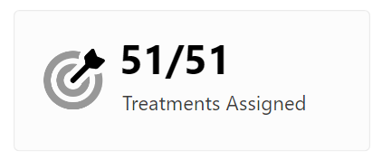
CAADFA44-89CB-49DE-B159-204F55A7471C
'6R' Migration Treatments
By evaluating each application's technical components and designated Application Strategy, the most suitable 6R migration treatment has been assigned.
This assignment directs the primary migration approach, determining how each application will be handled.
Servers not mapped to an application that are marked in scope have been assigned to Rehost

Slide 15

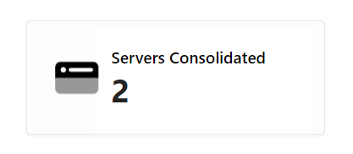
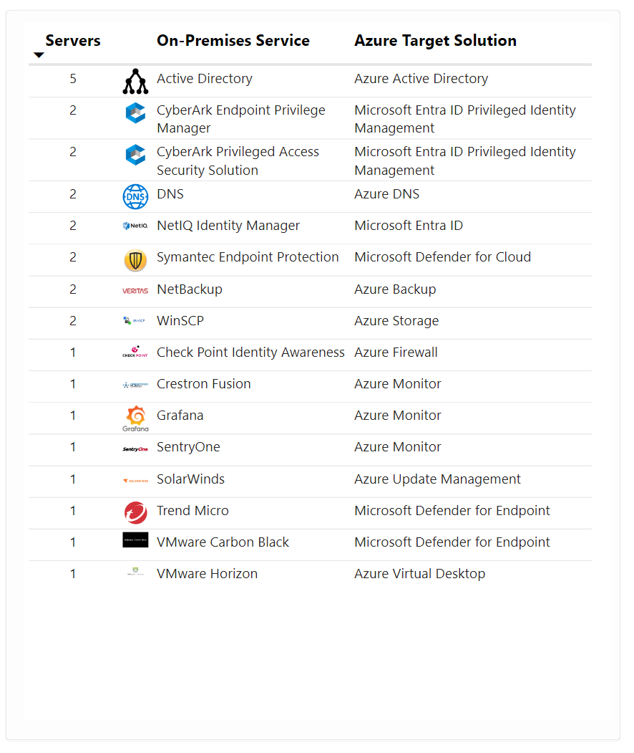
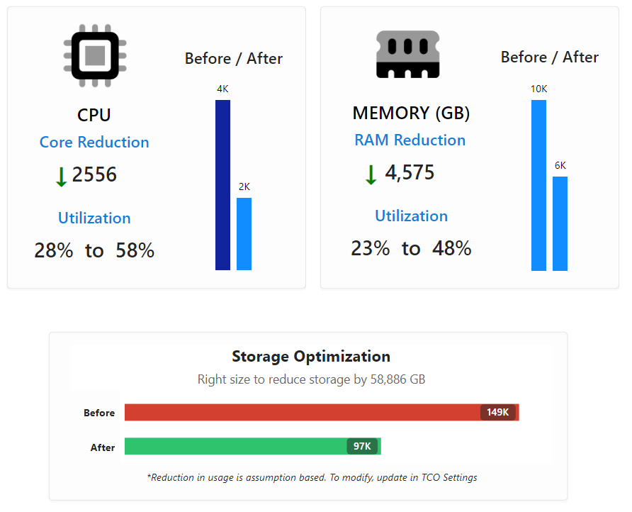
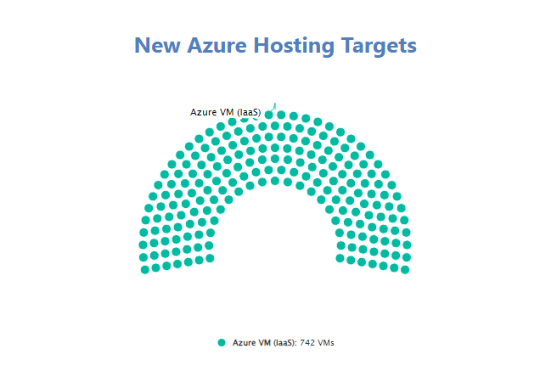
F6185FFA-F276-47BF-AD6A-791E0C919018
Planned Optimization & Enhancements
This summary highlights the key optimization, modernization, and service enhancements identified through the treatment planning process, providing a clear view of the outcomes that will guide execution.
Optimization
Reduce waste and improve efficiency through right-sizing of compute, memory, and storage for rehosted servers.
Modernize
Consolidate workloads and shift to Azure-native services to unlock scalability, automation, and cost benefits.
Enhance
Strengthen security posture and modern IT operations by replacing legacy tools with integrated Azure solutions.

Slide 16

DC8DE029-22B6-4CE0-8E2D-B8C489C73CBC
Delivery Sequencing
Migration groupings and complexity tiers to align execution with business priorities.

Slide 17
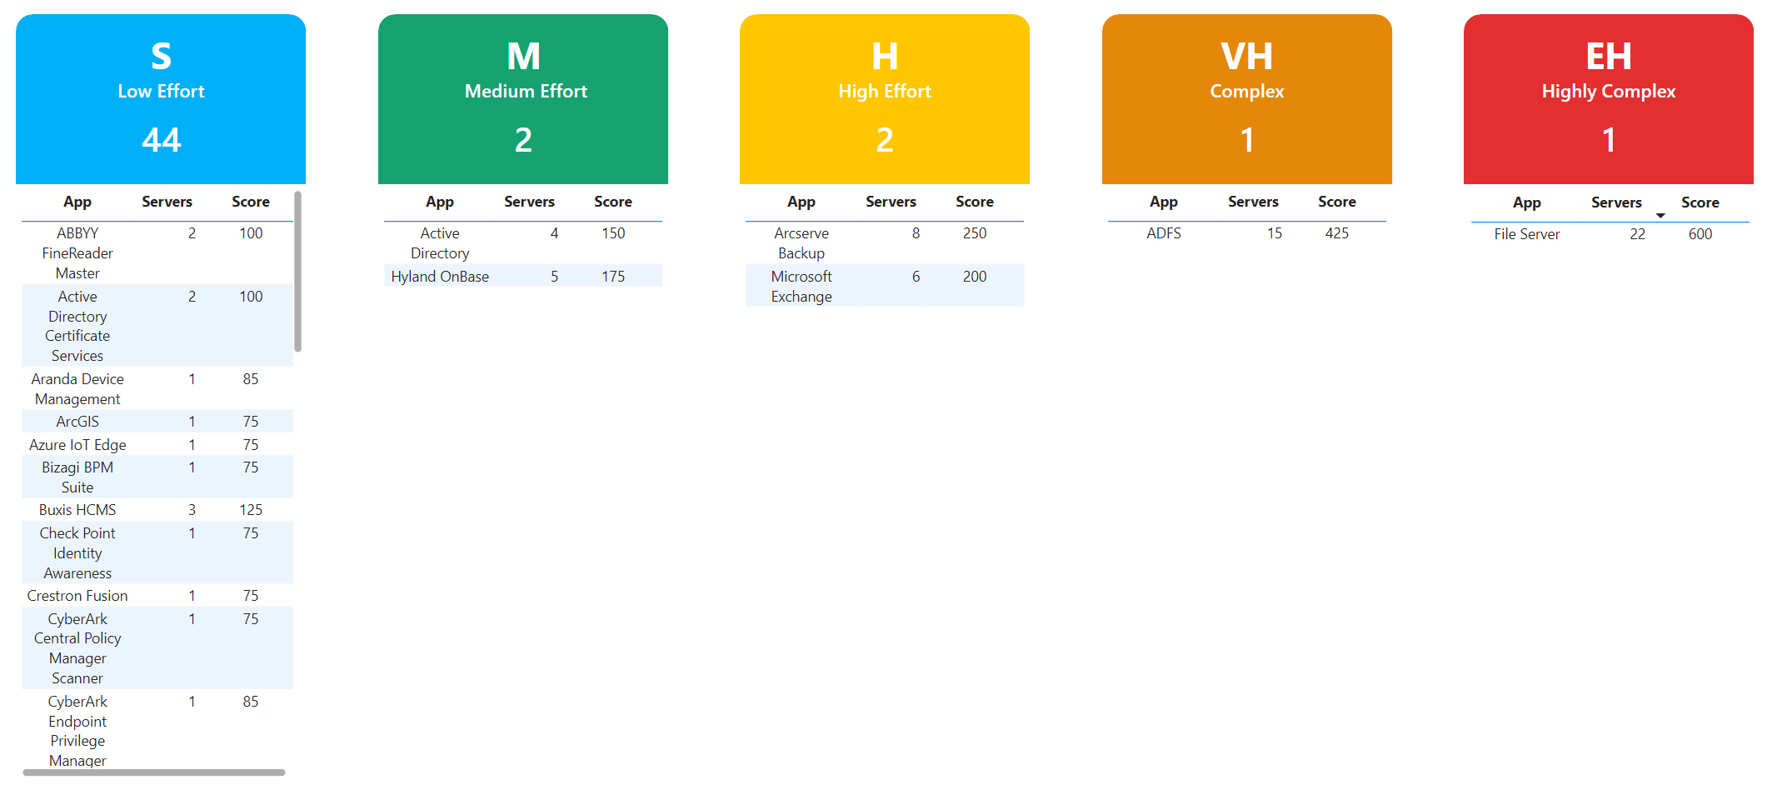
065A90FD-3D11-4E25-BA45-05DCCC03DB47
Workload Migration Complexity Rating
Applications are assessed and grouped by migration complexity to estimate the overall effort and resources required. This helps prioritize planning and align technical work with migration timelines.

Slide 18
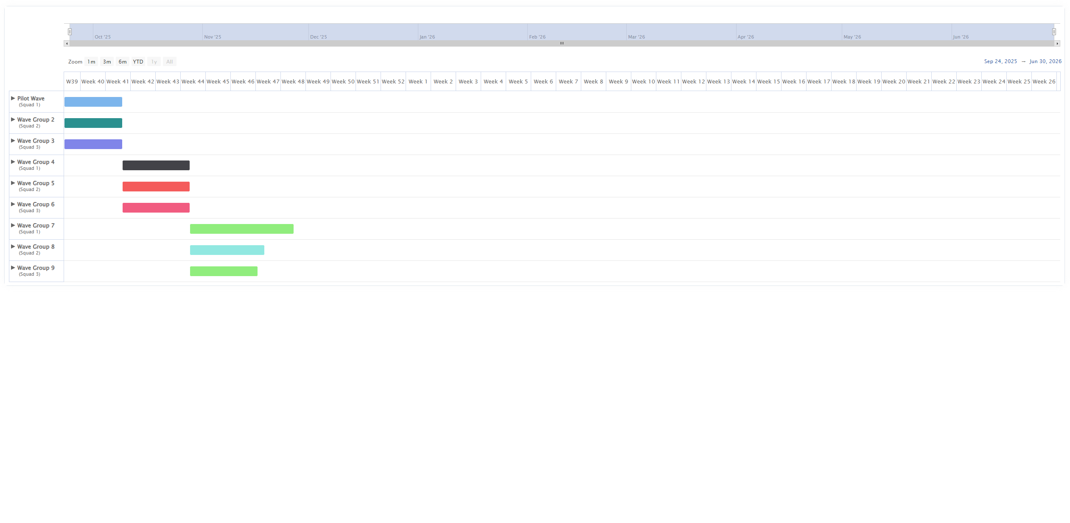
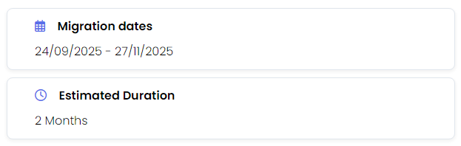
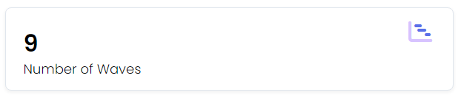
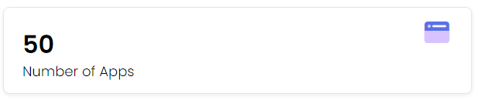
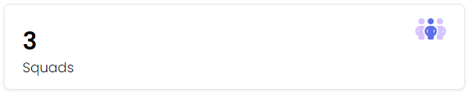
558BA3DC-E1AE-4338-9E8D-E75AB1FAC88F
Wave Plan
Based on application dependencies a base wave plan has been calculated. The 'Application Complexity' rating for each application has also been used to extrapolate estimated wave duration.

Slide 19

B5A85A19-2ABD-4AD0-A6D6-FCE09E9D44CF
Next Steps
Move from planning to execution.

Slide 20


183E8B8D-CCE6-45AA-93C0-8CB78C256256
Migration Pathway
Discover
Run DMC
Collect server data
Map inventory
Assess
Customer Walkthrough
Review opportunities
Capture goals
Tech preferences
Proposal
Tailor proposal
Explore Microsoft programs on offer
4
5
Mobilize
Sync Azure Migrate
Prep landing zone
Application designs
Plan
Modernization targets
6R treatments
Size applications
Wave planning
TCO
6
Migrate
Rehost
Re-architect
Replatform
Replace

Slide 21
F904B0EB-6E0E-44A0-B28B-B6F325EFBCF8
Next Steps
Align on Quick Wins and Execution
- Confirm low-complexity workloads as quick win targets from the wave plan.
- Assign owners, validate readiness, and agree on execution timelines.
Prepare Platform and Data
- Prepare landing zone
- Use Dr Migrate to refine wave actions and surface server-level readiness.
- Ensure Azure Migrate is connected to maintain up-to-date telemetry with Dr Migrate.
Explore Microsoft and Partner Support
- Review Microsoft programs and partner options to accelerate execution.

Slide 22
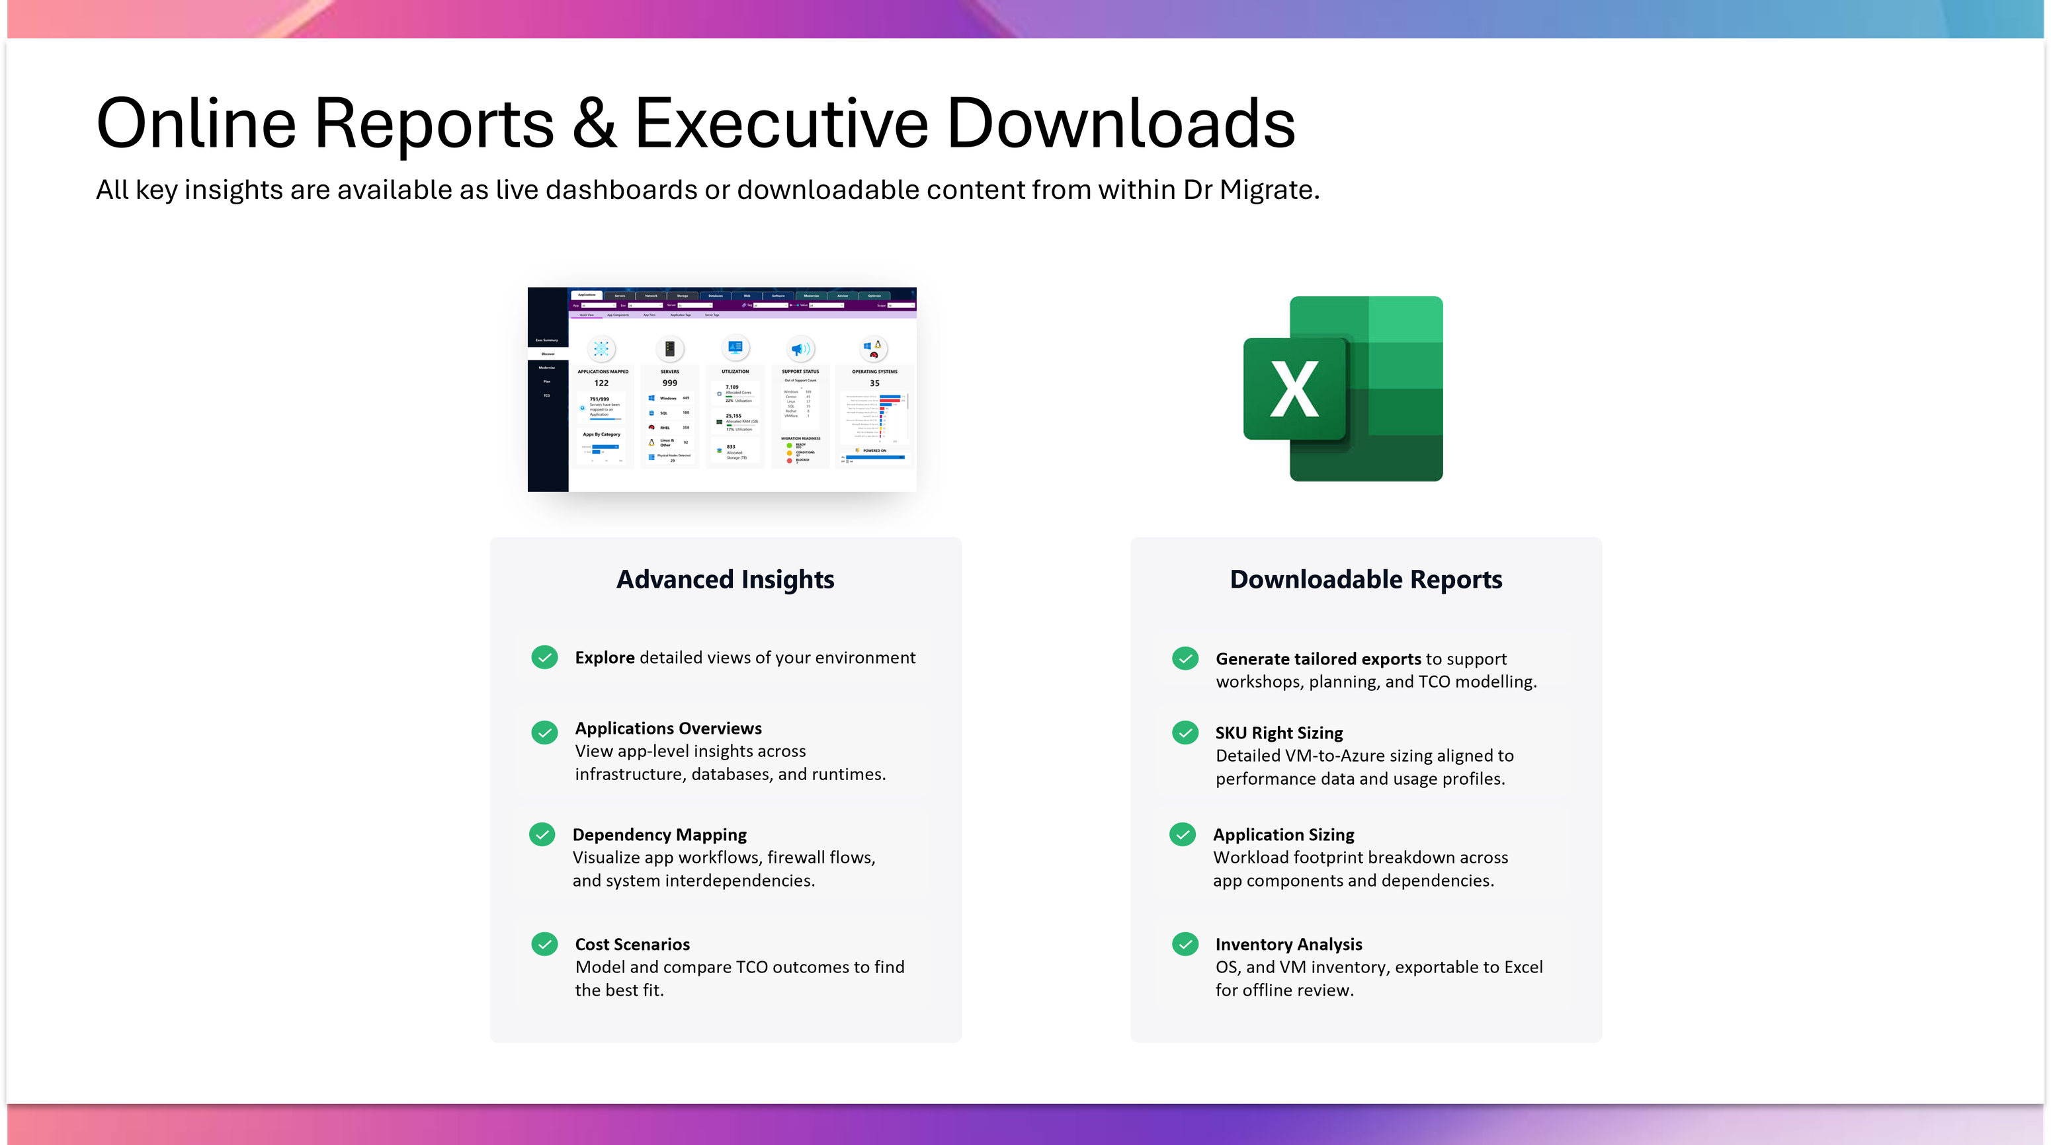
20805C7C-6D40-48DA-ABA3-72F332B1DA58

Slide 23
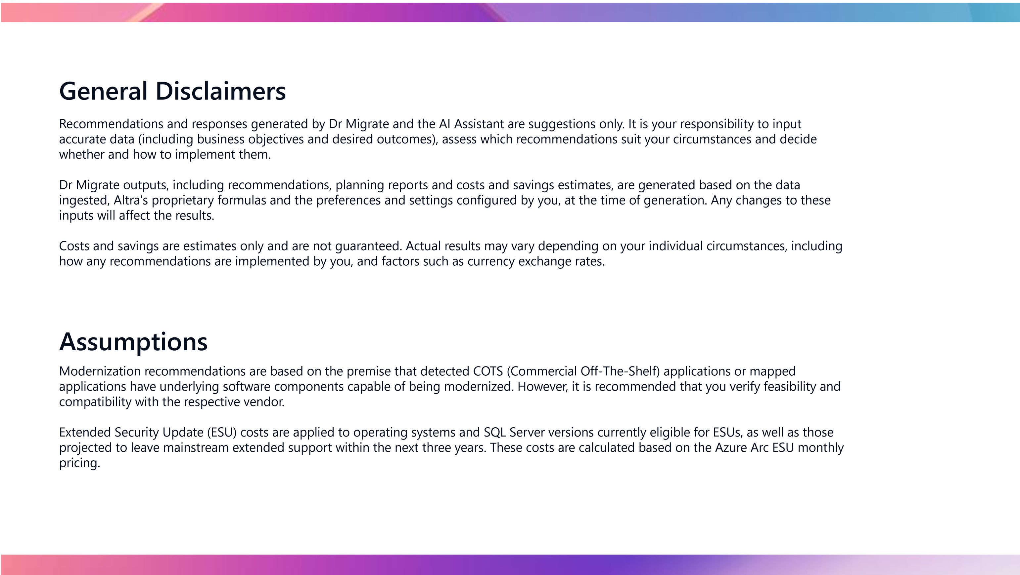
1C0FCE8F-14A3-47A2-B97E-6FA9B7ED237B

Slide 24

AE9391F6-AA96-4A0F-B9C0-D4658F7862C9

